Slide 1
No trade by country
Generated on 08-21-2022

Slide 2
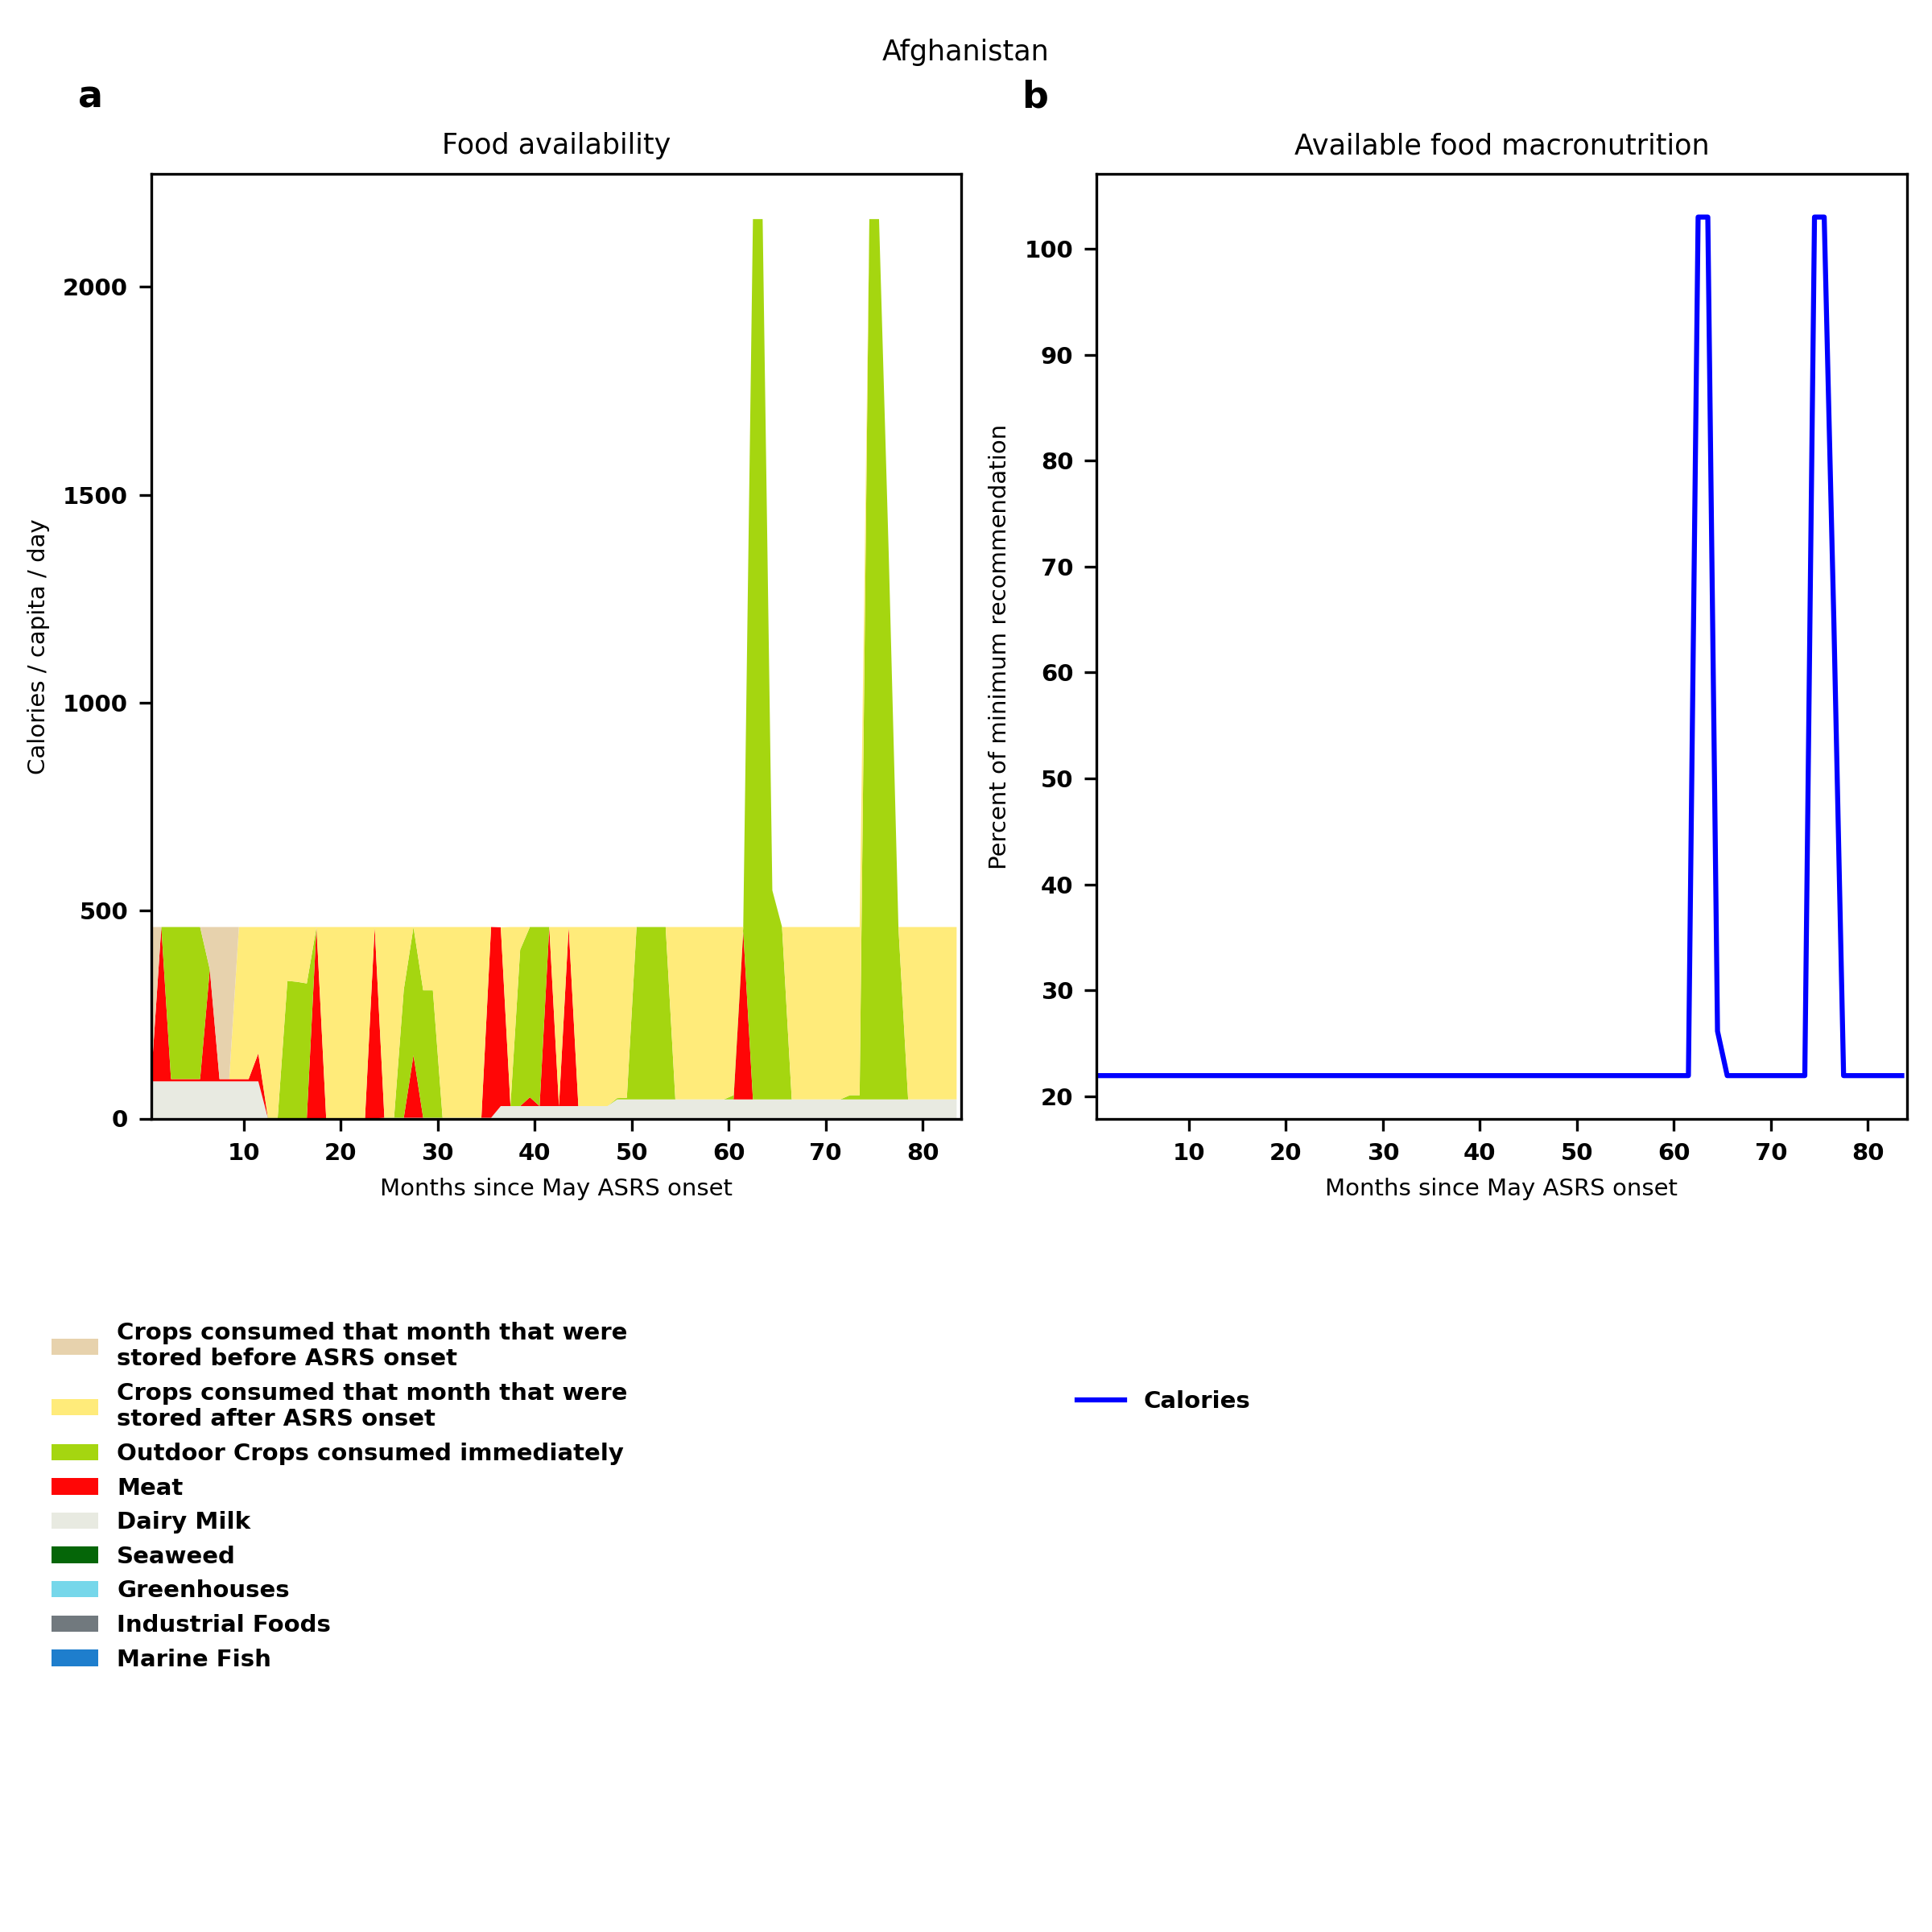
Afghanistan: Percent fed:21.9%
Scenario properties: no food trade 2month feed, 1month biofuel baseline waste minimum sufficient nutrition few stocks used normal crop seasons reduced fish nuclear winter crops don't include protein don't include fat cull animals use resilient foods dairy cow feed prioritized

Slide 3
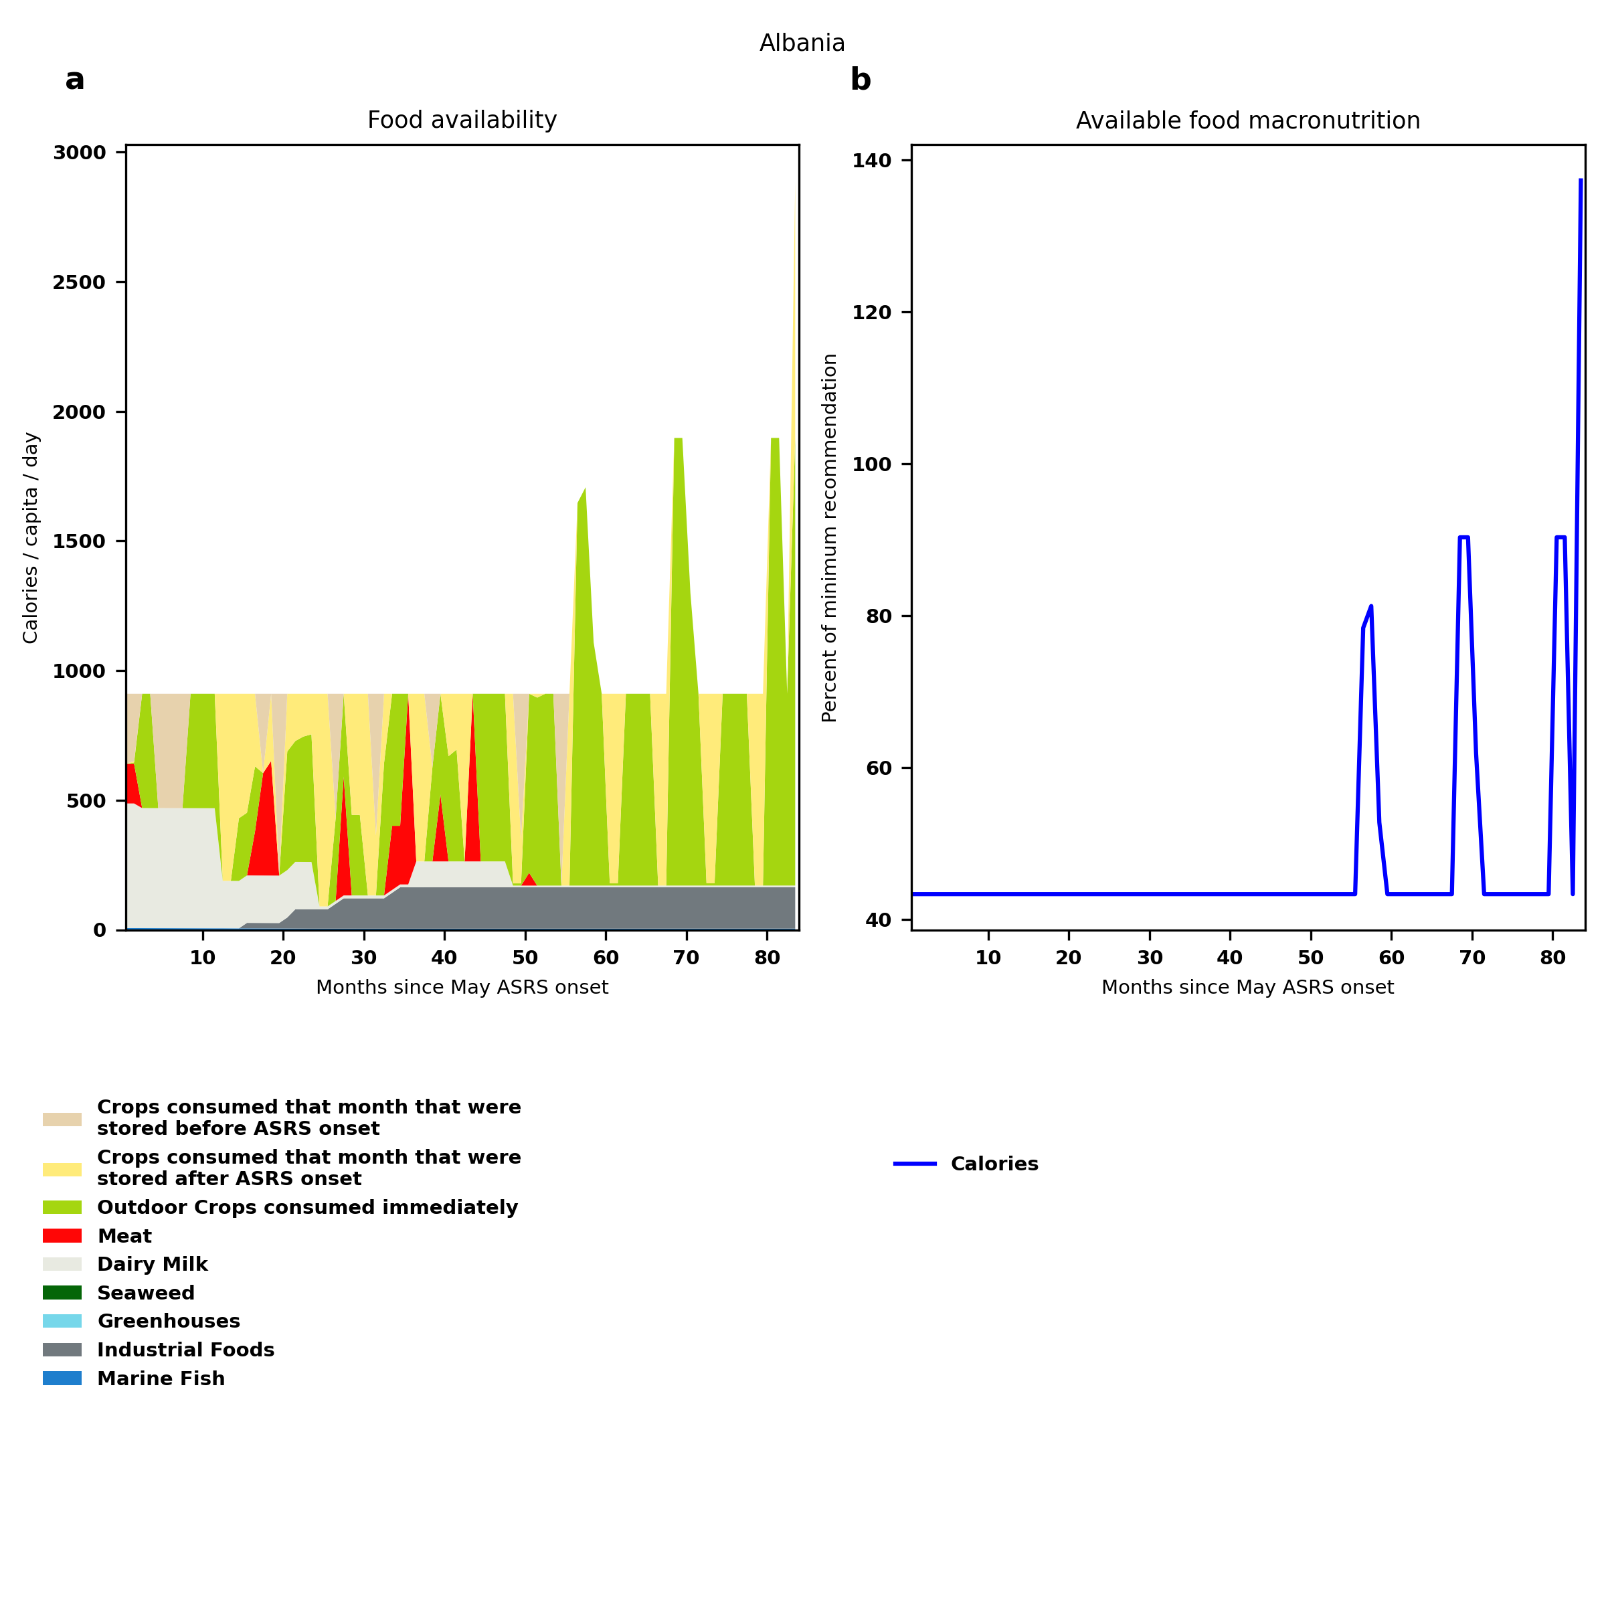
Albania: Percent fed:43.4%
Scenario properties: no food trade 2month feed, 1month biofuel baseline waste minimum sufficient nutrition few stocks used normal crop seasons reduced fish nuclear winter crops don't include protein don't include fat cull animals use resilient foods dairy cow feed prioritized

Slide 4
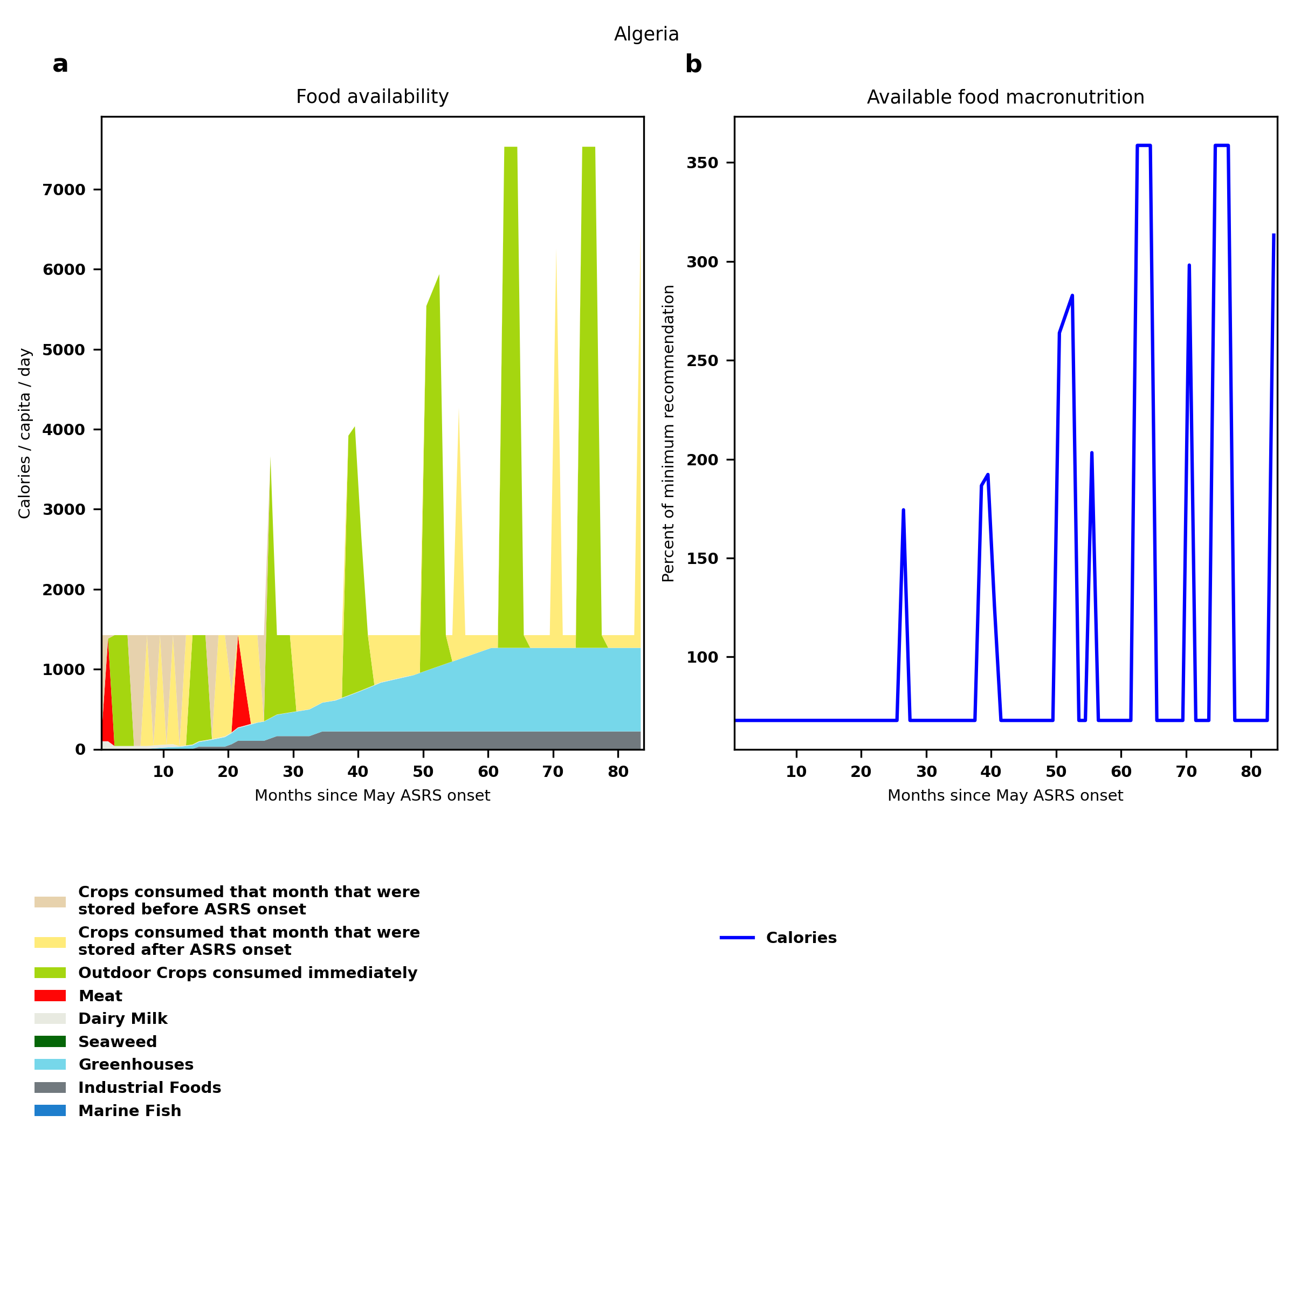
Algeria: Percent fed:67.9%
Scenario properties: no food trade 2month feed, 1month biofuel baseline waste minimum sufficient nutrition few stocks used normal crop seasons reduced fish nuclear winter crops don't include protein don't include fat cull animals use resilient foods dairy cow feed prioritized

Slide 5
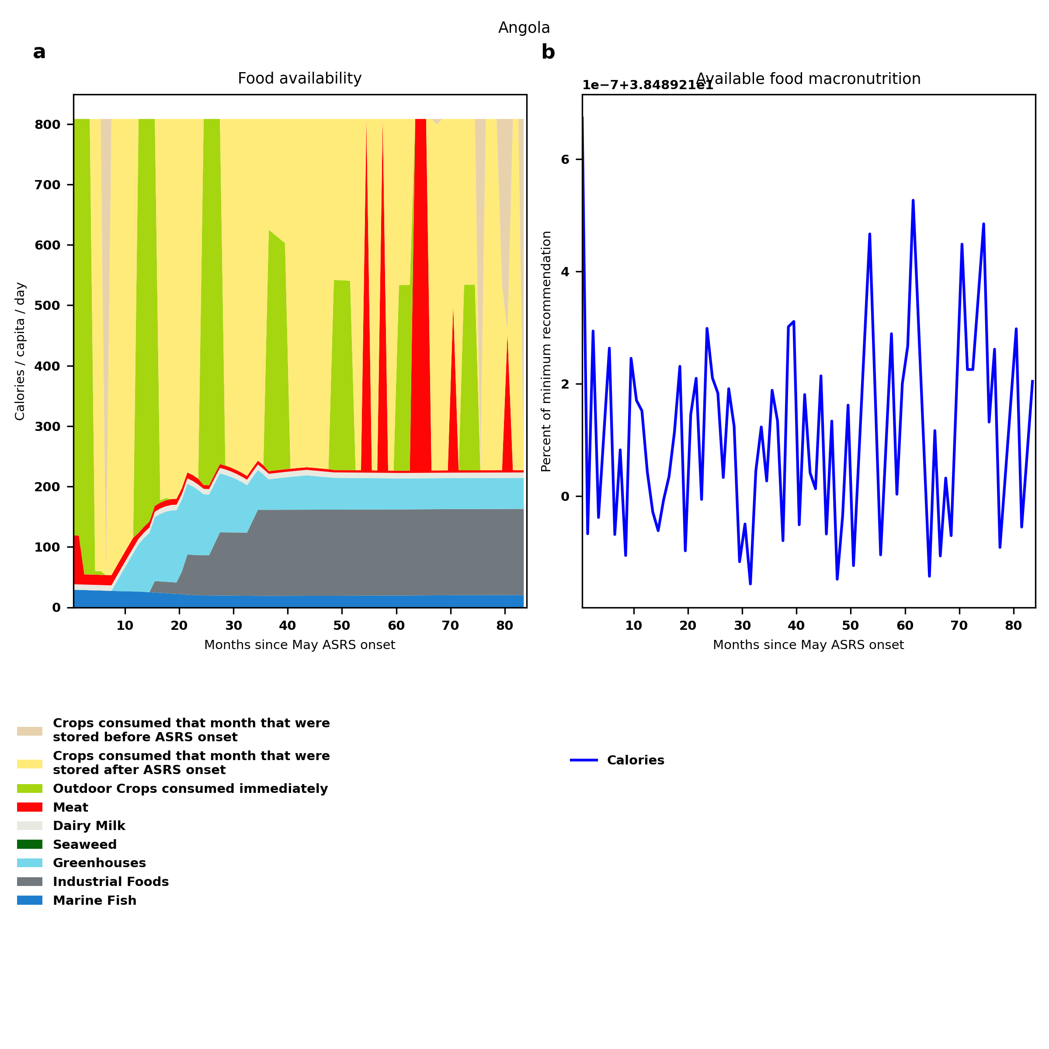
Angola: Percent fed:38.5%
Scenario properties: no food trade 2month feed, 1month biofuel baseline waste minimum sufficient nutrition few stocks used normal crop seasons reduced fish nuclear winter crops don't include protein don't include fat cull animals use resilient foods dairy cow feed prioritized

Slide 6
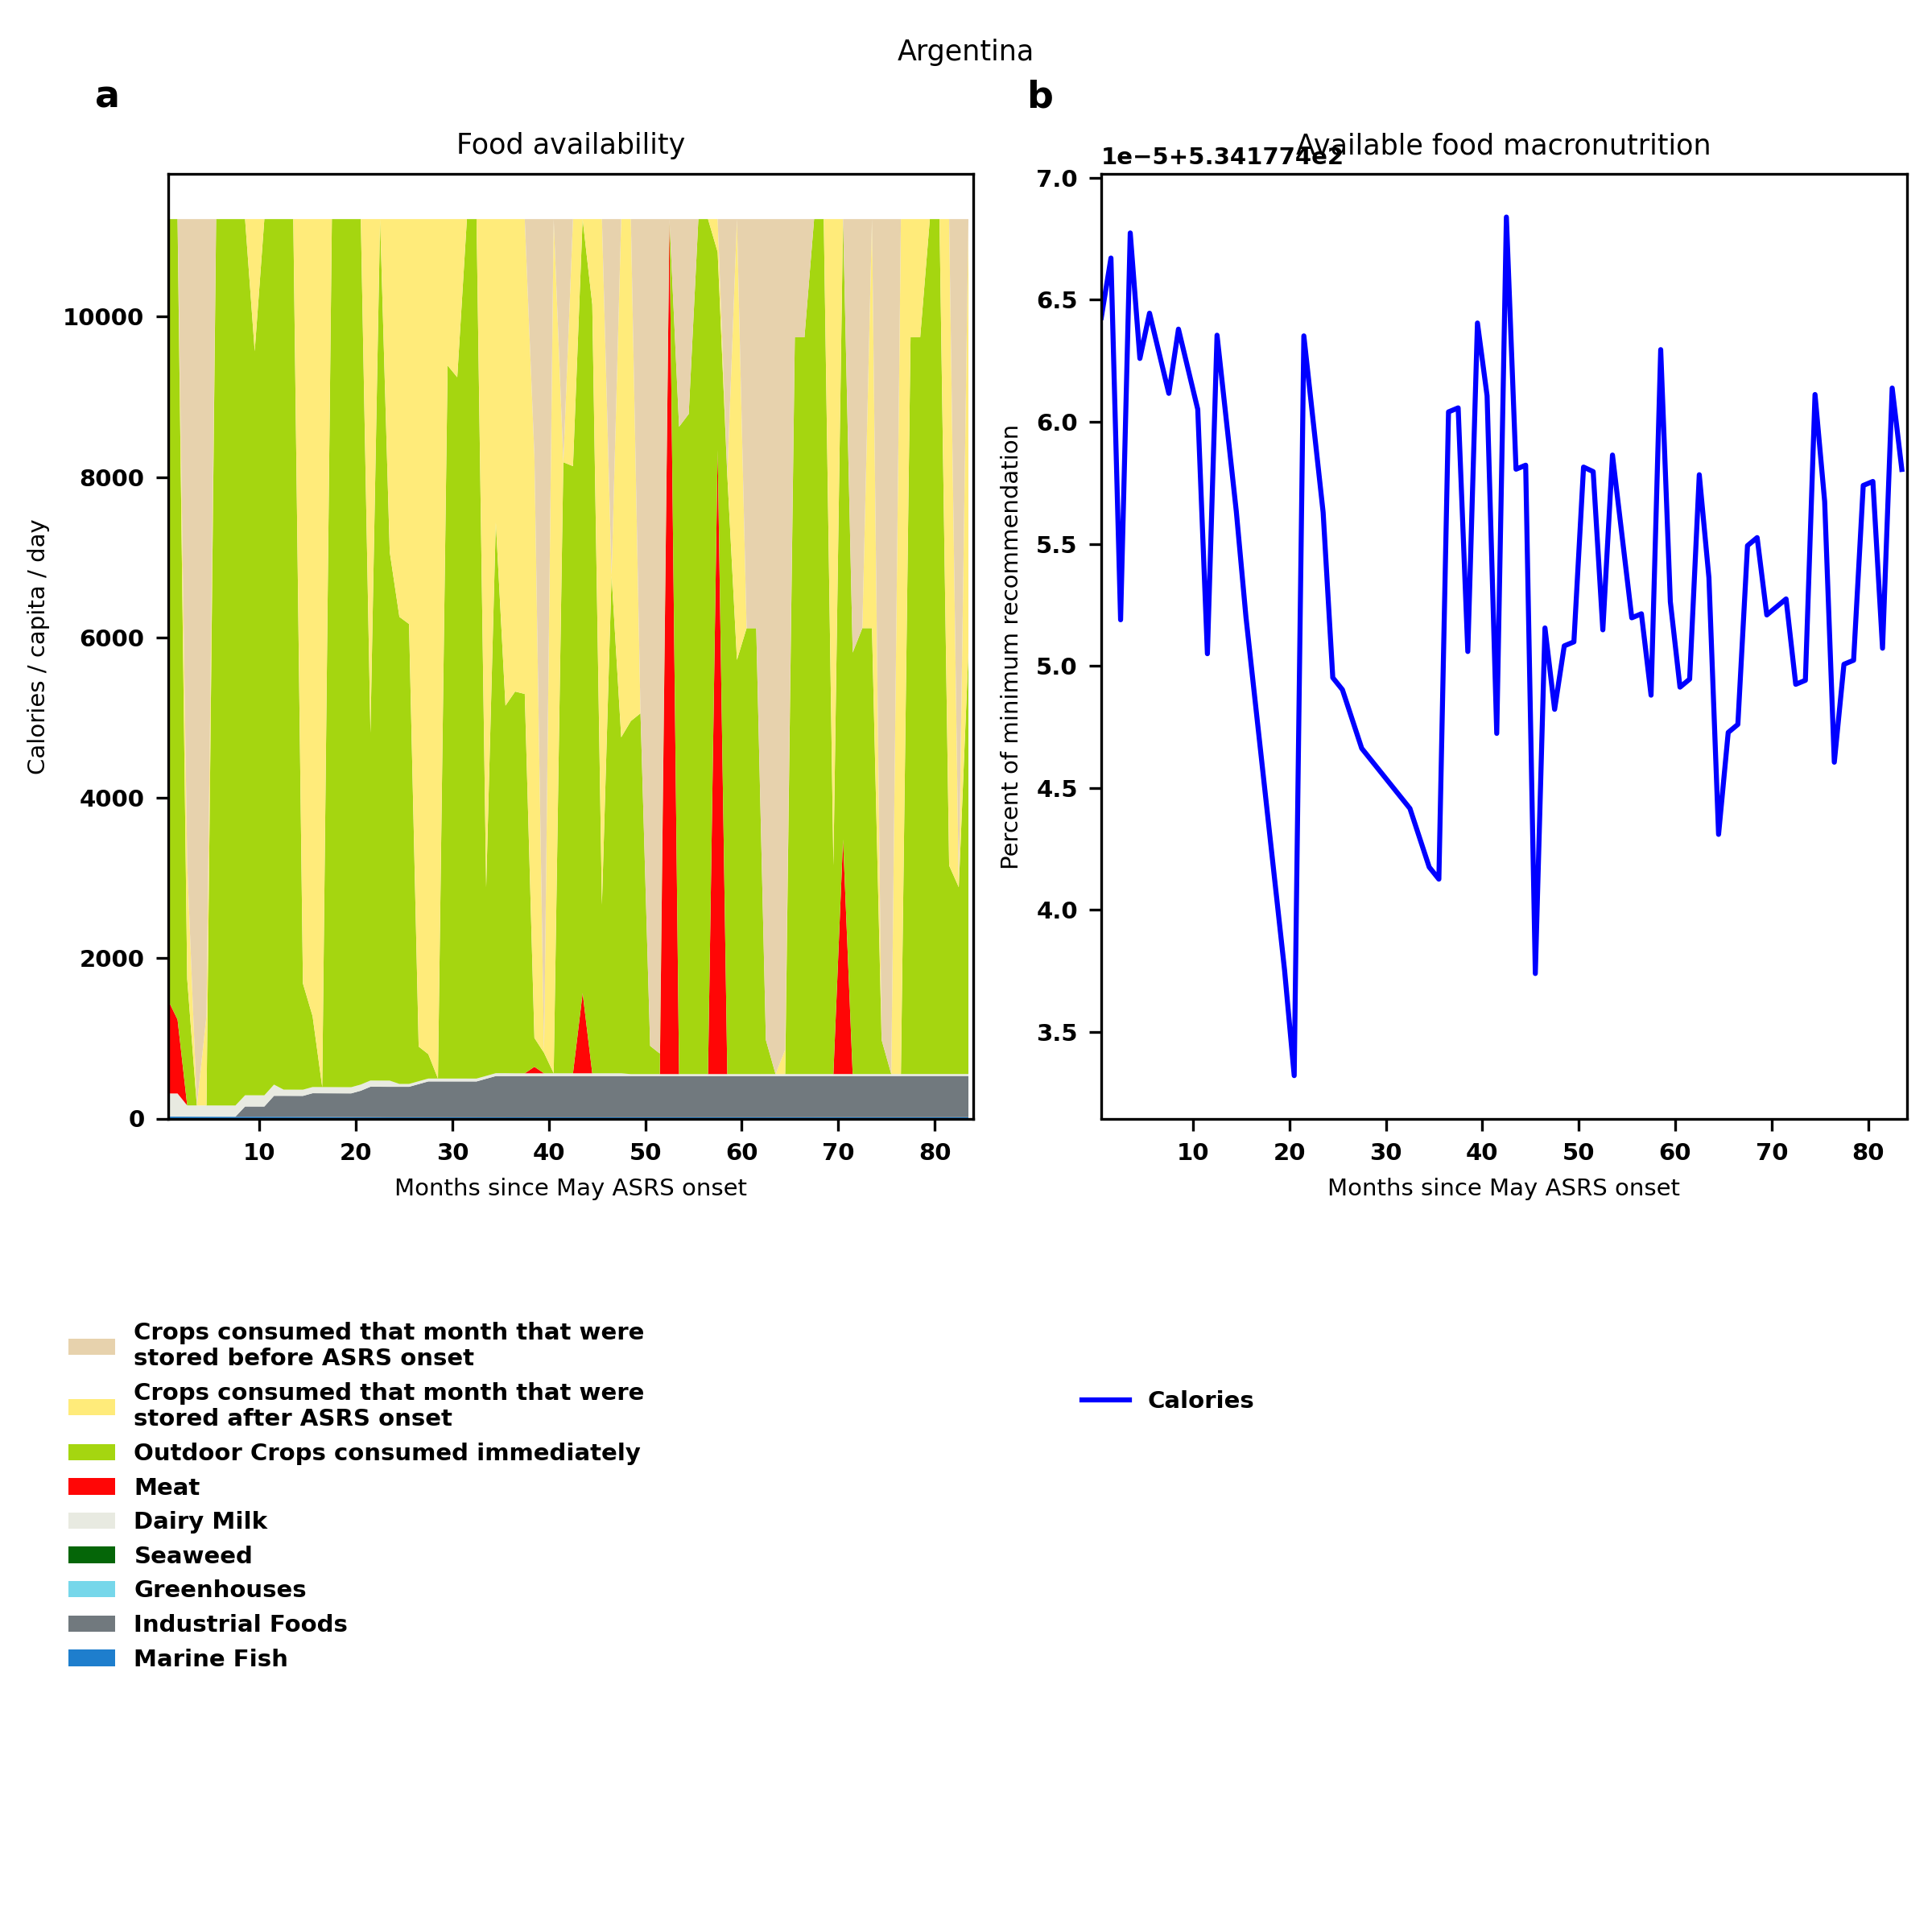
Argentina: Percent fed:534.2%
Scenario properties: no food trade 2month feed, 1month biofuel baseline waste minimum sufficient nutrition few stocks used normal crop seasons reduced fish nuclear winter crops don't include protein don't include fat cull animals use resilient foods dairy cow feed prioritized

Slide 7
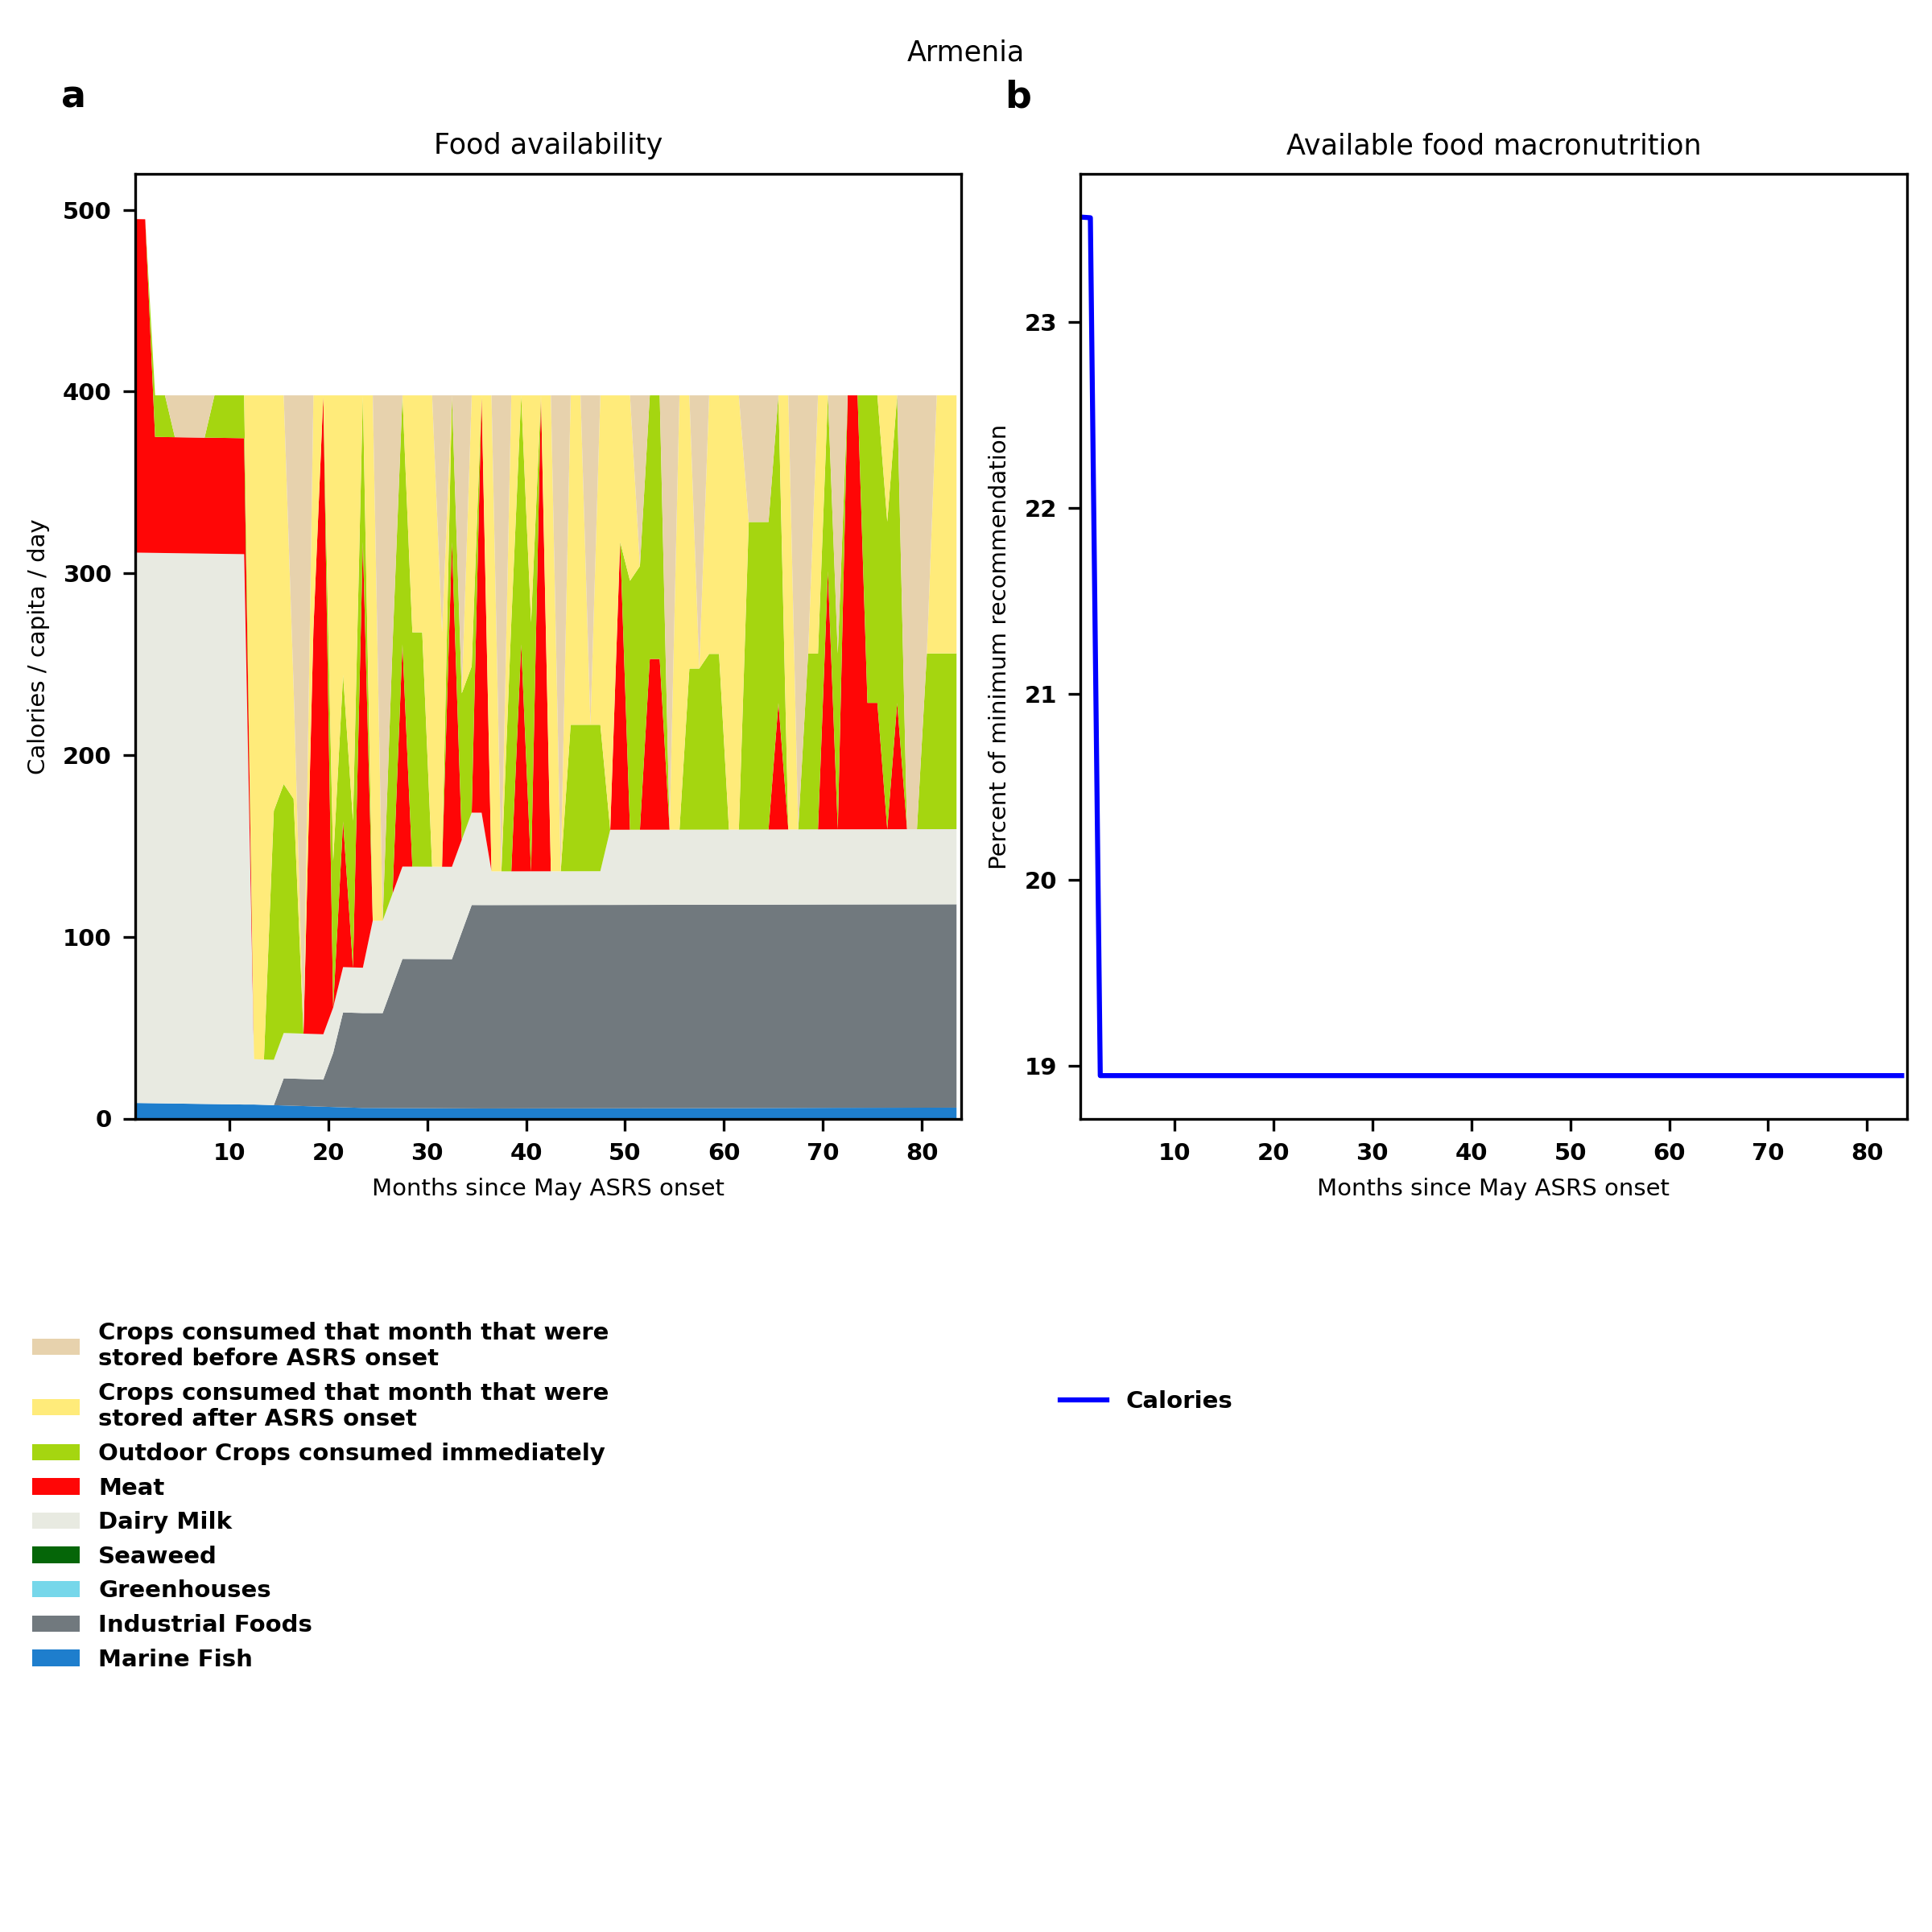
Armenia: Percent fed:18.9%
Scenario properties: no food trade 2month feed, 1month biofuel baseline waste minimum sufficient nutrition few stocks used normal crop seasons reduced fish nuclear winter crops don't include protein don't include fat cull animals use resilient foods dairy cow feed prioritized

Slide 8
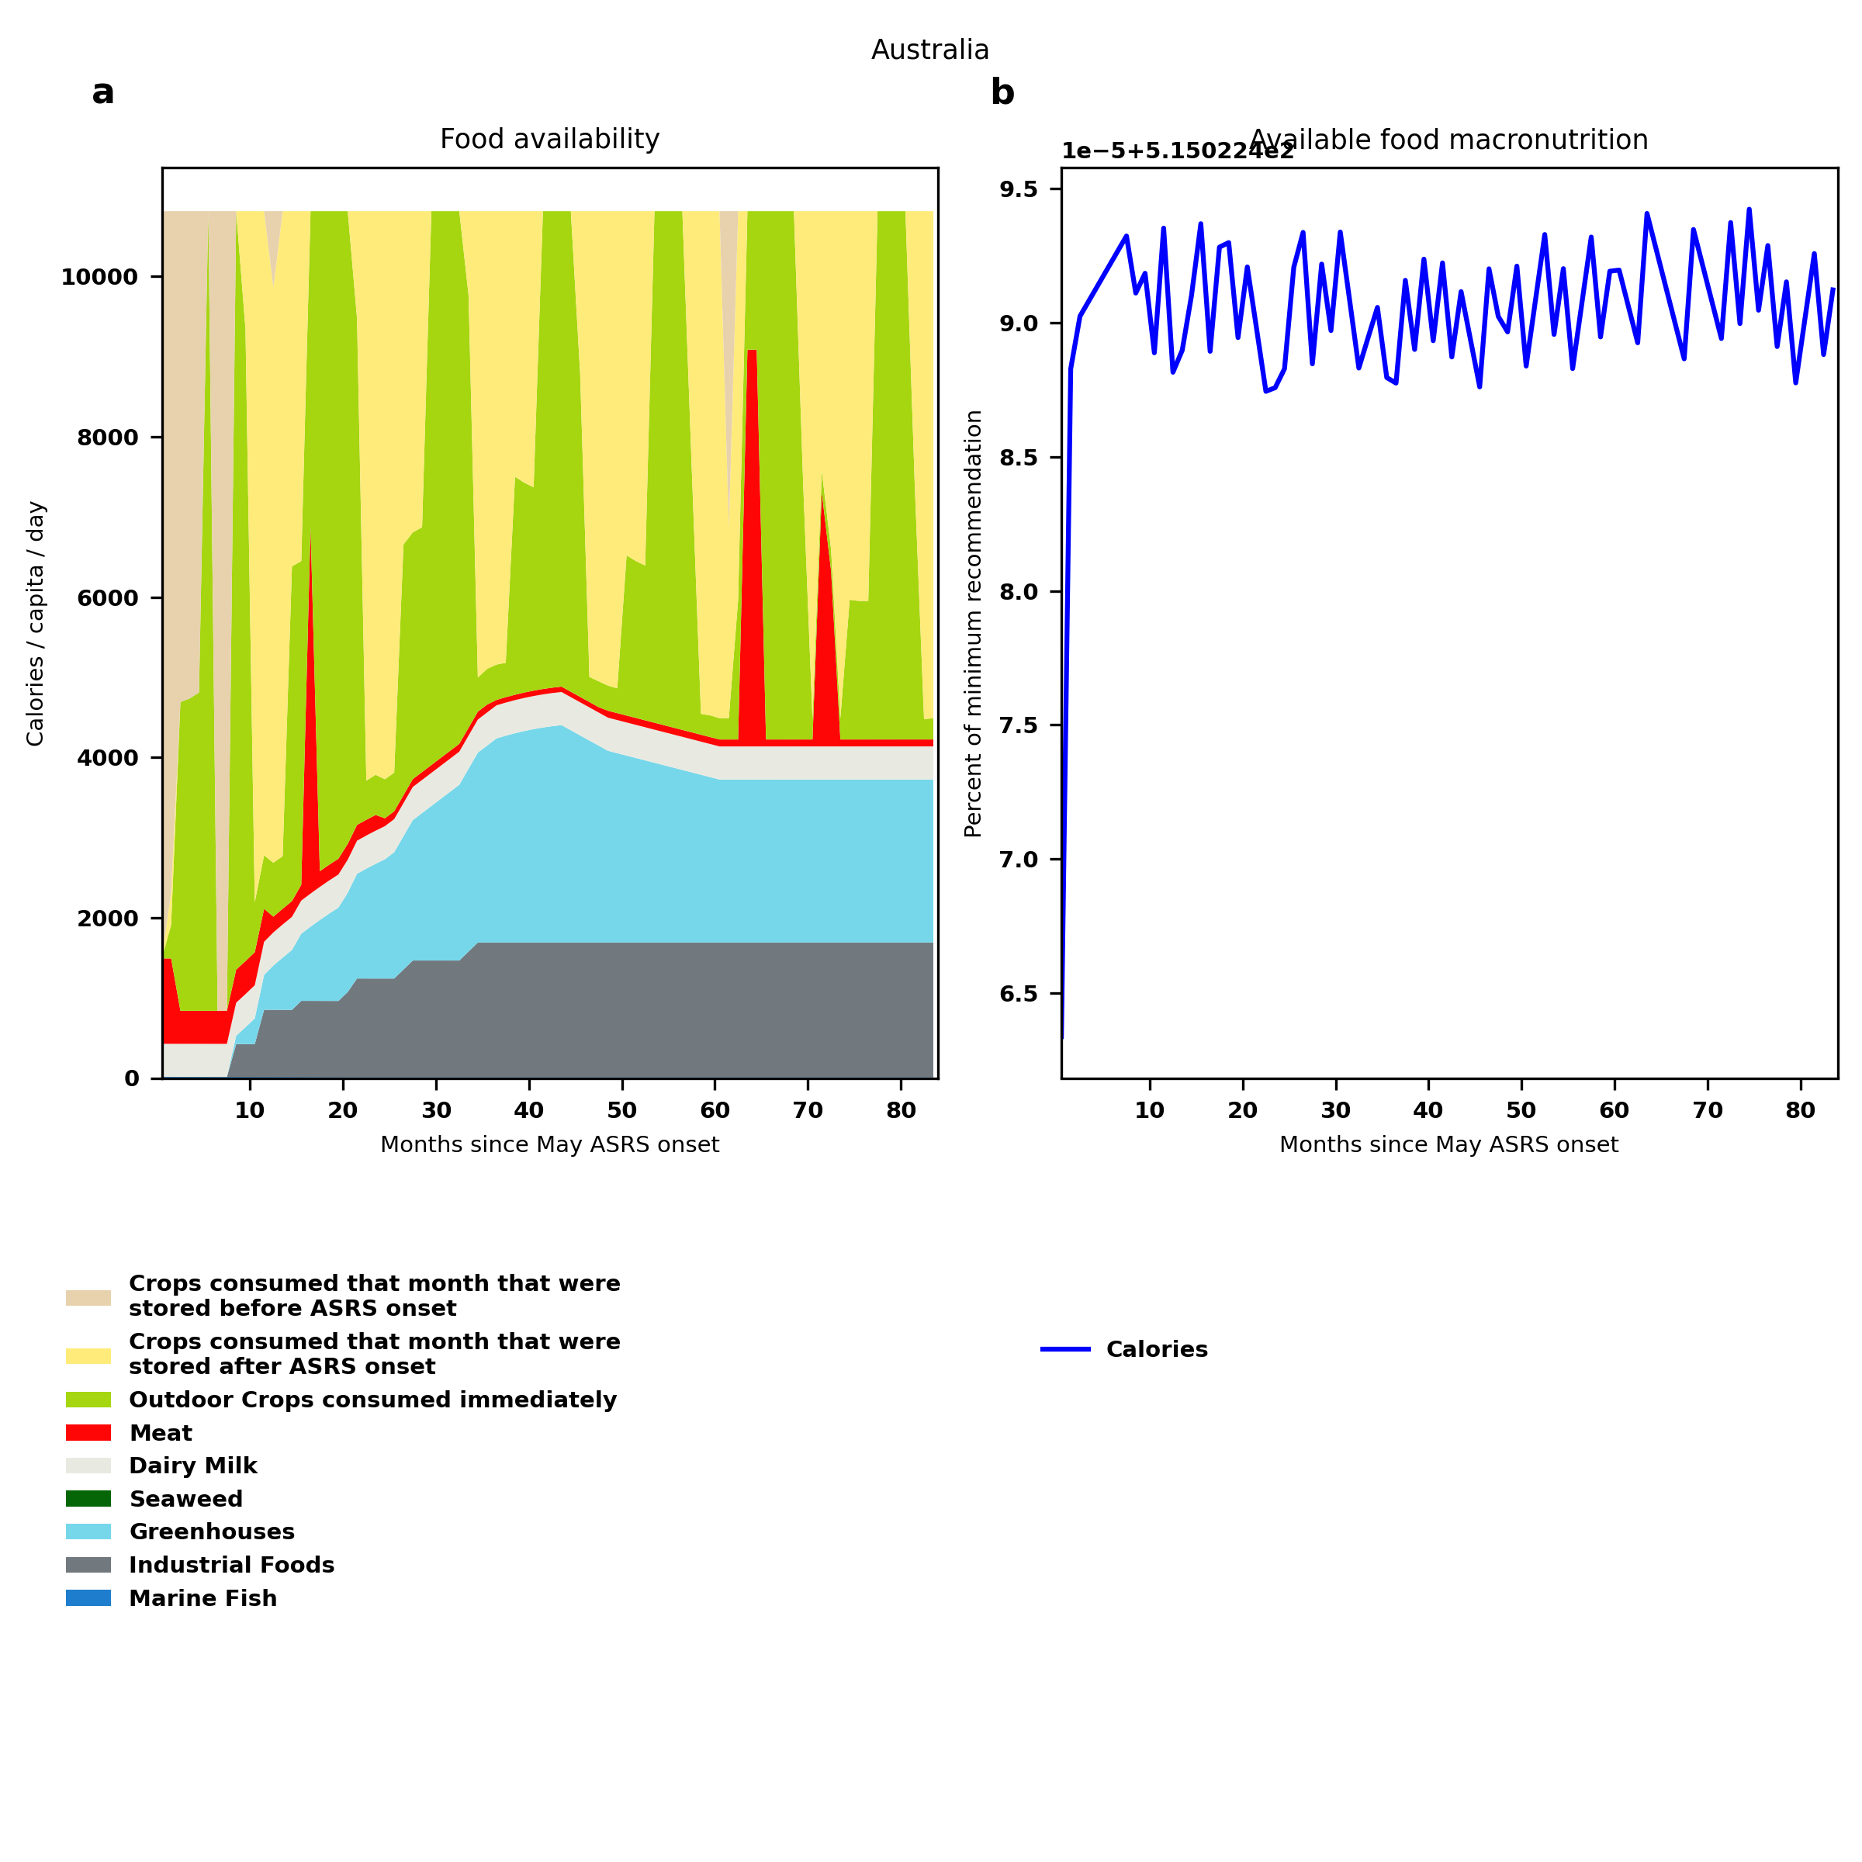
Australia: Percent fed:515.0%
Scenario properties: no food trade 2month feed, 1month biofuel baseline waste minimum sufficient nutrition few stocks used normal crop seasons reduced fish nuclear winter crops don't include protein don't include fat cull animals use resilient foods dairy cow feed prioritized

Slide 9
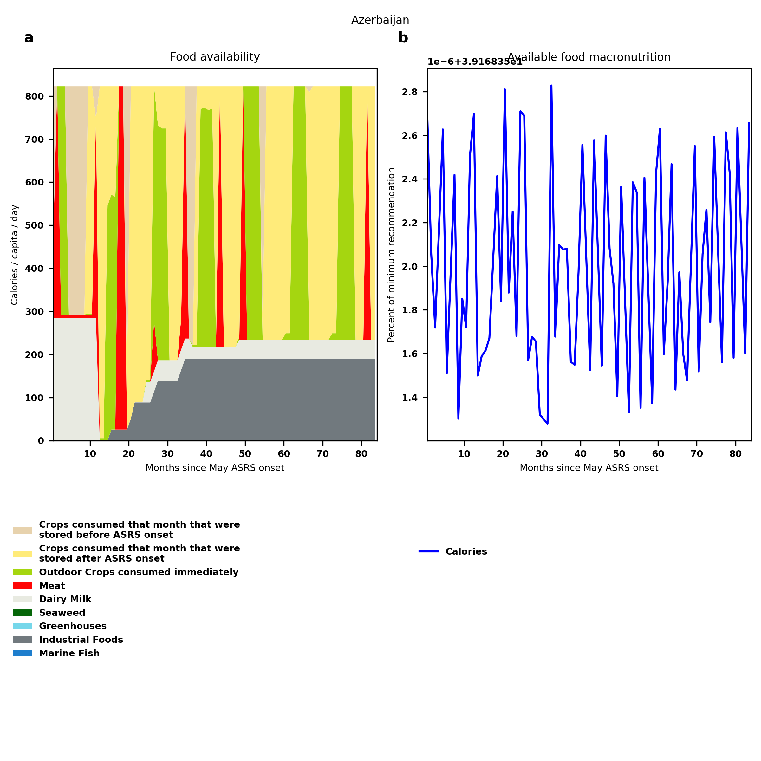
Azerbaijan: Percent fed:39.2%
Scenario properties: no food trade 2month feed, 1month biofuel baseline waste minimum sufficient nutrition few stocks used normal crop seasons reduced fish nuclear winter crops don't include protein don't include fat cull animals use resilient foods dairy cow feed prioritized

Slide 10
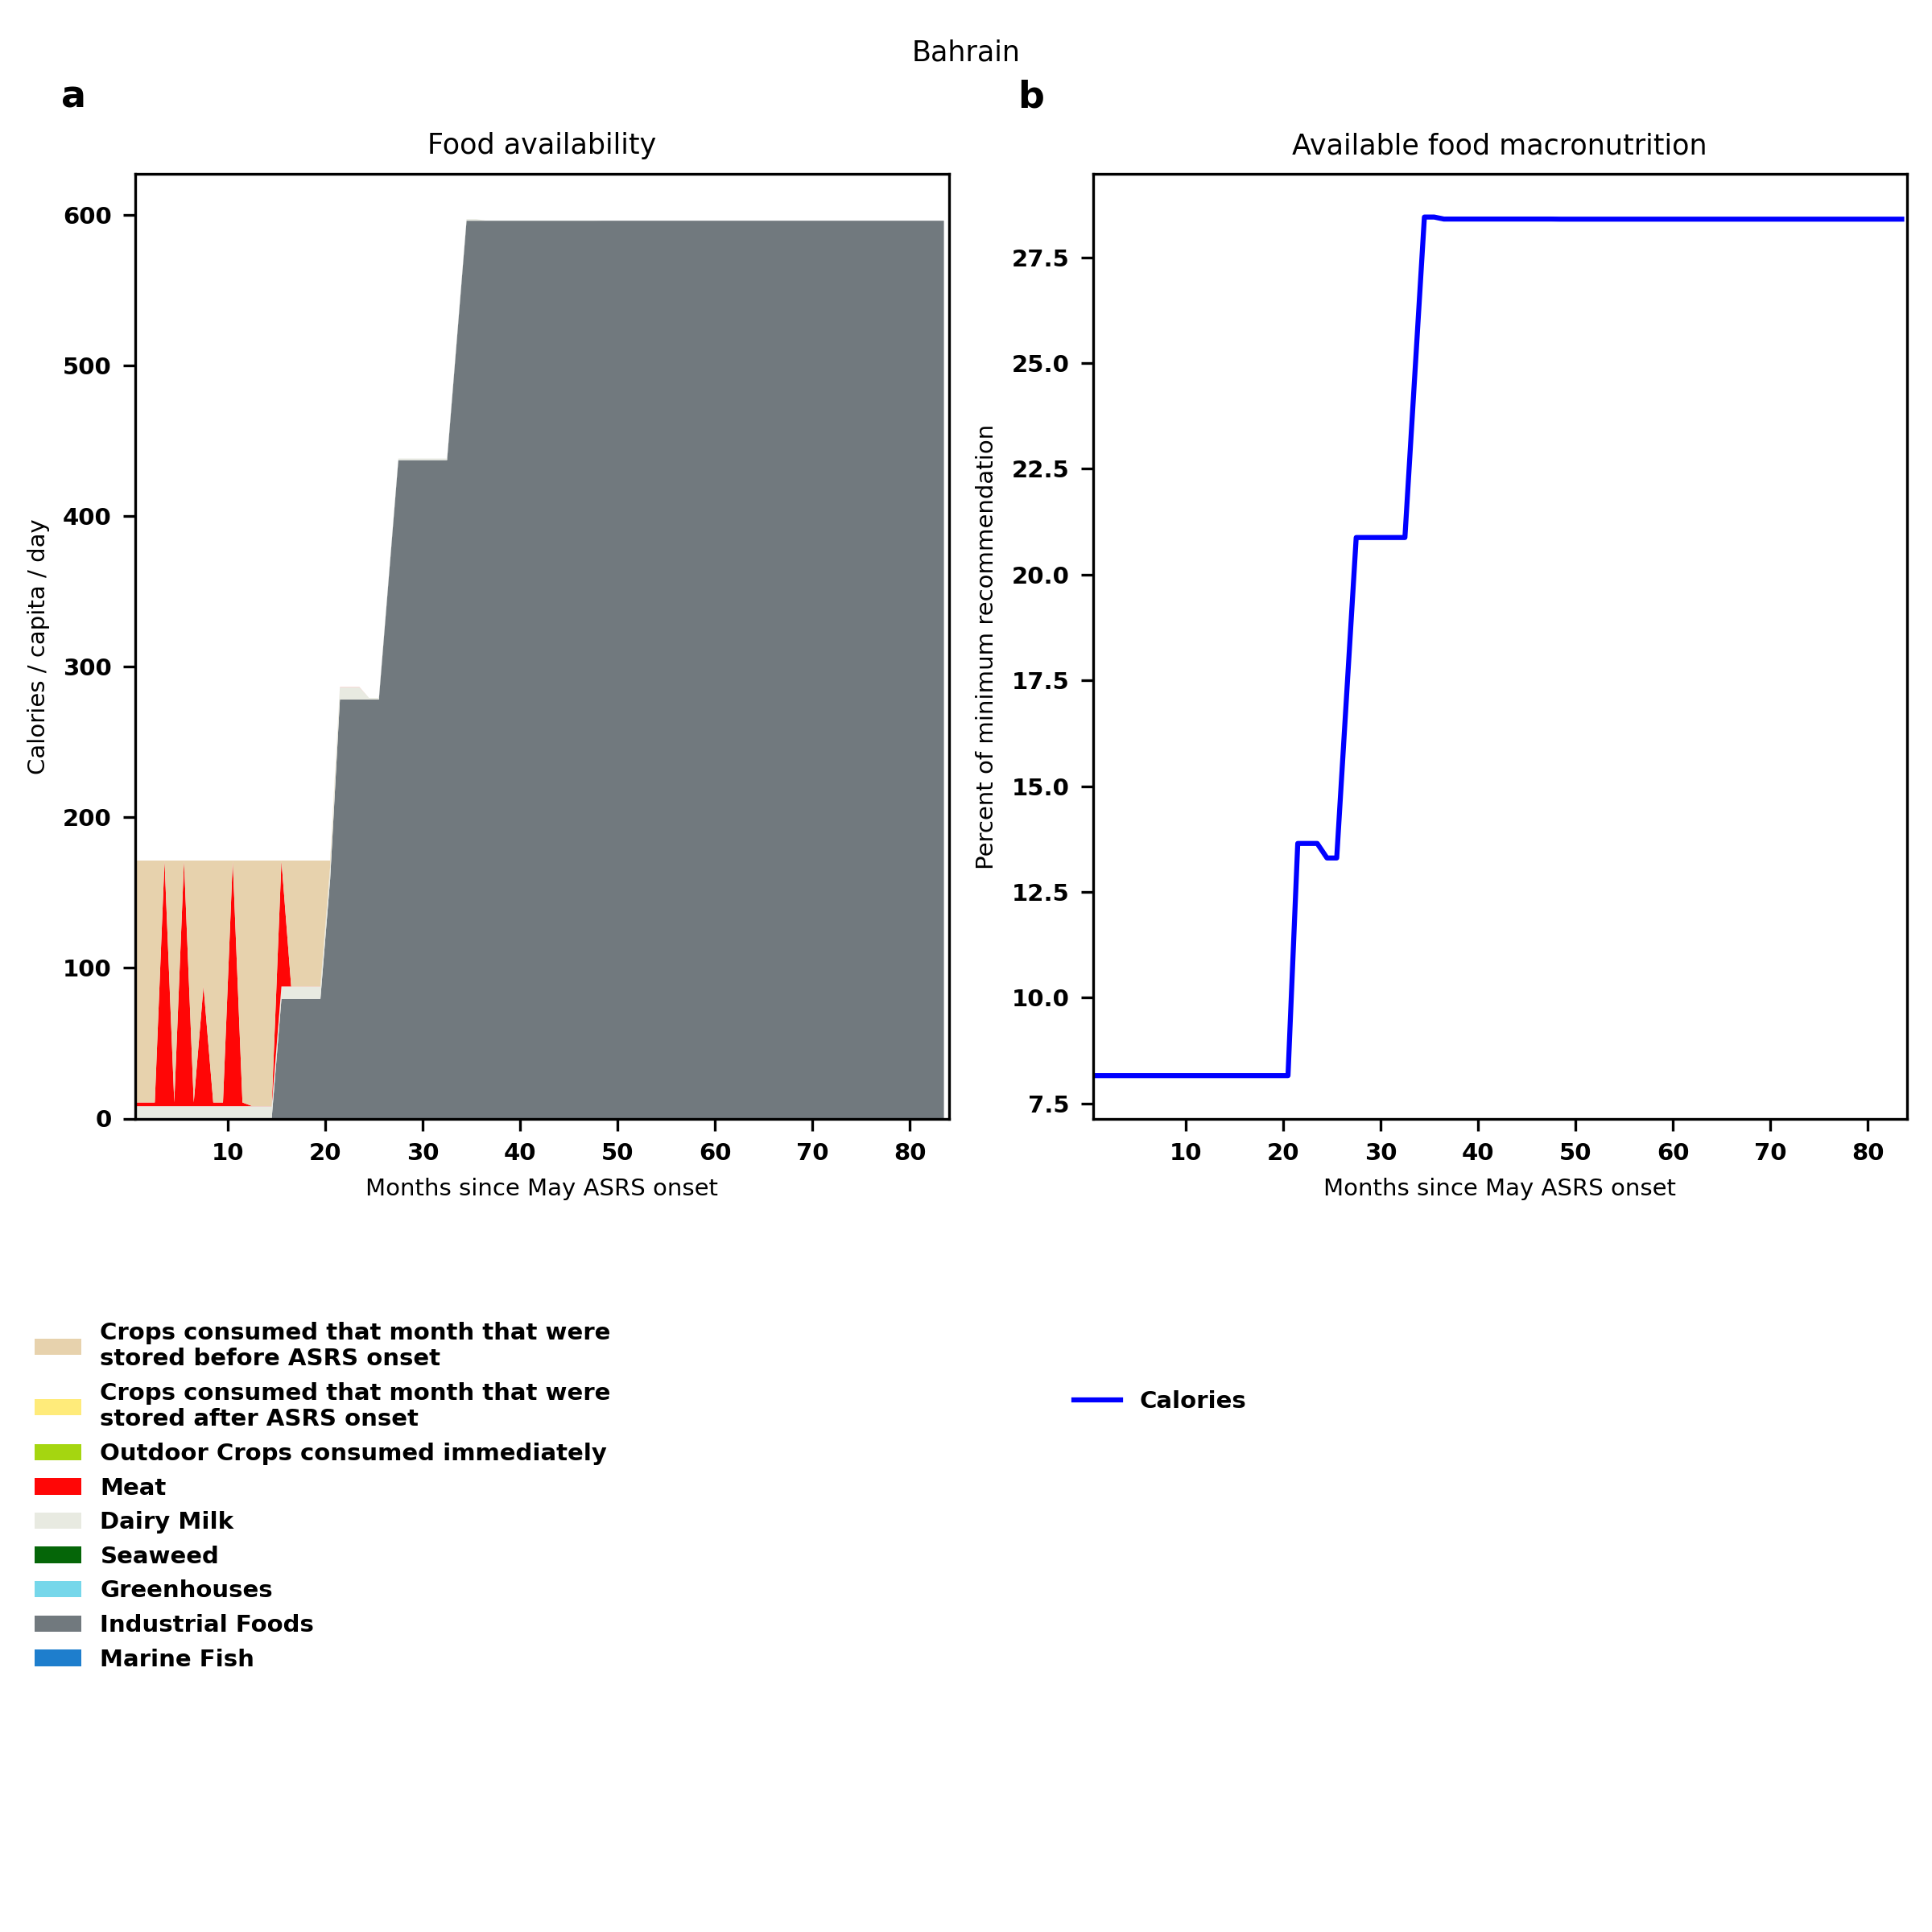
Bahrain: Percent fed:8.2%
Scenario properties: no food trade 2month feed, 1month biofuel baseline waste minimum sufficient nutrition few stocks used normal crop seasons reduced fish nuclear winter crops don't include protein don't include fat cull animals use resilient foods dairy cow feed prioritized

Slide 11
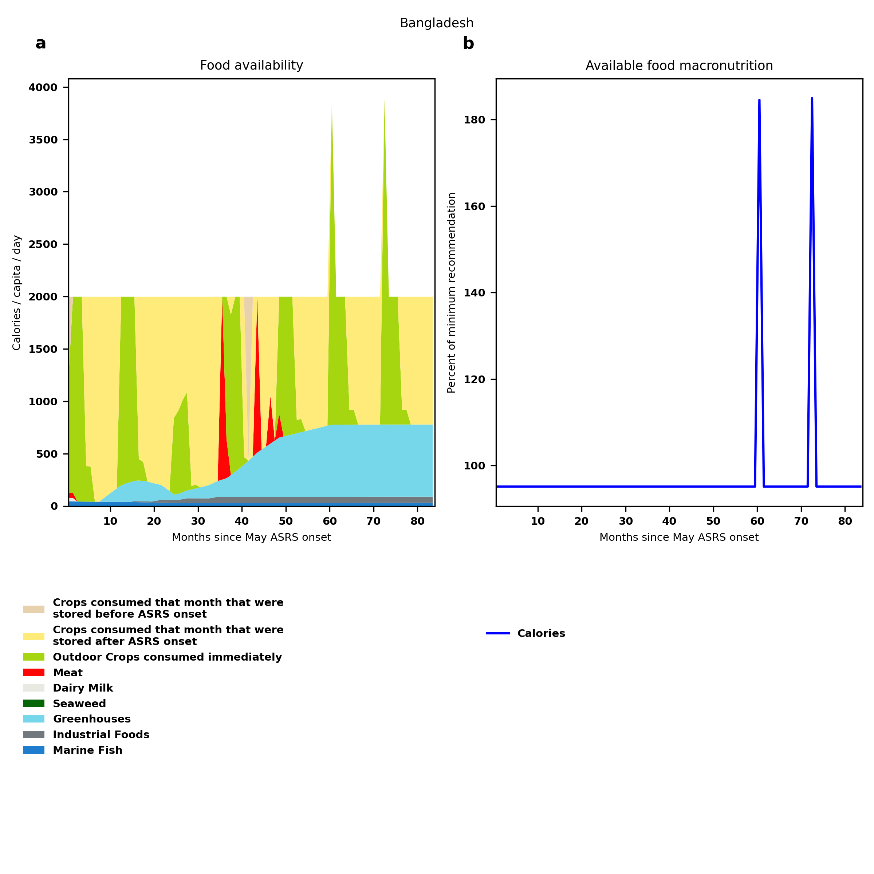
Bangladesh: Percent fed:95.1%
Scenario properties: no food trade 2month feed, 1month biofuel baseline waste minimum sufficient nutrition few stocks used normal crop seasons reduced fish nuclear winter crops don't include protein don't include fat cull animals use resilient foods dairy cow feed prioritized

Slide 12
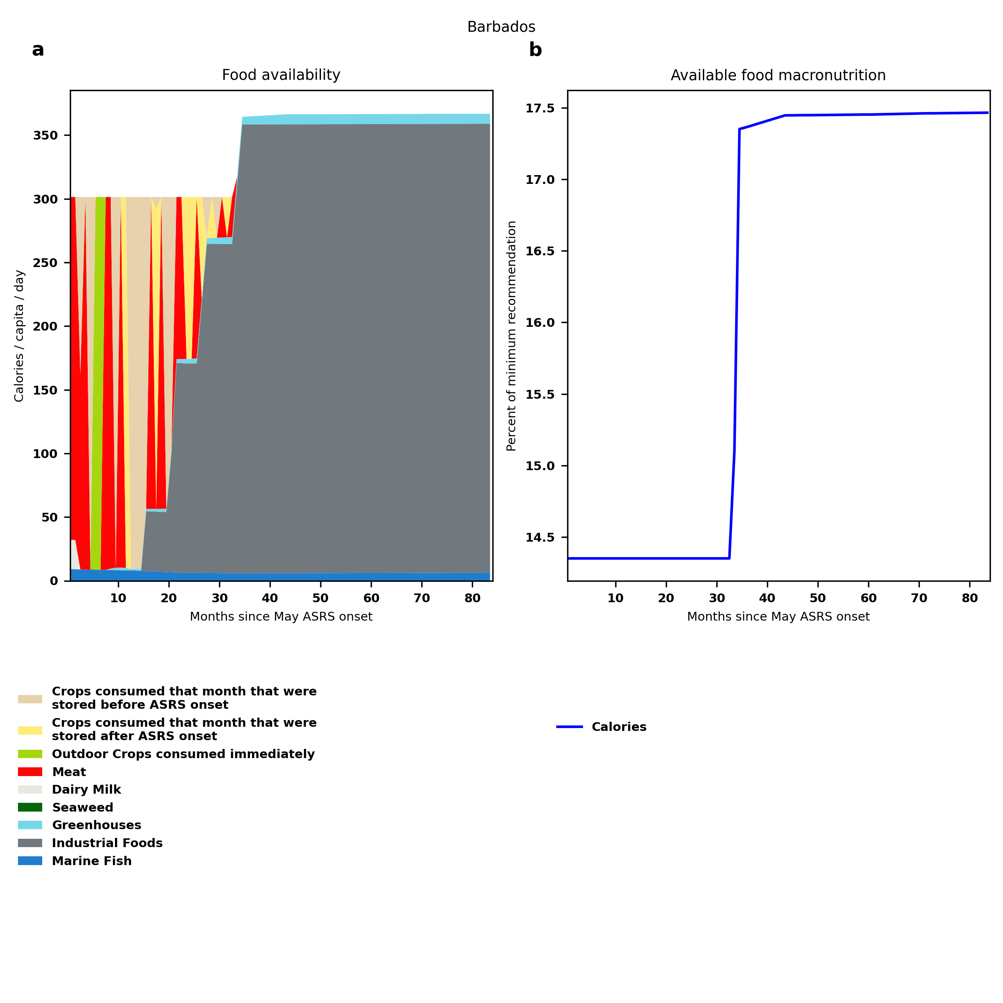
Barbados: Percent fed:14.4%
Scenario properties: no food trade 2month feed, 1month biofuel baseline waste minimum sufficient nutrition few stocks used normal crop seasons reduced fish nuclear winter crops don't include protein don't include fat cull animals use resilient foods dairy cow feed prioritized

Slide 13
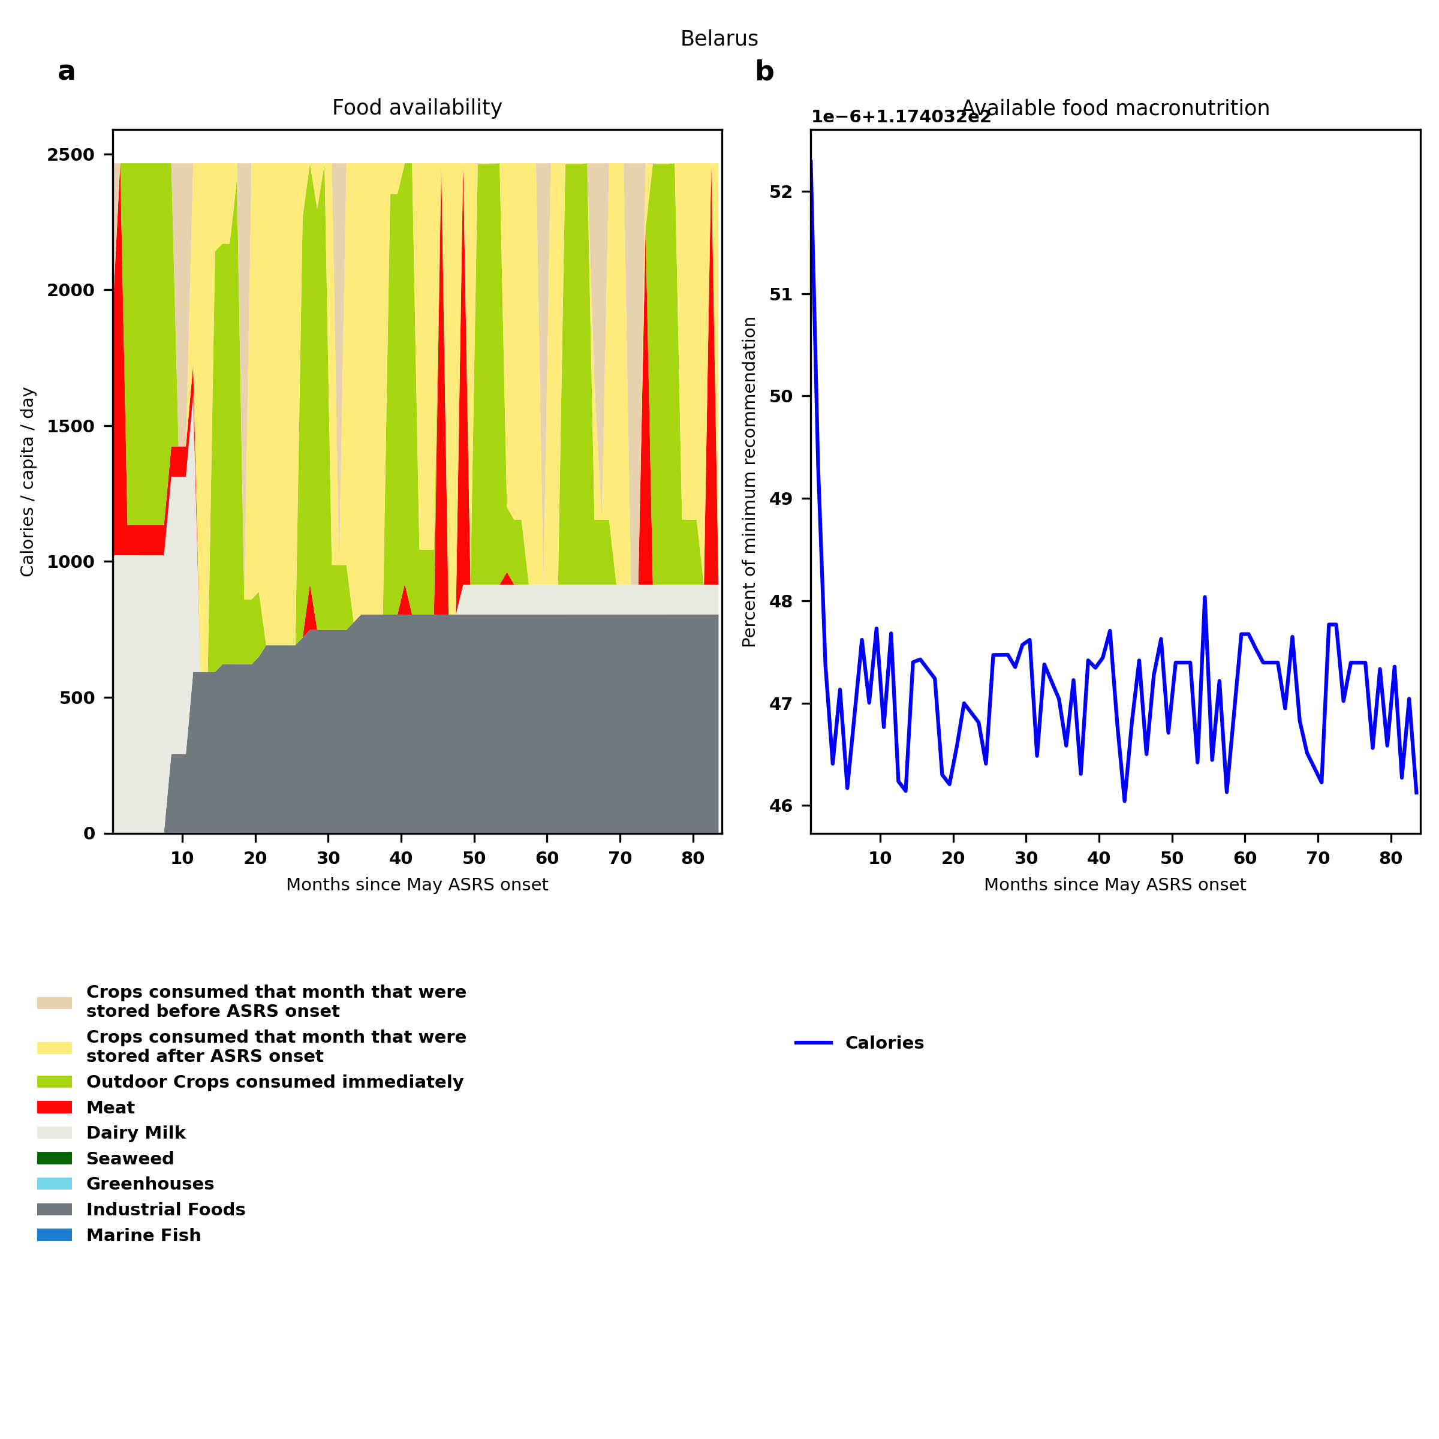
Belarus: Percent fed:117.4%
Scenario properties: no food trade 2month feed, 1month biofuel baseline waste minimum sufficient nutrition few stocks used normal crop seasons reduced fish nuclear winter crops don't include protein don't include fat cull animals use resilient foods dairy cow feed prioritized

Slide 14
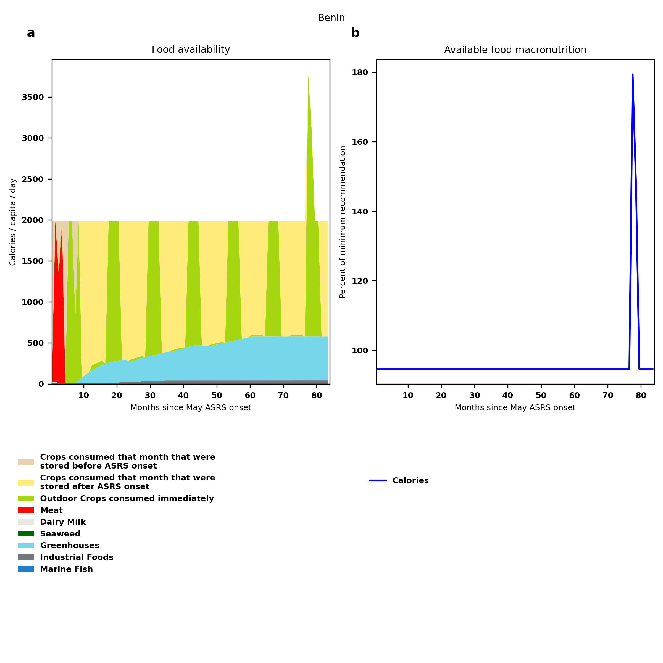
Benin: Percent fed:94.6%
Scenario properties: no food trade 2month feed, 1month biofuel baseline waste minimum sufficient nutrition few stocks used normal crop seasons reduced fish nuclear winter crops don't include protein don't include fat cull animals use resilient foods dairy cow feed prioritized

Slide 15
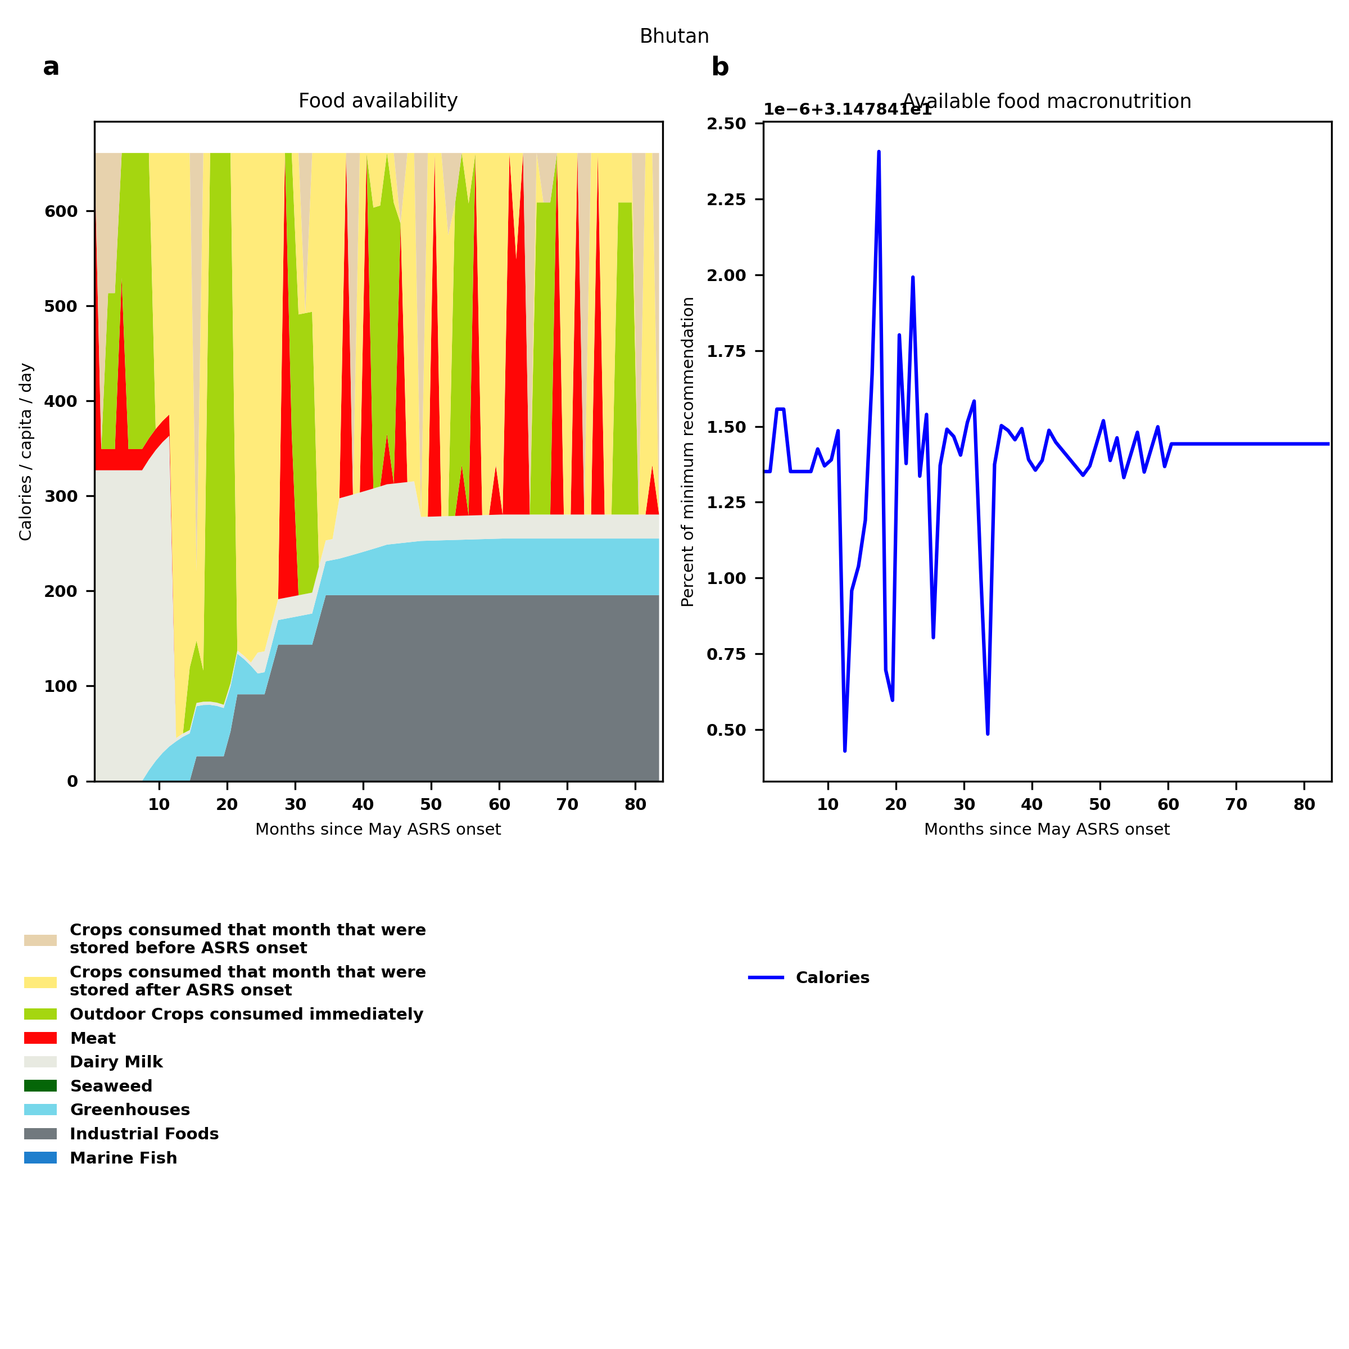
Bhutan: Percent fed:31.5%
Scenario properties: no food trade 2month feed, 1month biofuel baseline waste minimum sufficient nutrition few stocks used normal crop seasons reduced fish nuclear winter crops don't include protein don't include fat cull animals use resilient foods dairy cow feed prioritized

Slide 16
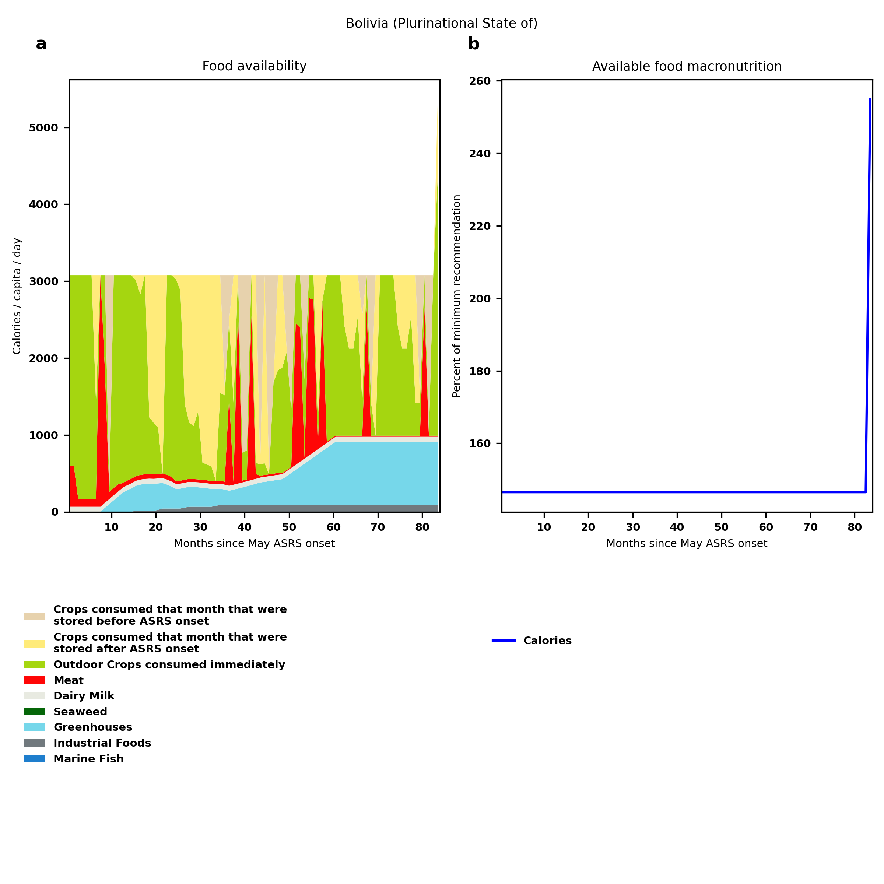
Bolivia (Plurinational State of): Percent fed:146.5%
Scenario properties: no food trade 2month feed, 1month biofuel baseline waste minimum sufficient nutrition few stocks used normal crop seasons reduced fish nuclear winter crops don't include protein don't include fat cull animals use resilient foods dairy cow feed prioritized

Slide 17
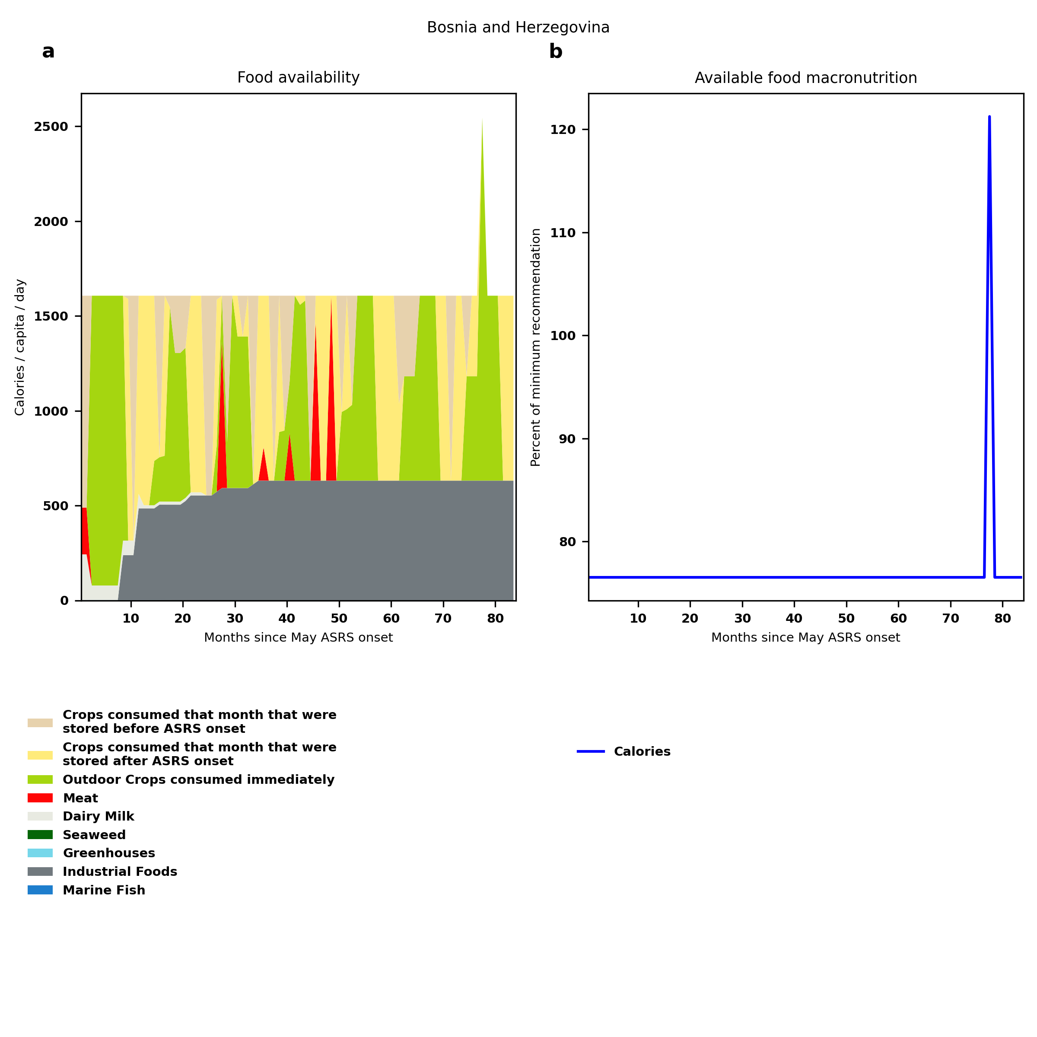
Bosnia and Herzegovina: Percent fed:76.5%
Scenario properties: no food trade 2month feed, 1month biofuel baseline waste minimum sufficient nutrition few stocks used normal crop seasons reduced fish nuclear winter crops don't include protein don't include fat cull animals use resilient foods dairy cow feed prioritized

Slide 18
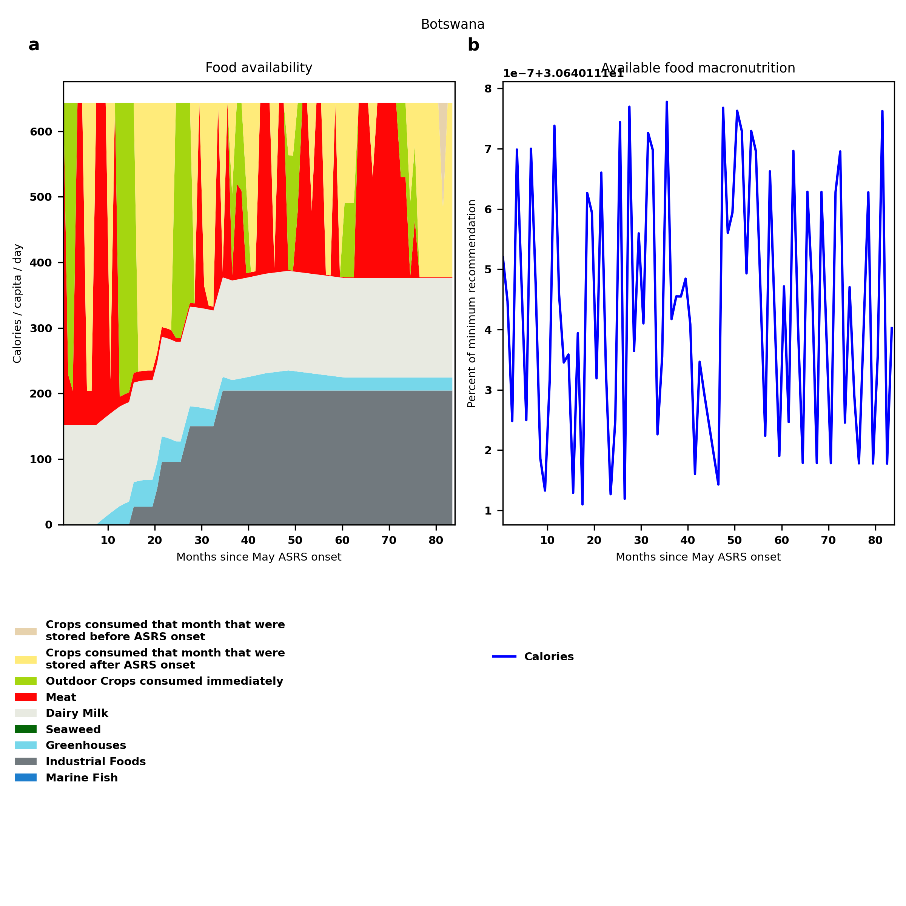
Botswana: Percent fed:30.6%
Scenario properties: no food trade 2month feed, 1month biofuel baseline waste minimum sufficient nutrition few stocks used normal crop seasons reduced fish nuclear winter crops don't include protein don't include fat cull animals use resilient foods dairy cow feed prioritized

Slide 19
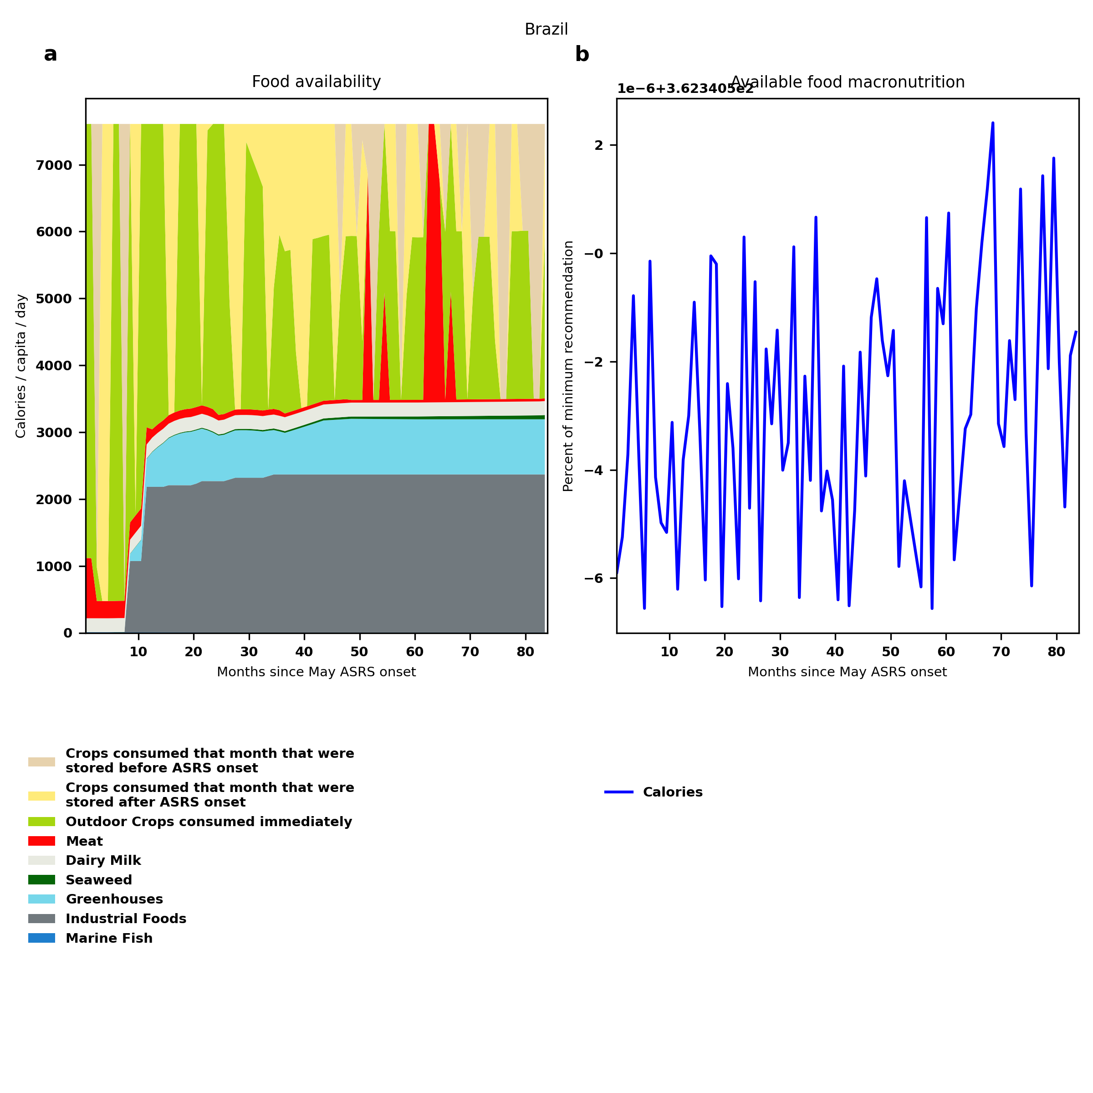
Brazil: Percent fed:362.3%
Scenario properties: no food trade 2month feed, 1month biofuel baseline waste minimum sufficient nutrition few stocks used normal crop seasons reduced fish nuclear winter crops don't include protein don't include fat cull animals use resilient foods dairy cow feed prioritized

Slide 20
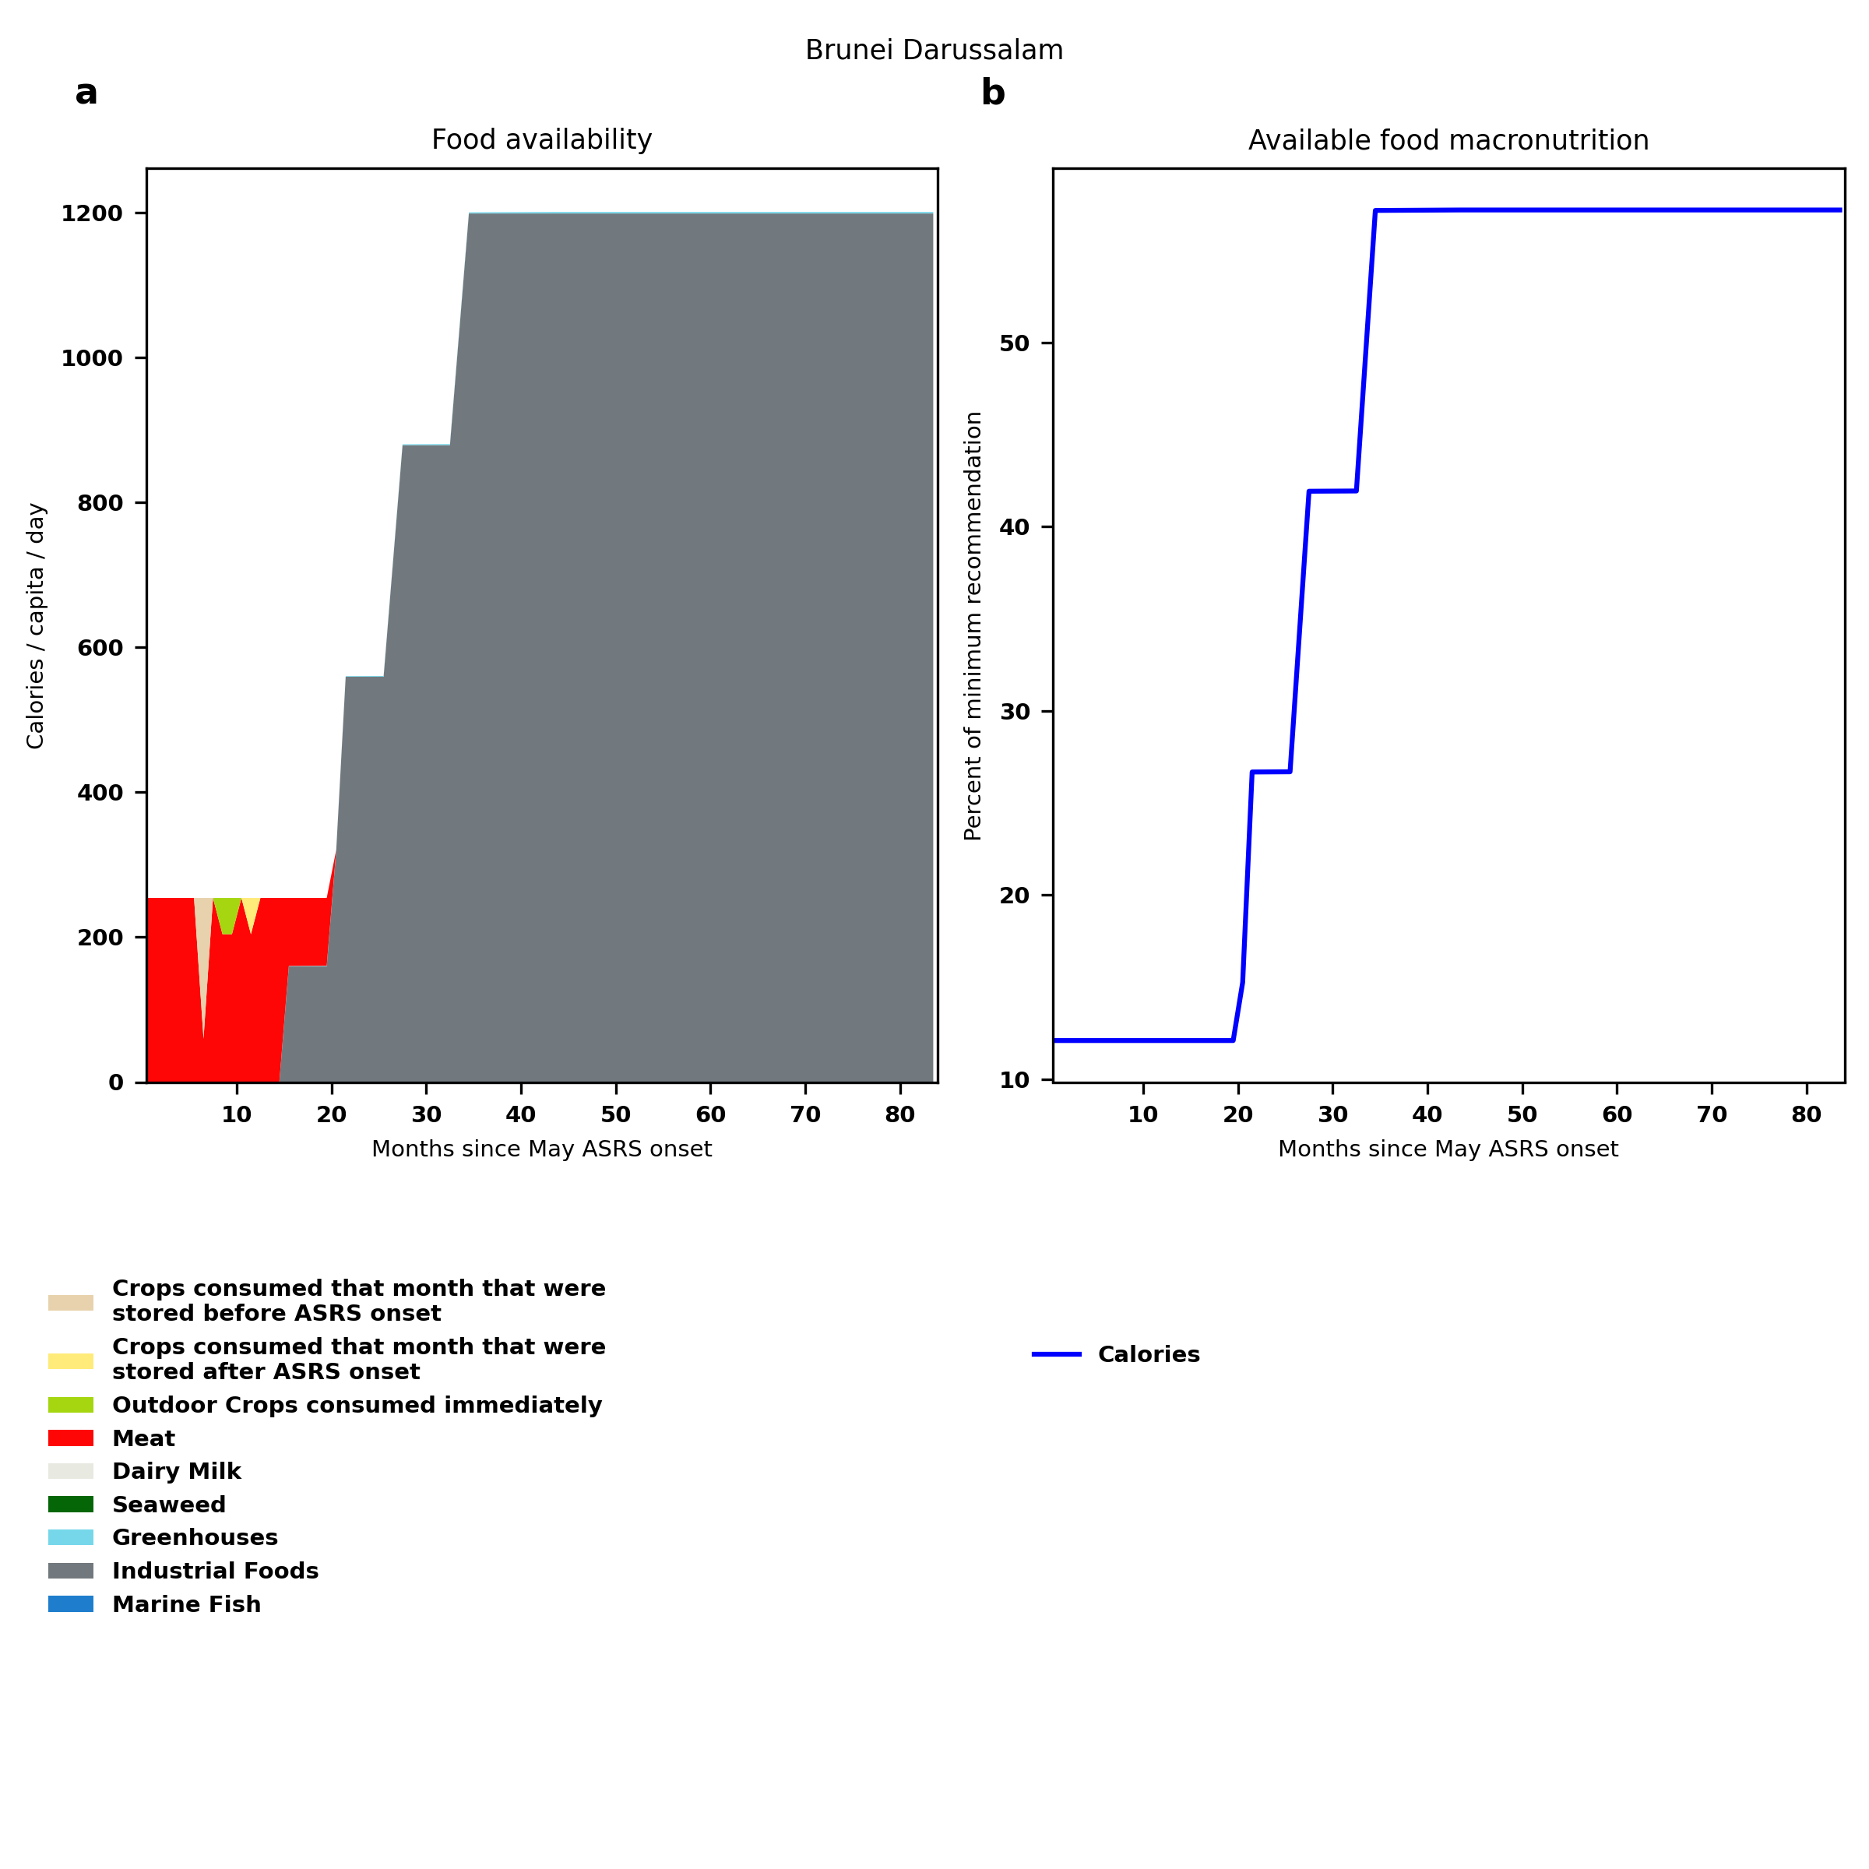
Brunei Darussalam: Percent fed:12.1%
Scenario properties: no food trade 2month feed, 1month biofuel baseline waste minimum sufficient nutrition few stocks used normal crop seasons reduced fish nuclear winter crops don't include protein don't include fat cull animals use resilient foods dairy cow feed prioritized

Slide 21
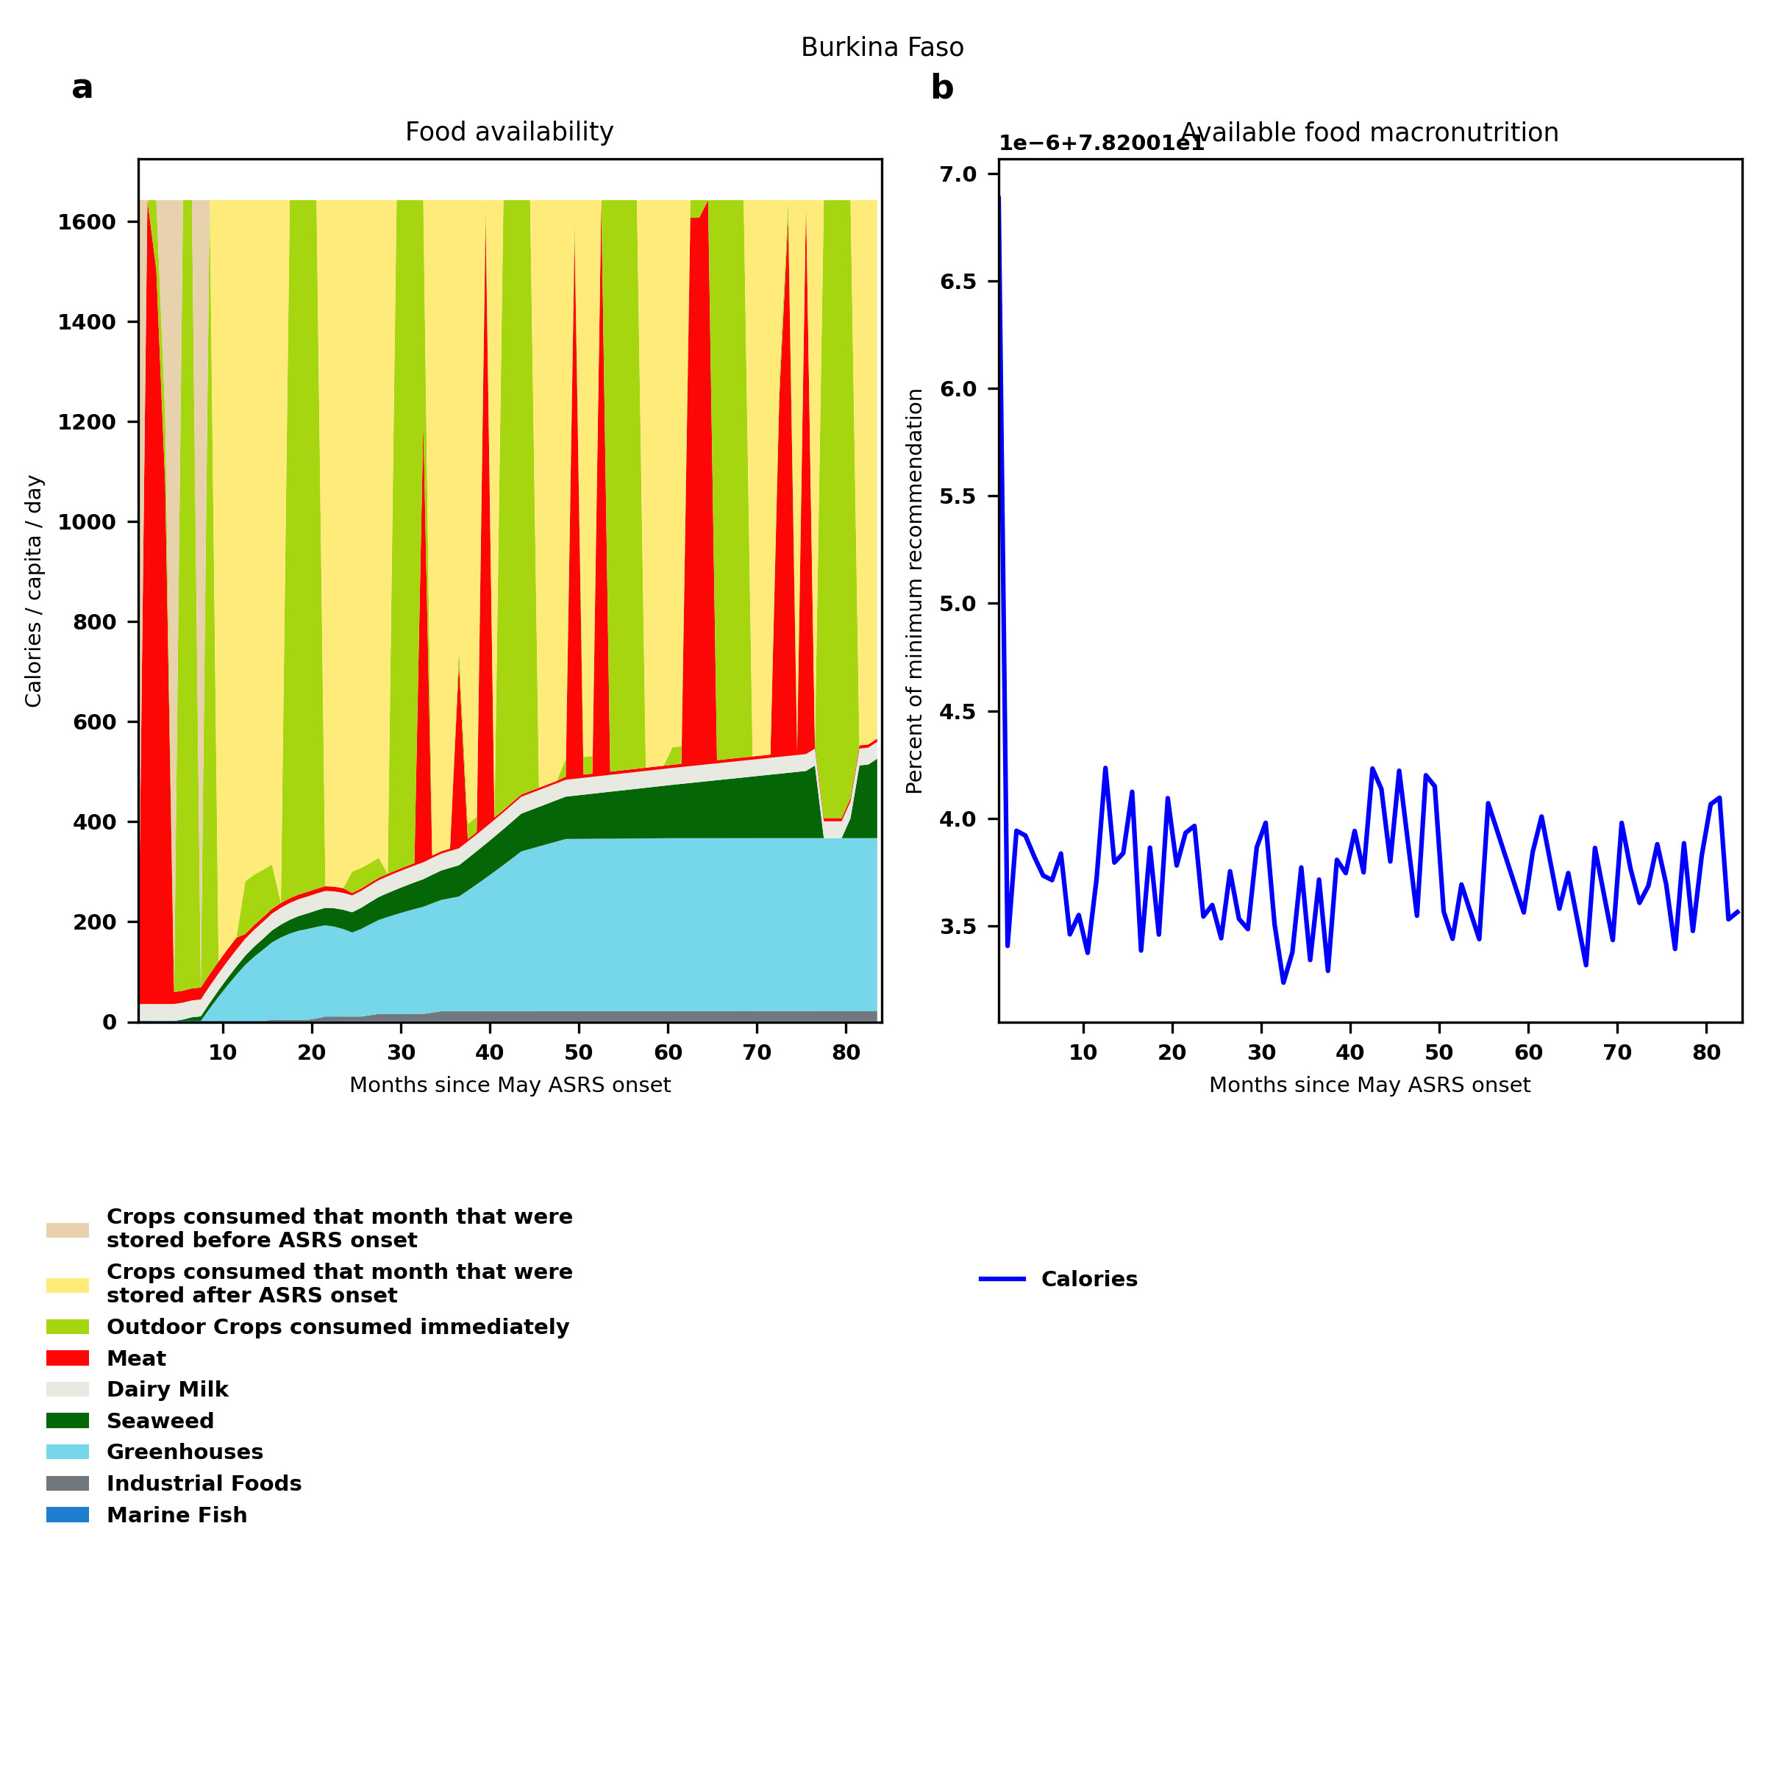
Burkina Faso: Percent fed:78.2%
Scenario properties: no food trade 2month feed, 1month biofuel baseline waste minimum sufficient nutrition few stocks used normal crop seasons reduced fish nuclear winter crops don't include protein don't include fat cull animals use resilient foods dairy cow feed prioritized

Slide 22
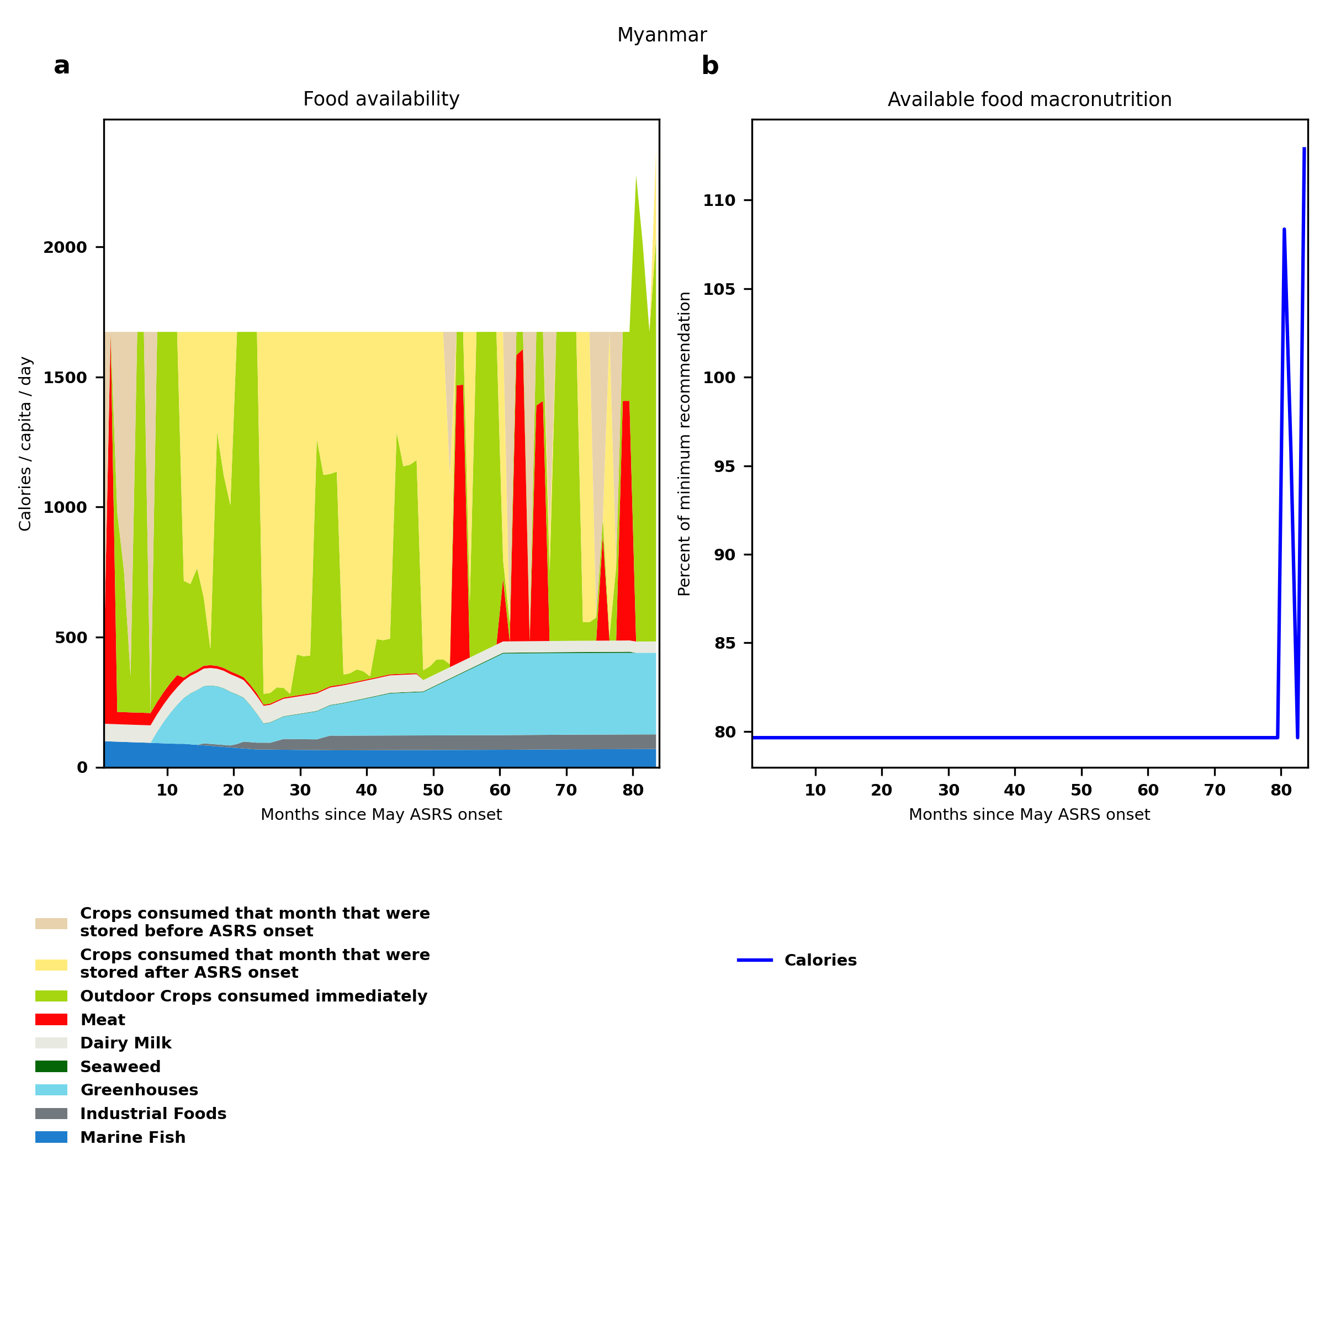
Myanmar: Percent fed:79.6%
Scenario properties: no food trade 2month feed, 1month biofuel baseline waste minimum sufficient nutrition few stocks used normal crop seasons reduced fish nuclear winter crops don't include protein don't include fat cull animals use resilient foods dairy cow feed prioritized

Slide 23
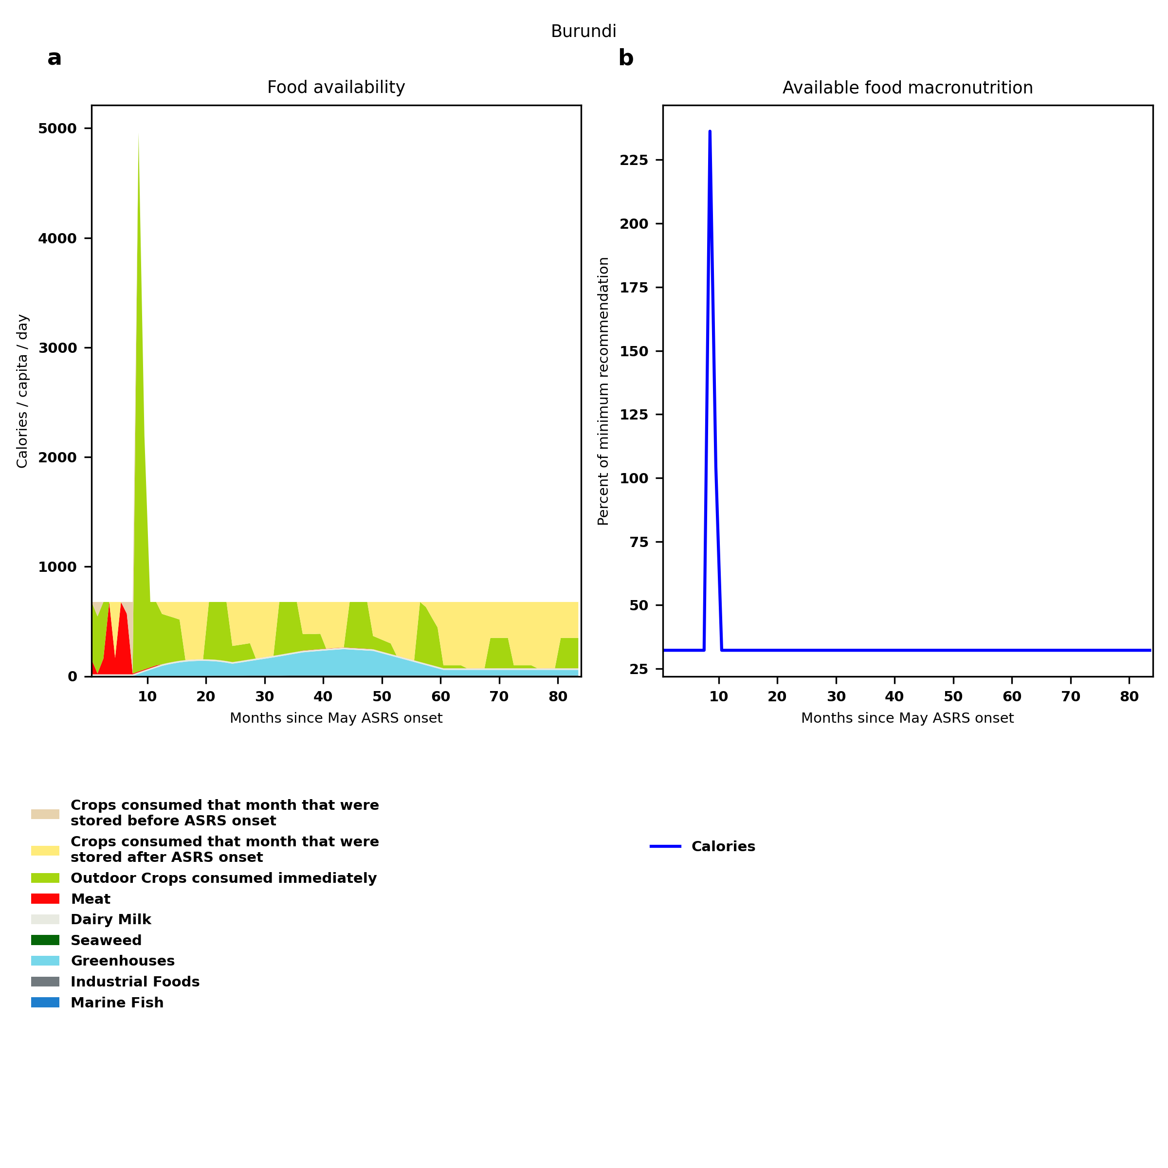
Burundi: Percent fed:32.3%
Scenario properties: no food trade 2month feed, 1month biofuel baseline waste minimum sufficient nutrition few stocks used normal crop seasons reduced fish nuclear winter crops don't include protein don't include fat cull animals use resilient foods dairy cow feed prioritized

Slide 24
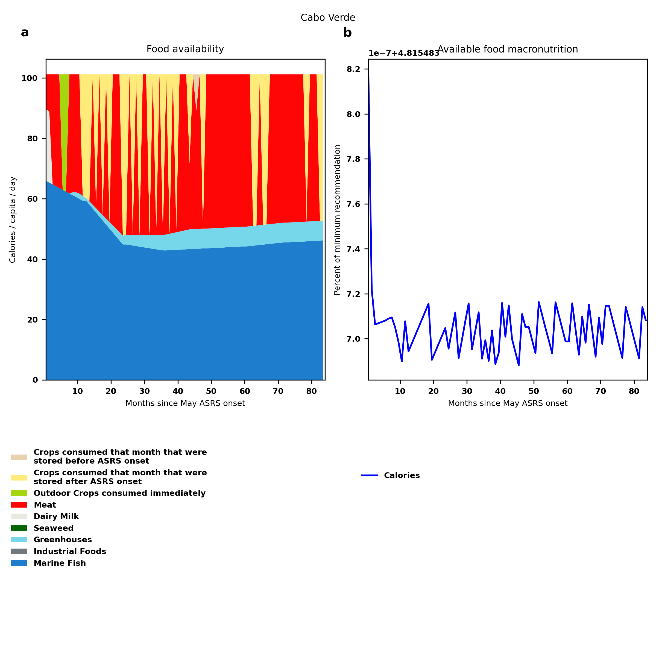
Cabo Verde: Percent fed:4.8%
Scenario properties: no food trade 2month feed, 1month biofuel baseline waste minimum sufficient nutrition few stocks used normal crop seasons reduced fish nuclear winter crops don't include protein don't include fat cull animals use resilient foods dairy cow feed prioritized

Slide 25
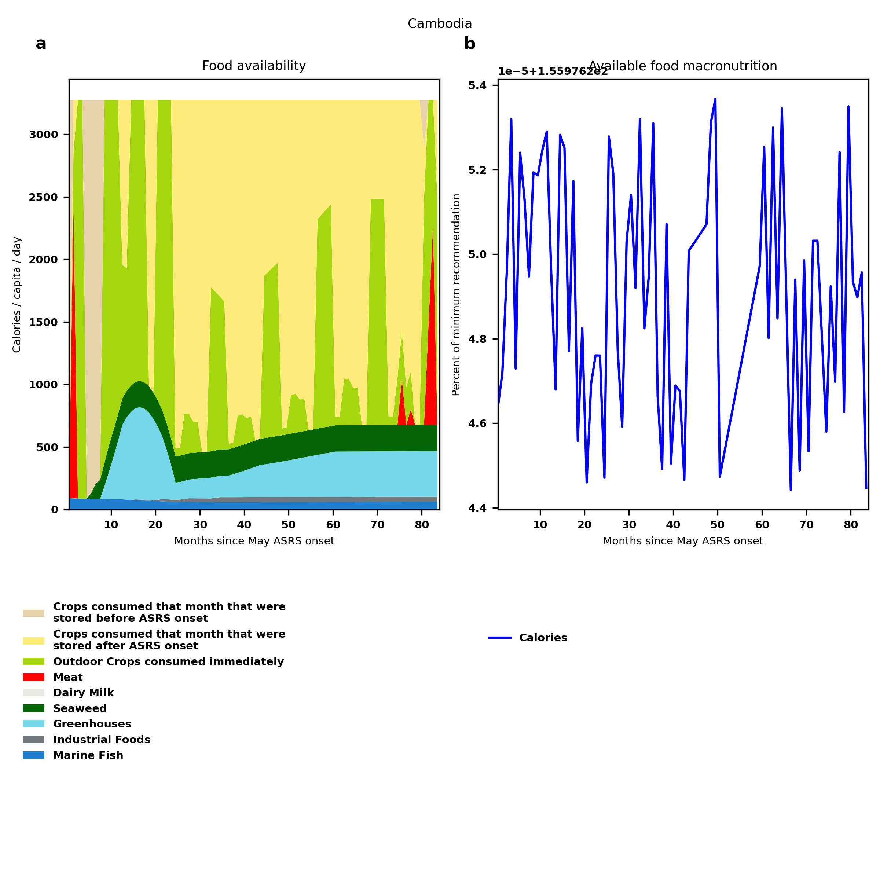
Cambodia: Percent fed:156.0%
Scenario properties: no food trade 2month feed, 1month biofuel baseline waste minimum sufficient nutrition few stocks used normal crop seasons reduced fish nuclear winter crops don't include protein don't include fat cull animals use resilient foods dairy cow feed prioritized

Slide 26
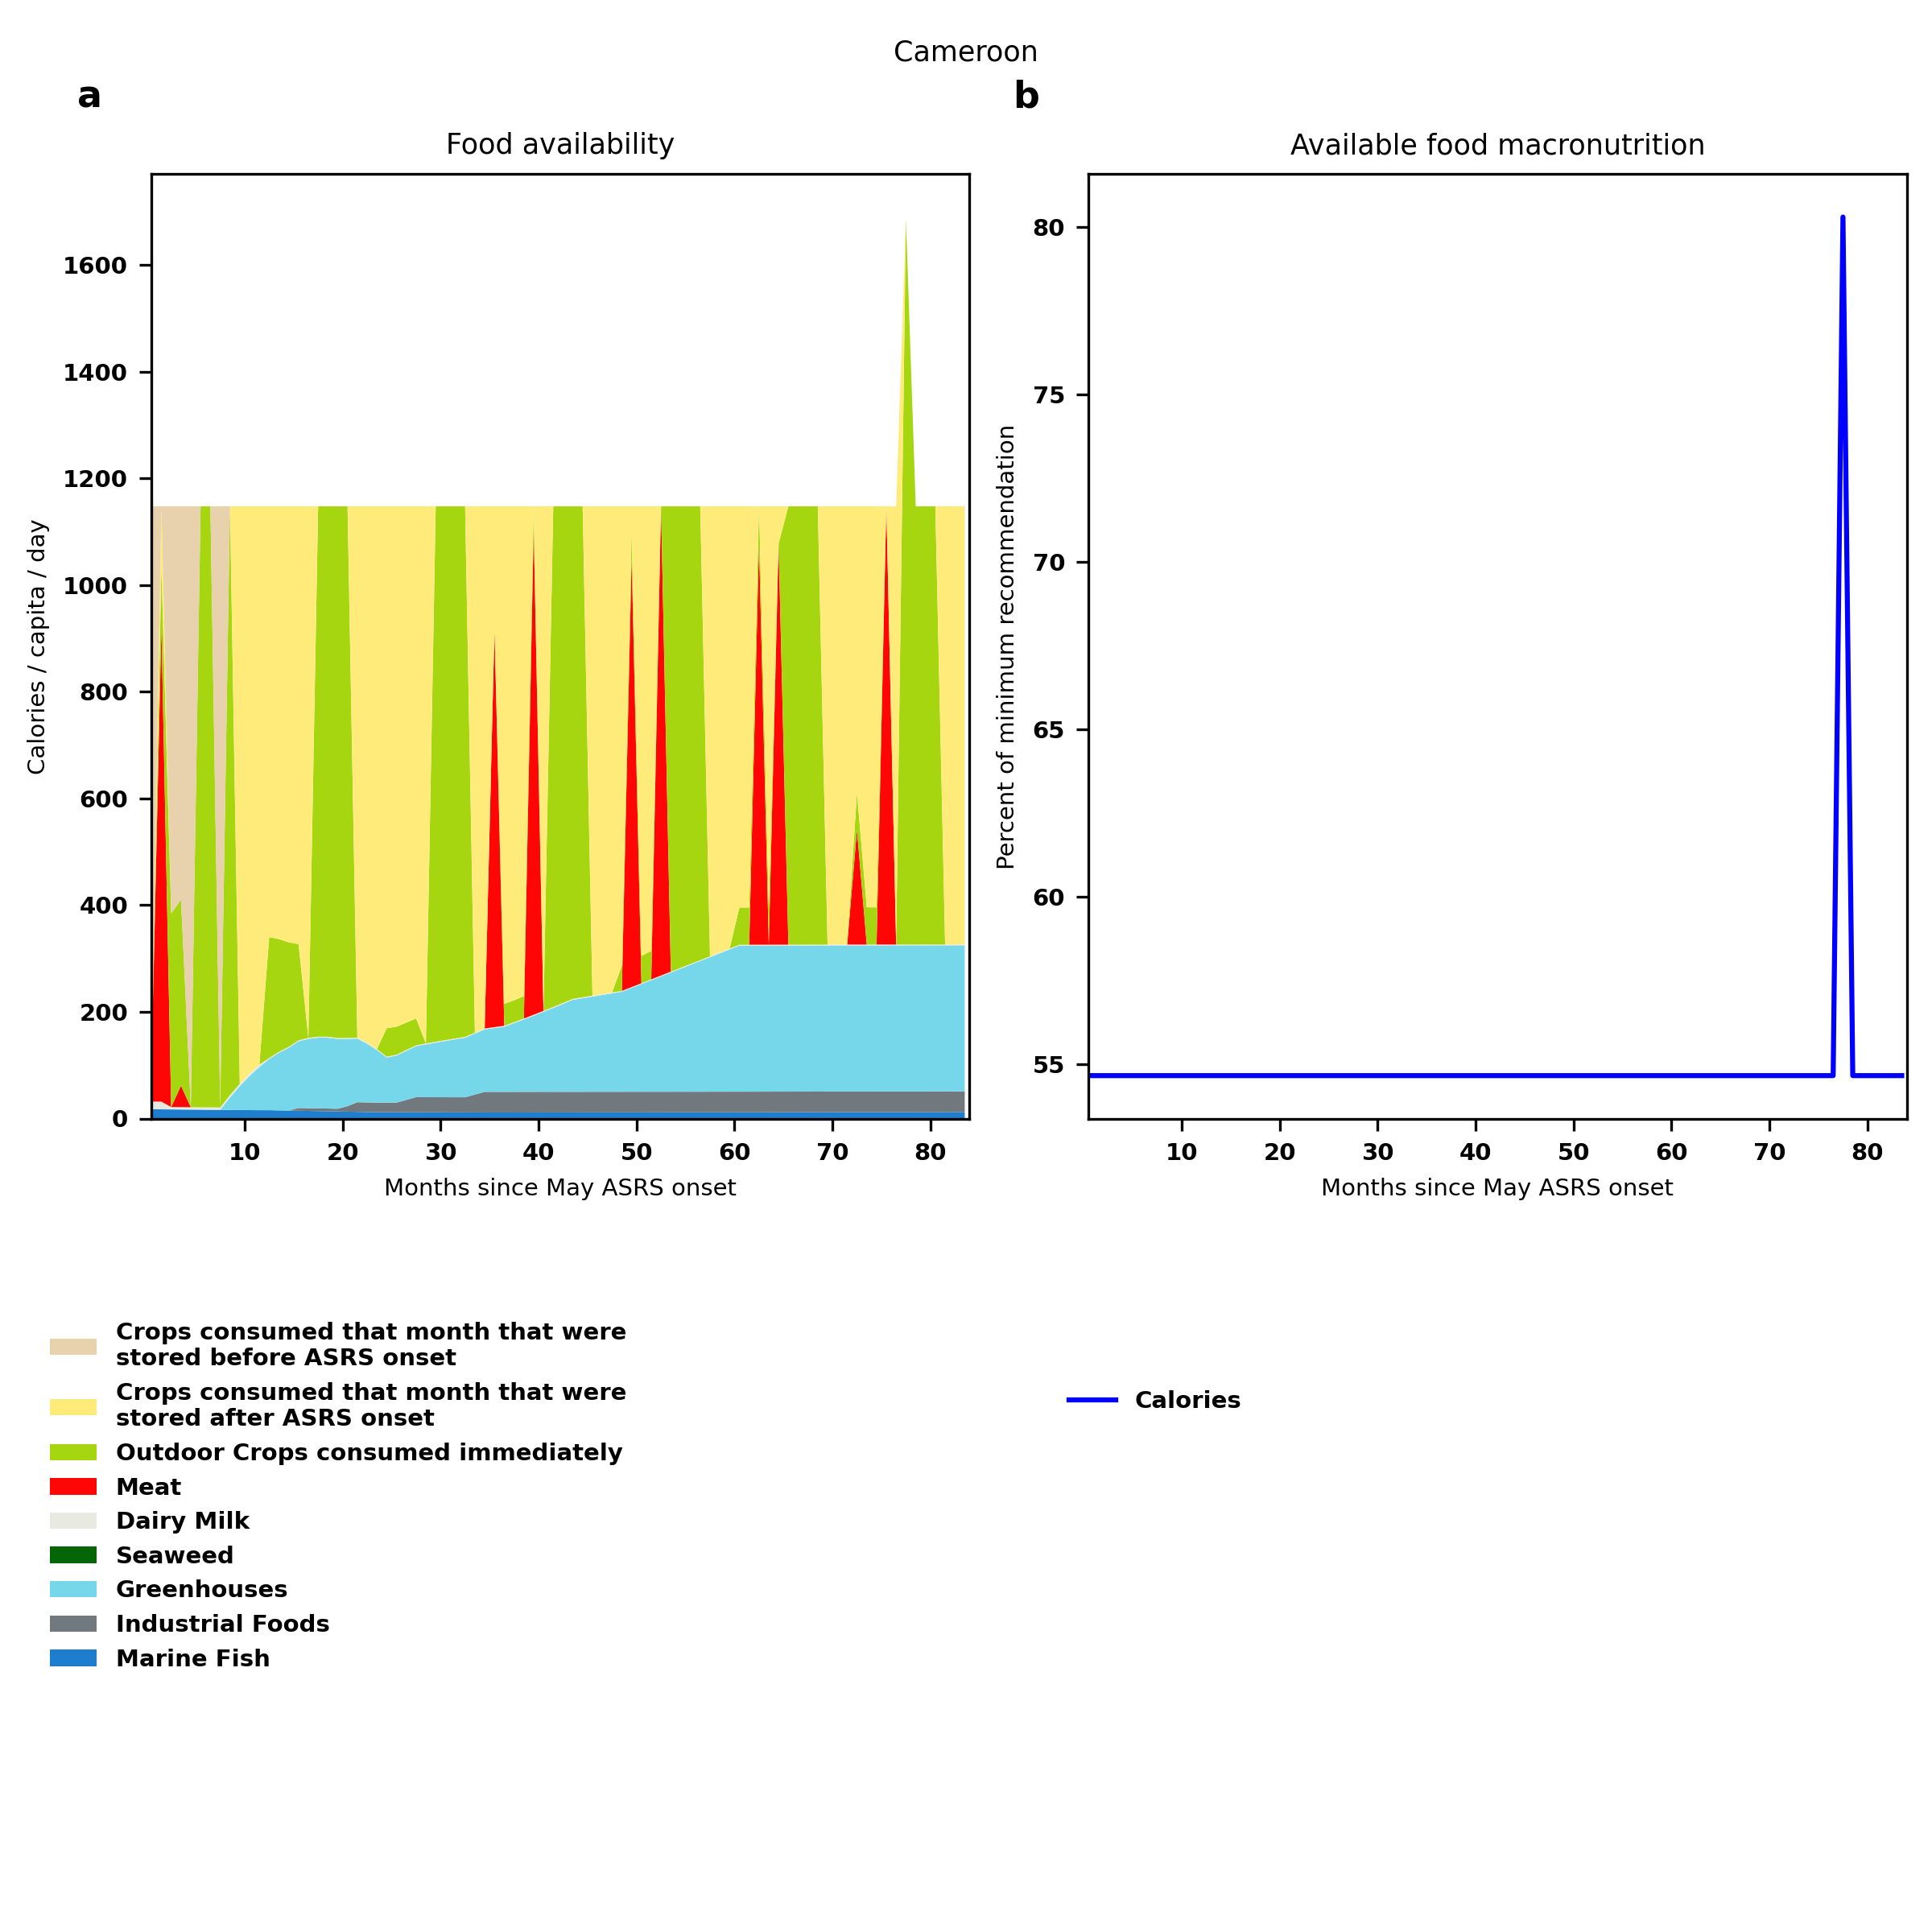
Cameroon: Percent fed:54.7%
Scenario properties: no food trade 2month feed, 1month biofuel baseline waste minimum sufficient nutrition few stocks used normal crop seasons reduced fish nuclear winter crops don't include protein don't include fat cull animals use resilient foods dairy cow feed prioritized

Slide 27
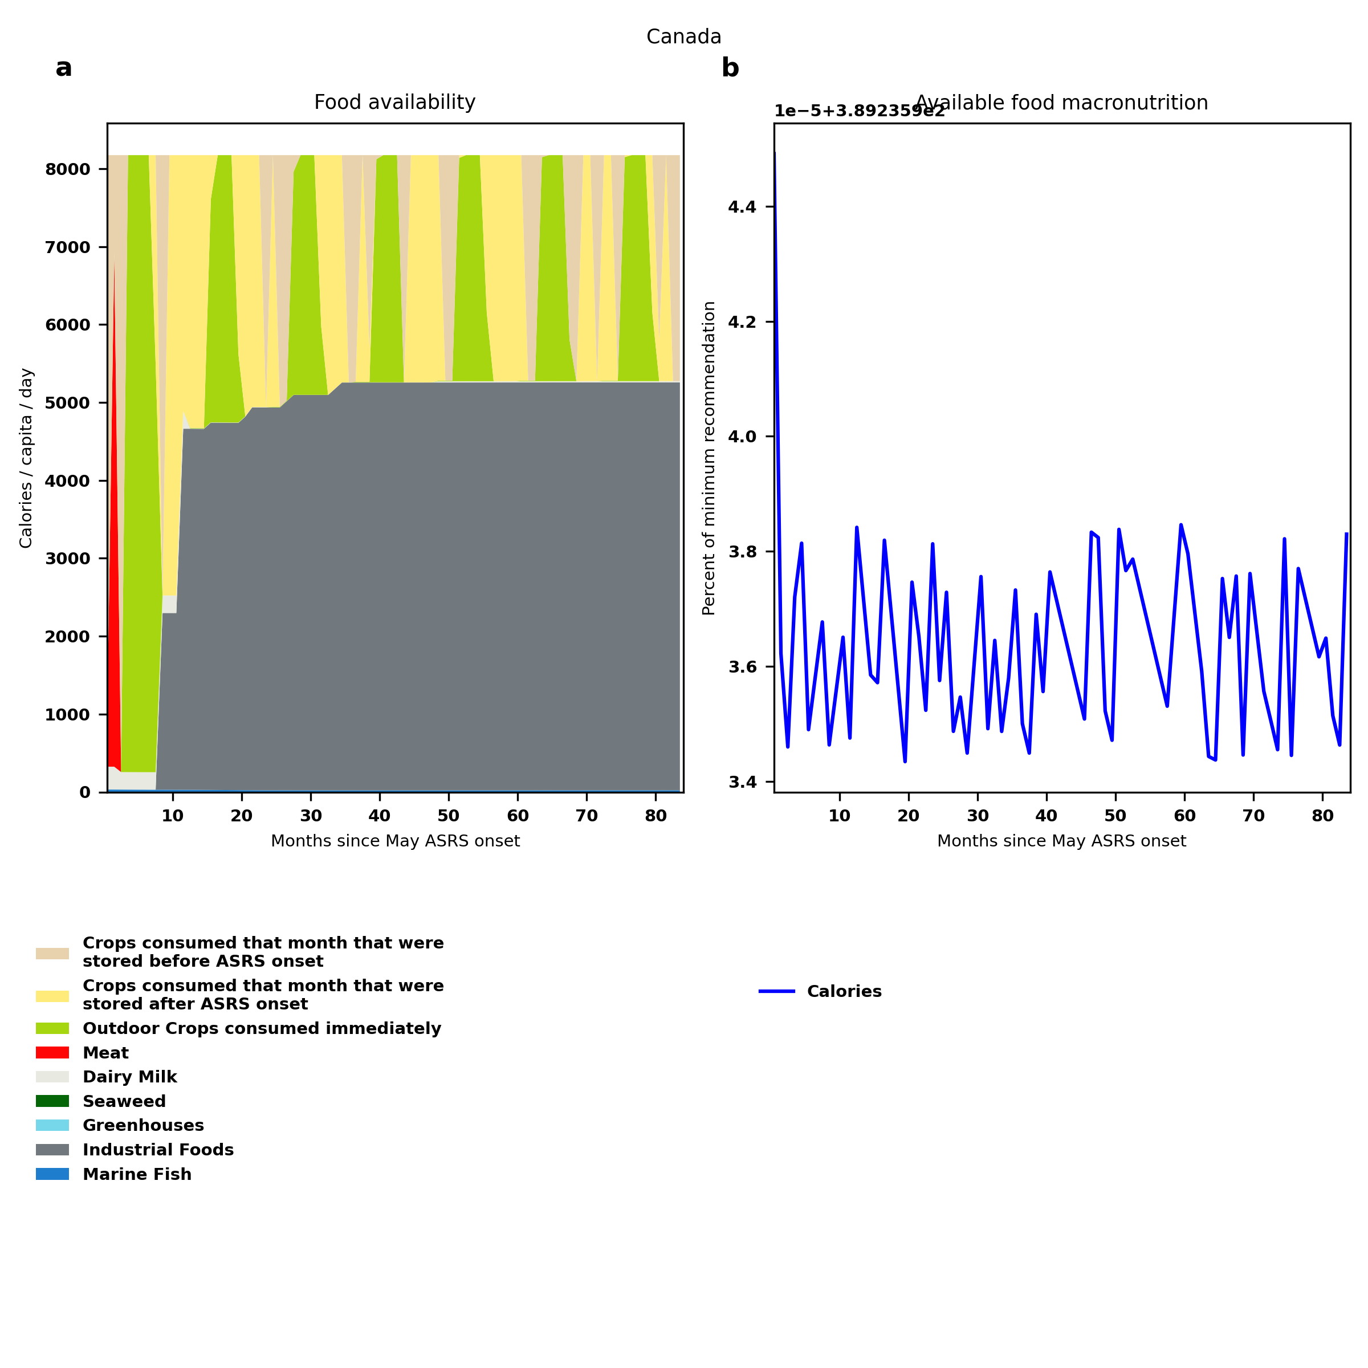
Canada: Percent fed:389.2%
Scenario properties: no food trade 2month feed, 1month biofuel baseline waste minimum sufficient nutrition few stocks used normal crop seasons reduced fish nuclear winter crops don't include protein don't include fat cull animals use resilient foods dairy cow feed prioritized

Slide 28
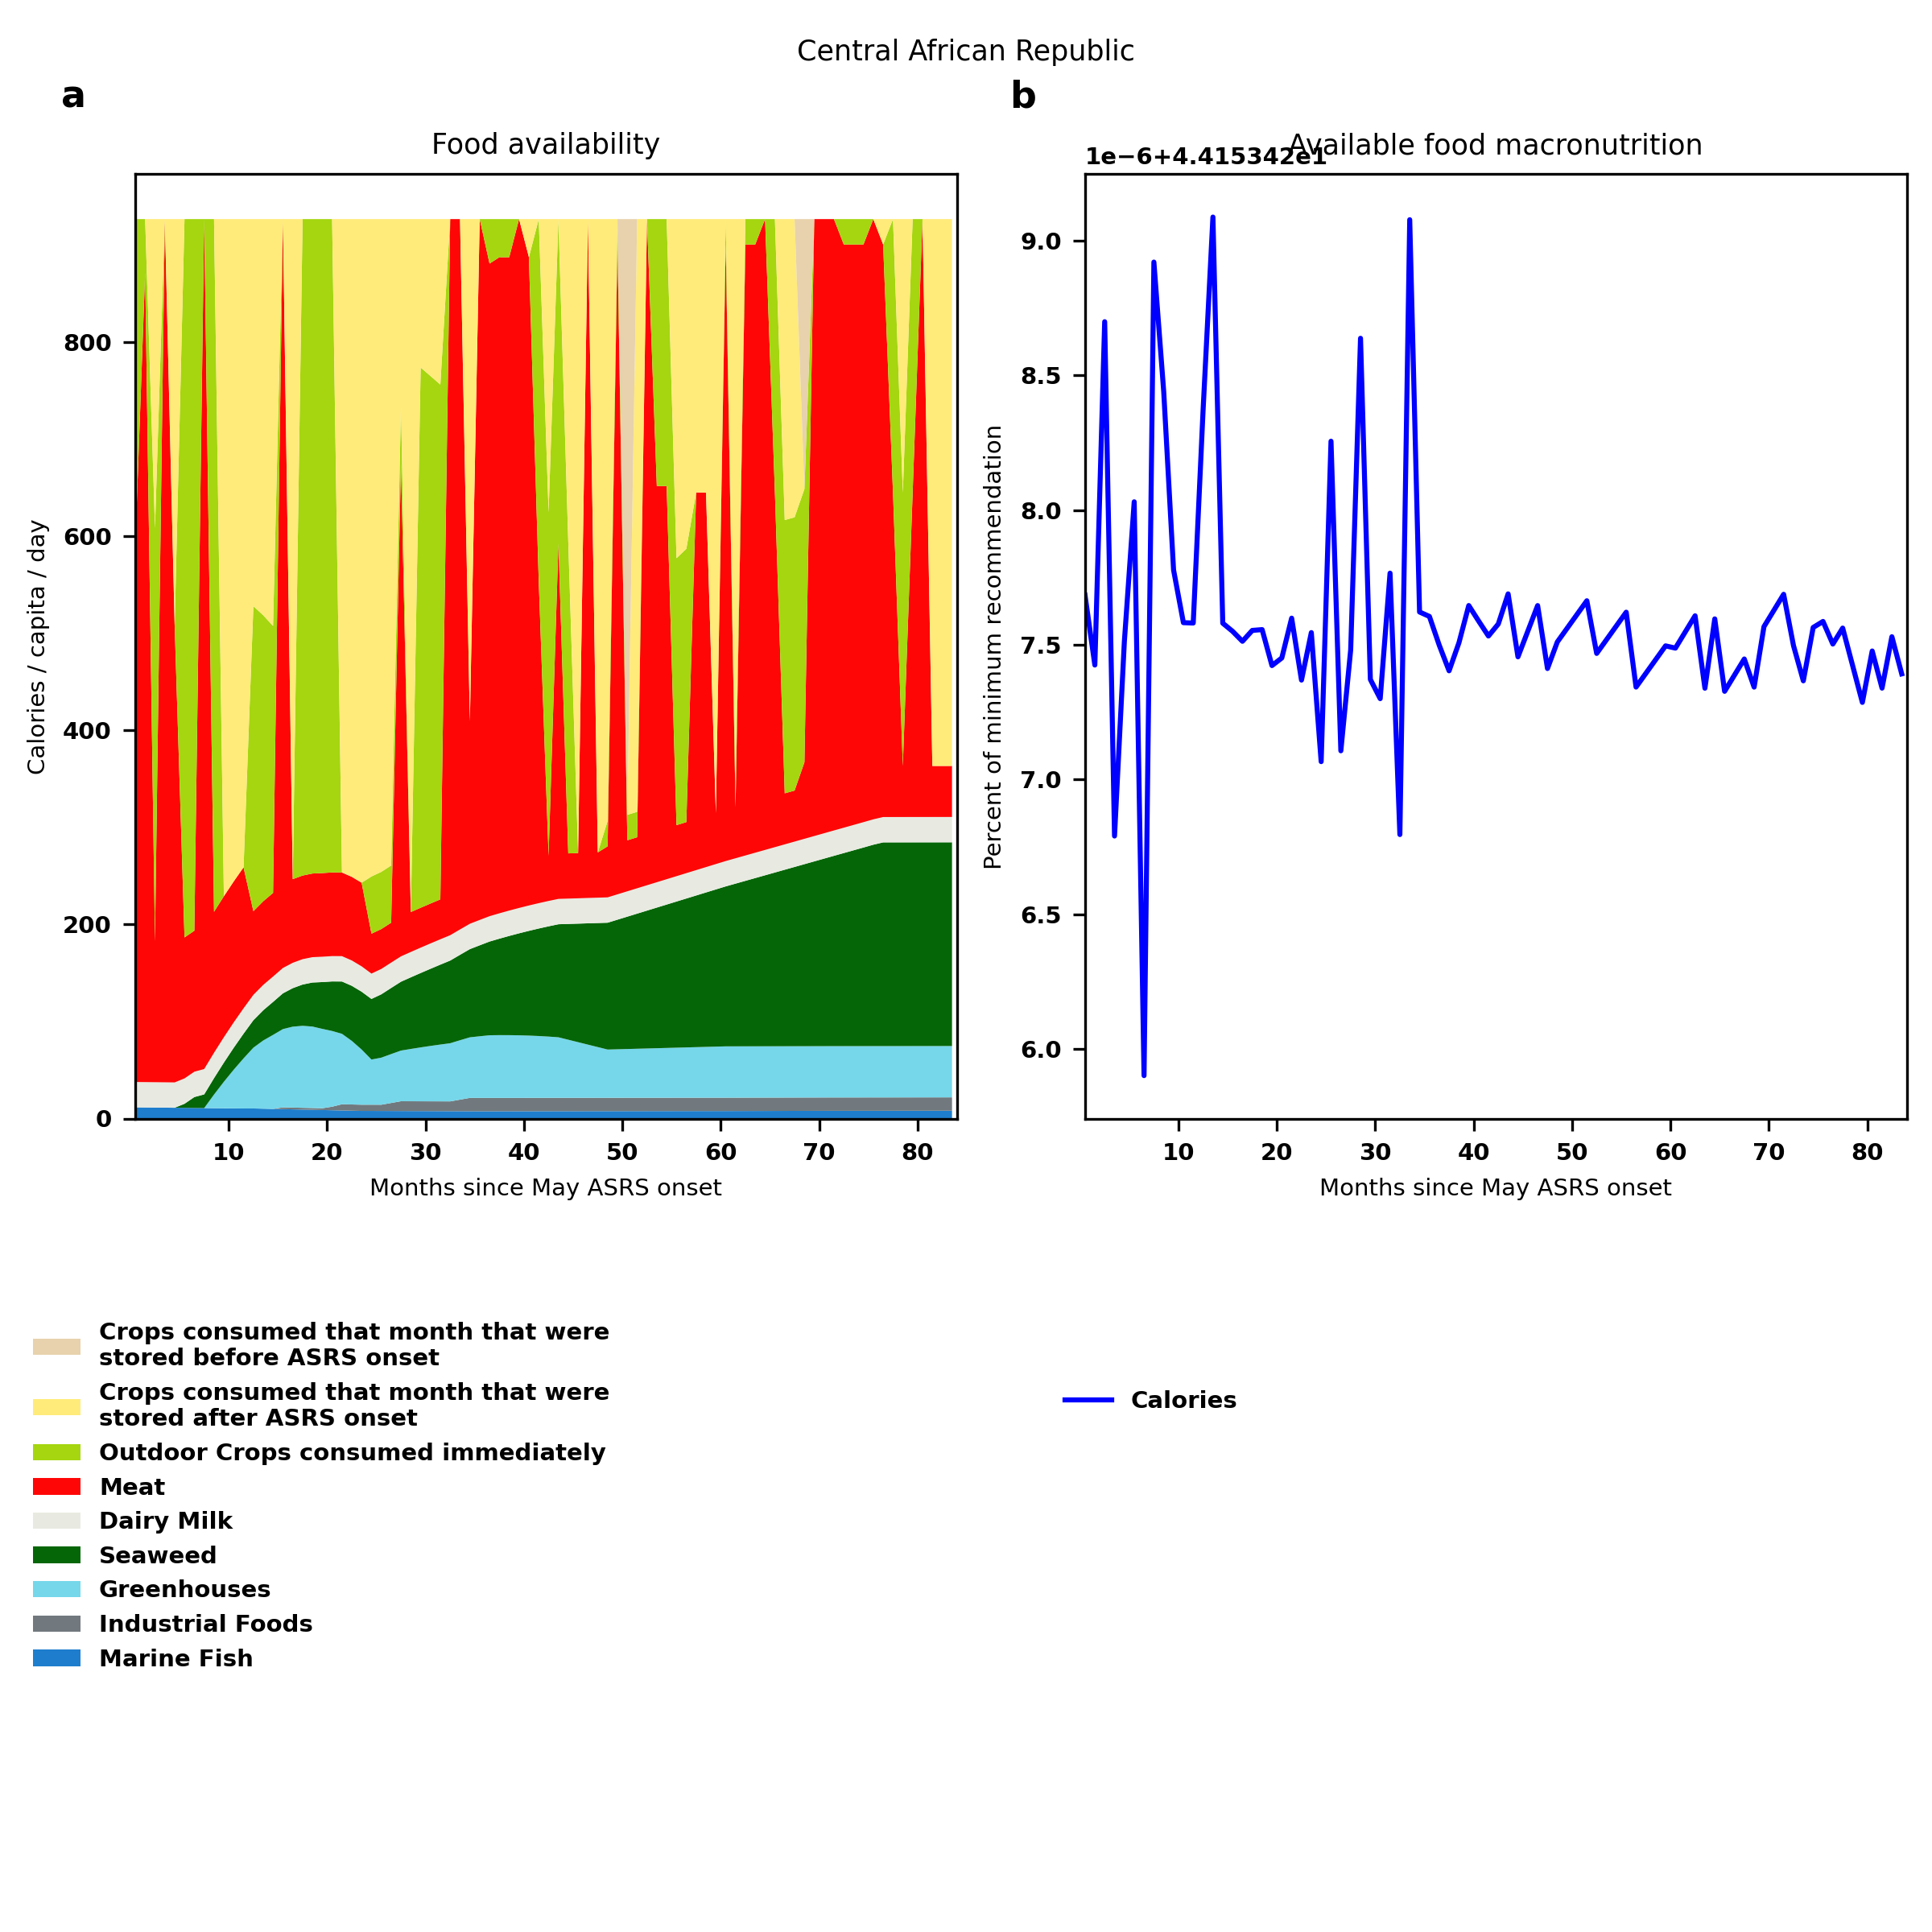
Central African Republic: Percent fed:44.2%
Scenario properties: no food trade 2month feed, 1month biofuel baseline waste minimum sufficient nutrition few stocks used normal crop seasons reduced fish nuclear winter crops don't include protein don't include fat cull animals use resilient foods dairy cow feed prioritized

Slide 29
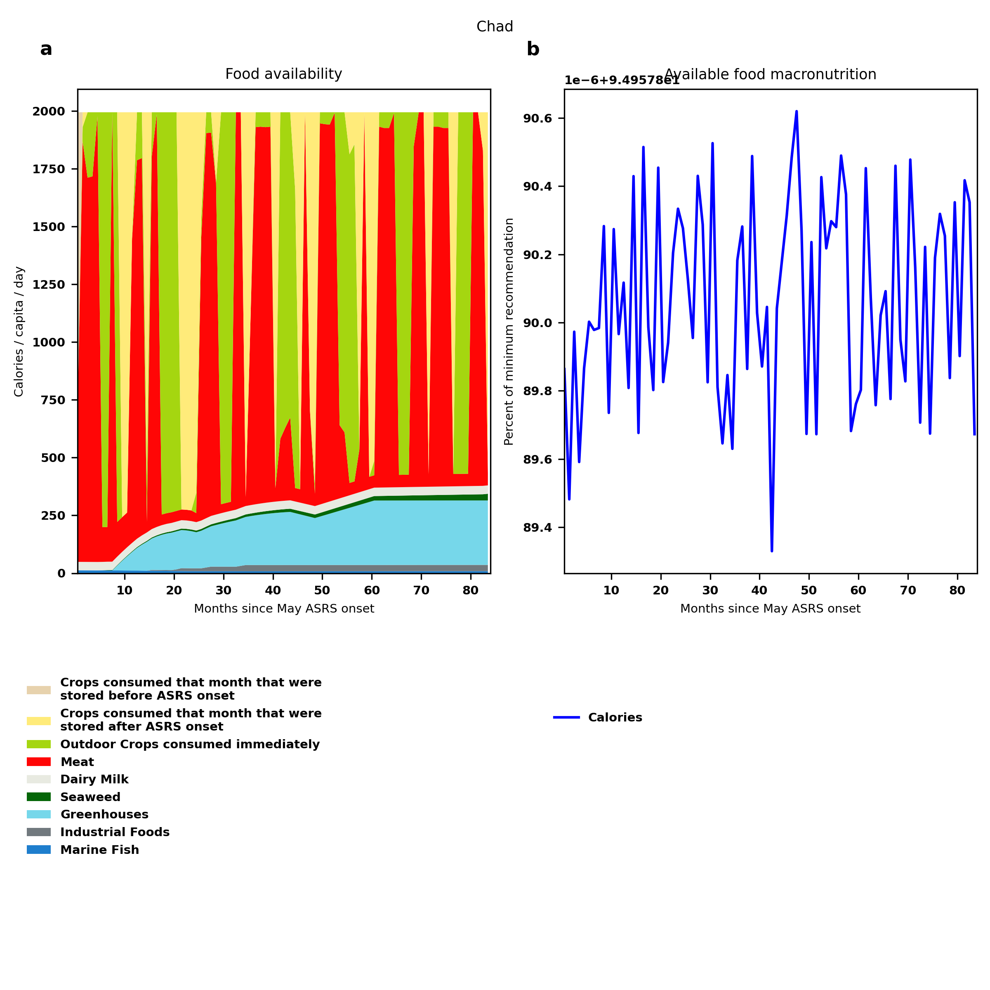
Chad: Percent fed:95.0%
Scenario properties: no food trade 2month feed, 1month biofuel baseline waste minimum sufficient nutrition few stocks used normal crop seasons reduced fish nuclear winter crops don't include protein don't include fat cull animals use resilient foods dairy cow feed prioritized

Slide 30
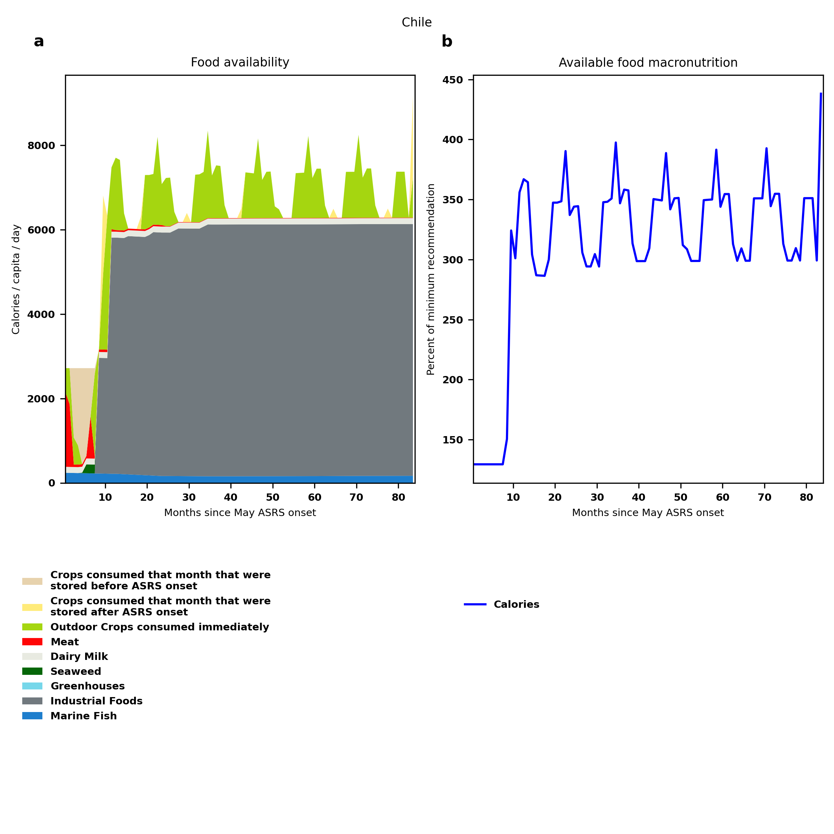
Chile: Percent fed:129.4%
Scenario properties: no food trade 2month feed, 1month biofuel baseline waste minimum sufficient nutrition few stocks used normal crop seasons reduced fish nuclear winter crops don't include protein don't include fat cull animals use resilient foods dairy cow feed prioritized

Slide 31
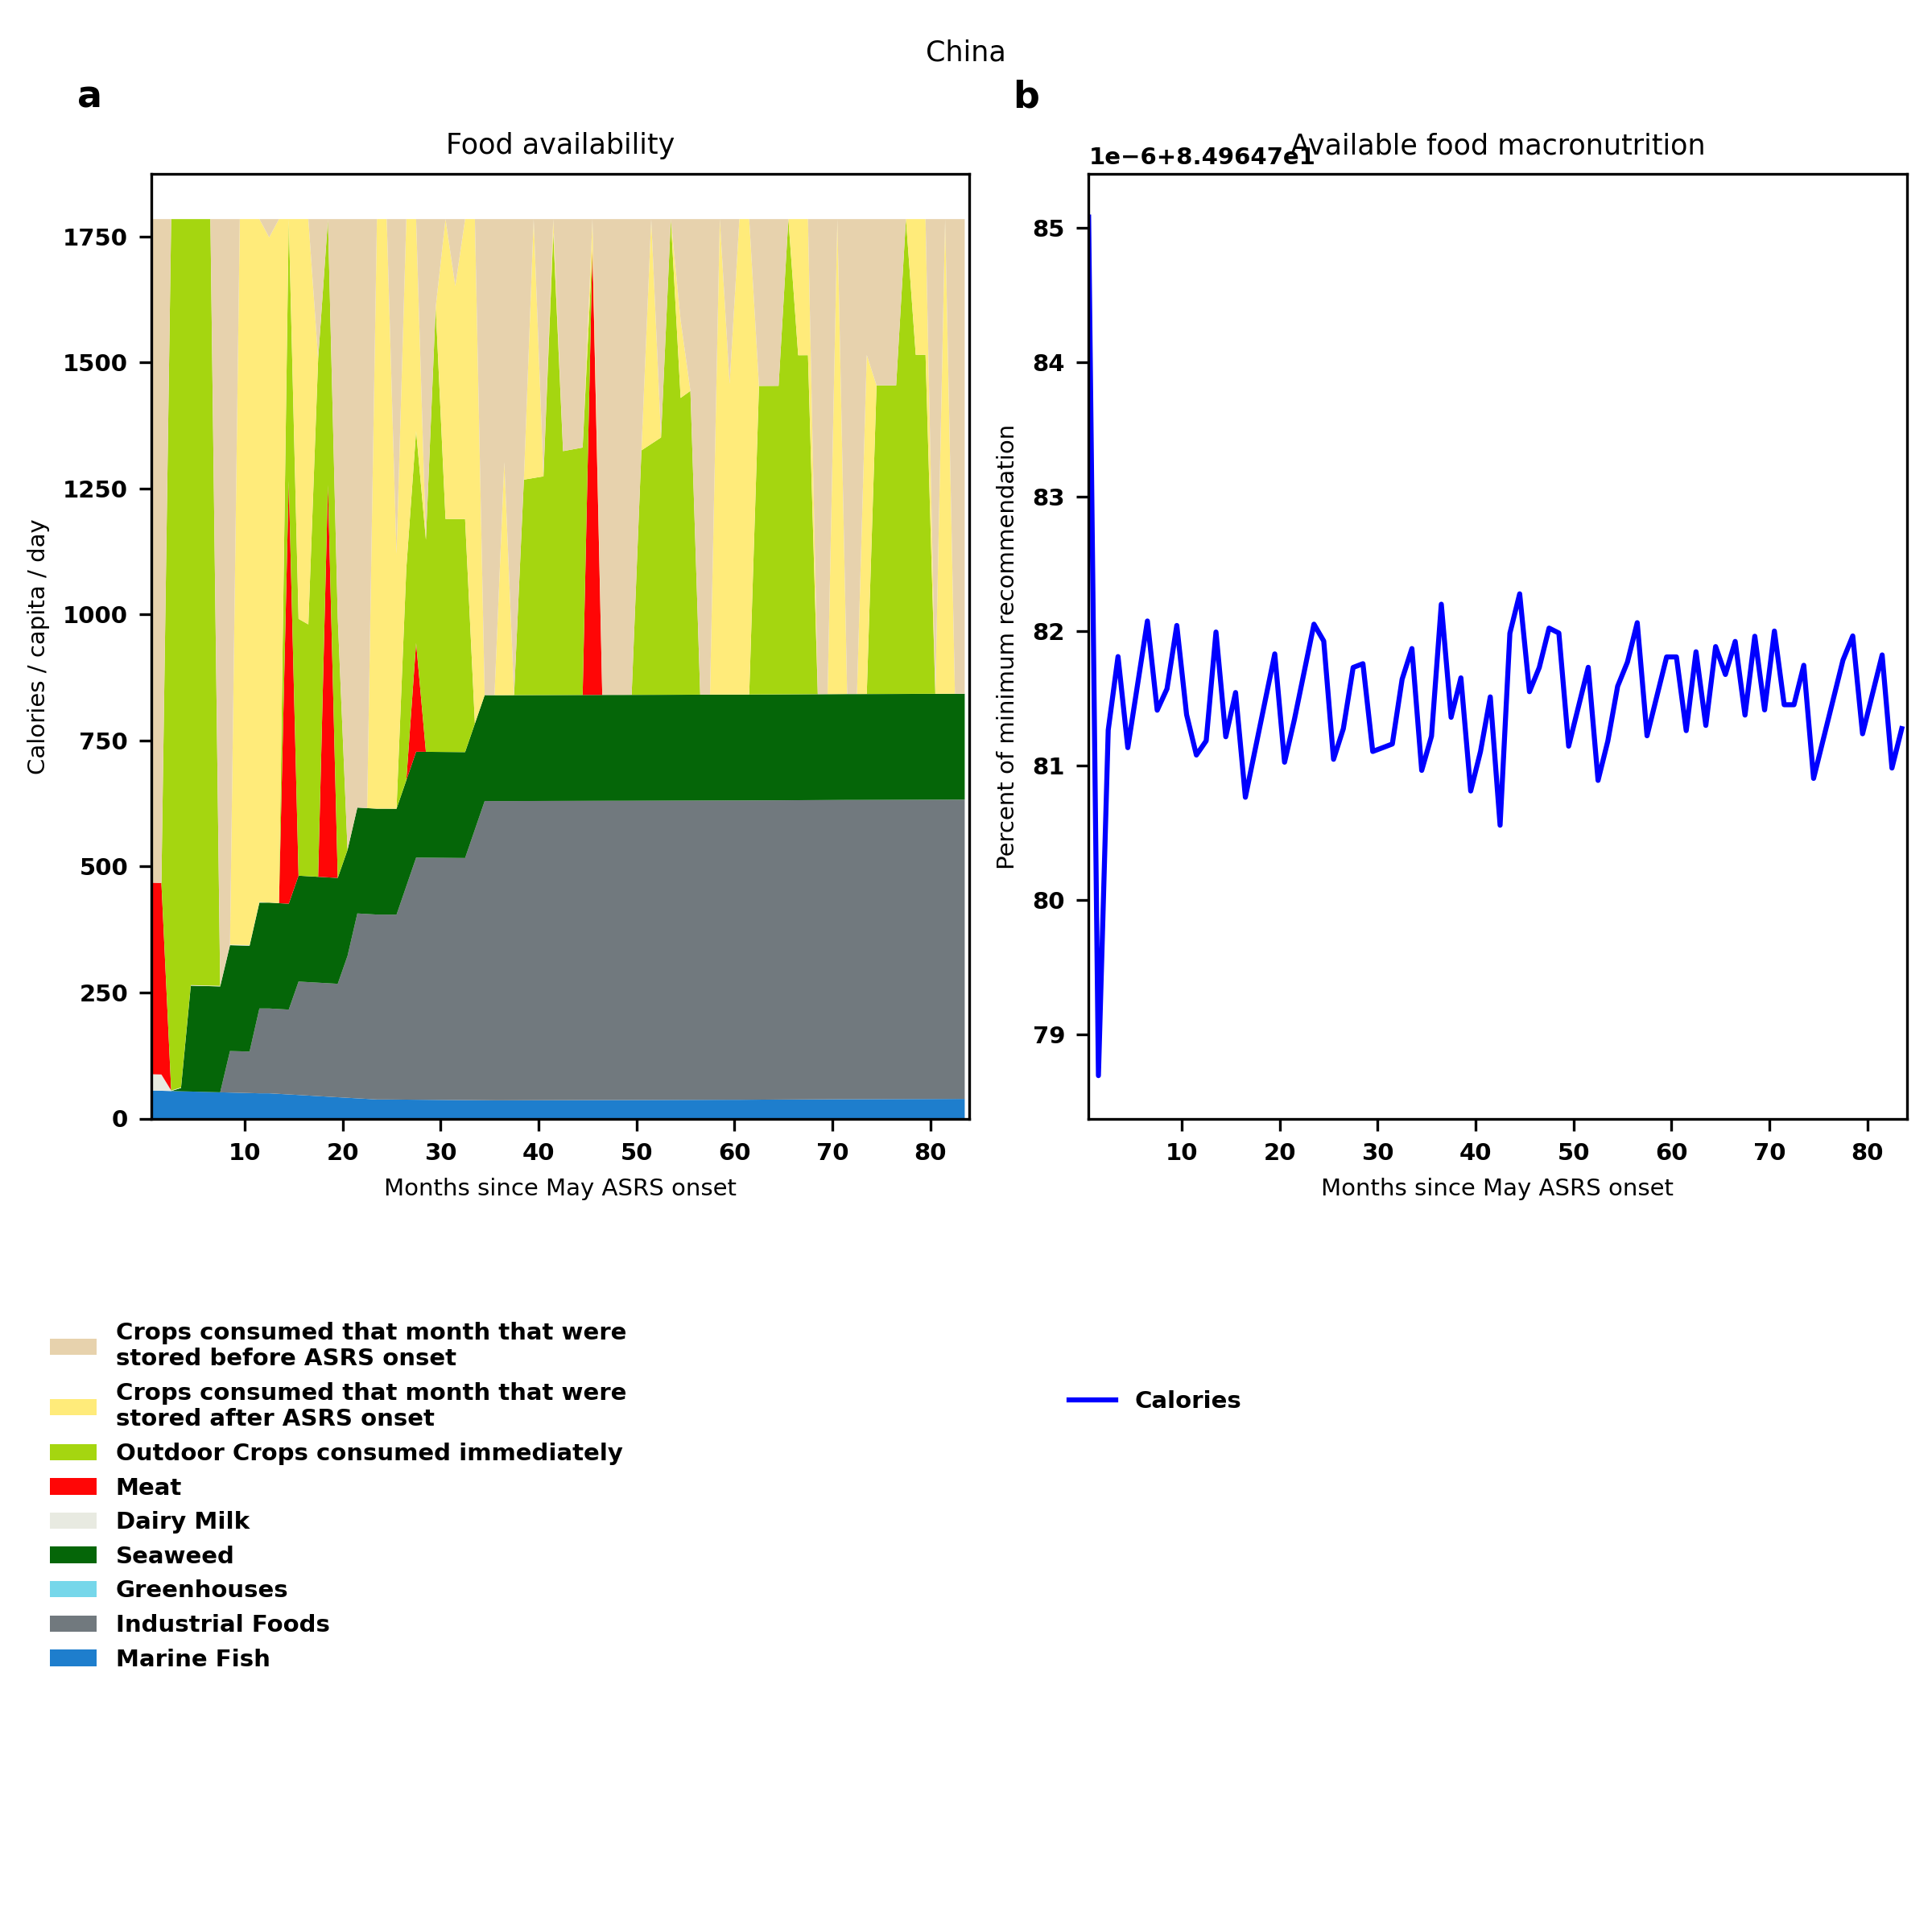
China: Percent fed:85.0%
Scenario properties: no food trade 2month feed, 1month biofuel baseline waste minimum sufficient nutrition few stocks used normal crop seasons reduced fish nuclear winter crops don't include protein don't include fat cull animals use resilient foods dairy cow feed prioritized

Slide 32
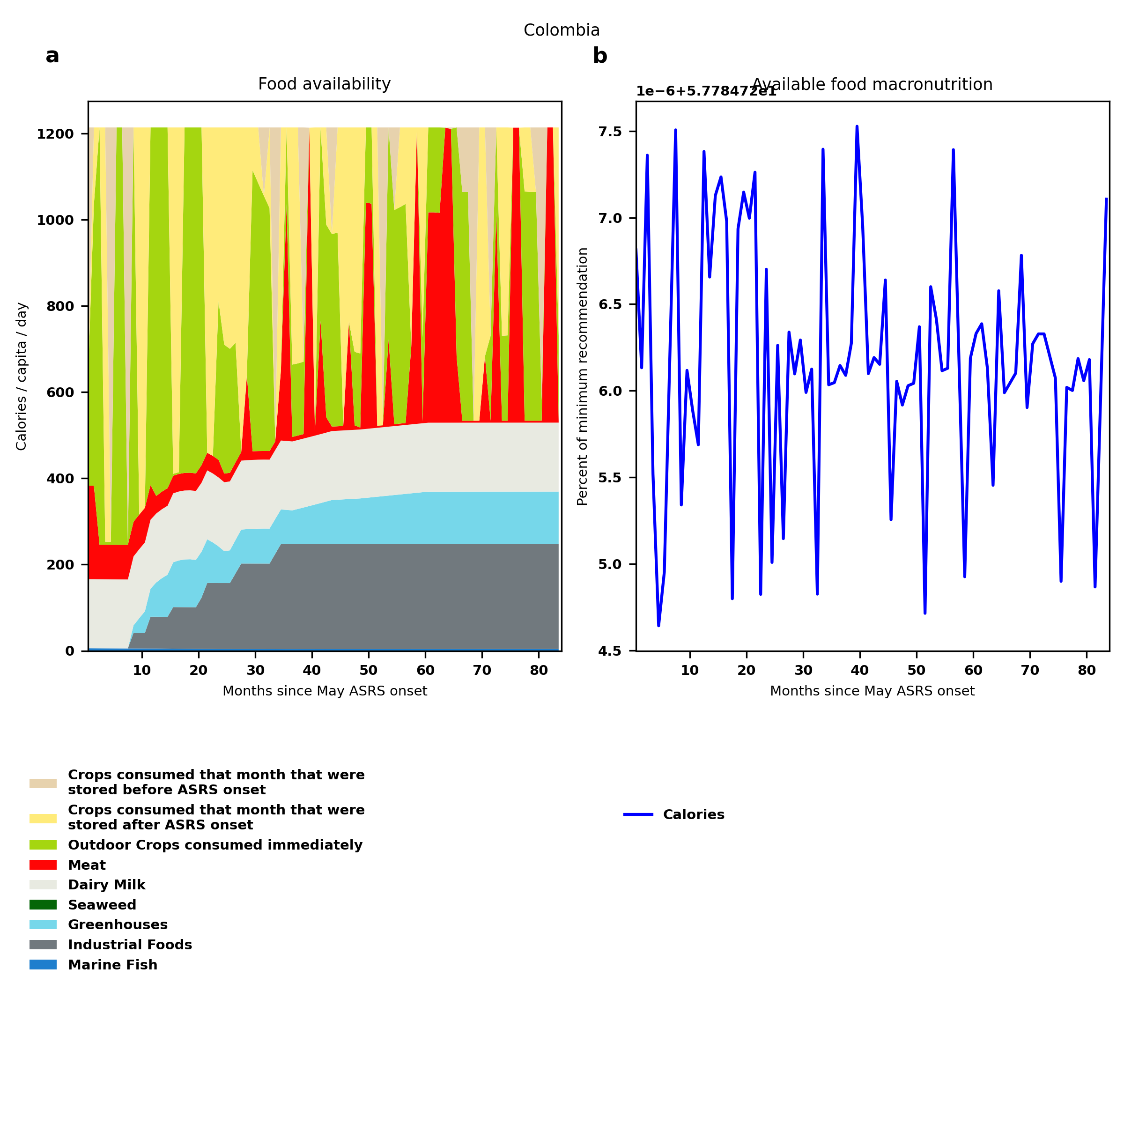
Colombia: Percent fed:57.8%
Scenario properties: no food trade 2month feed, 1month biofuel baseline waste minimum sufficient nutrition few stocks used normal crop seasons reduced fish nuclear winter crops don't include protein don't include fat cull animals use resilient foods dairy cow feed prioritized

Slide 33
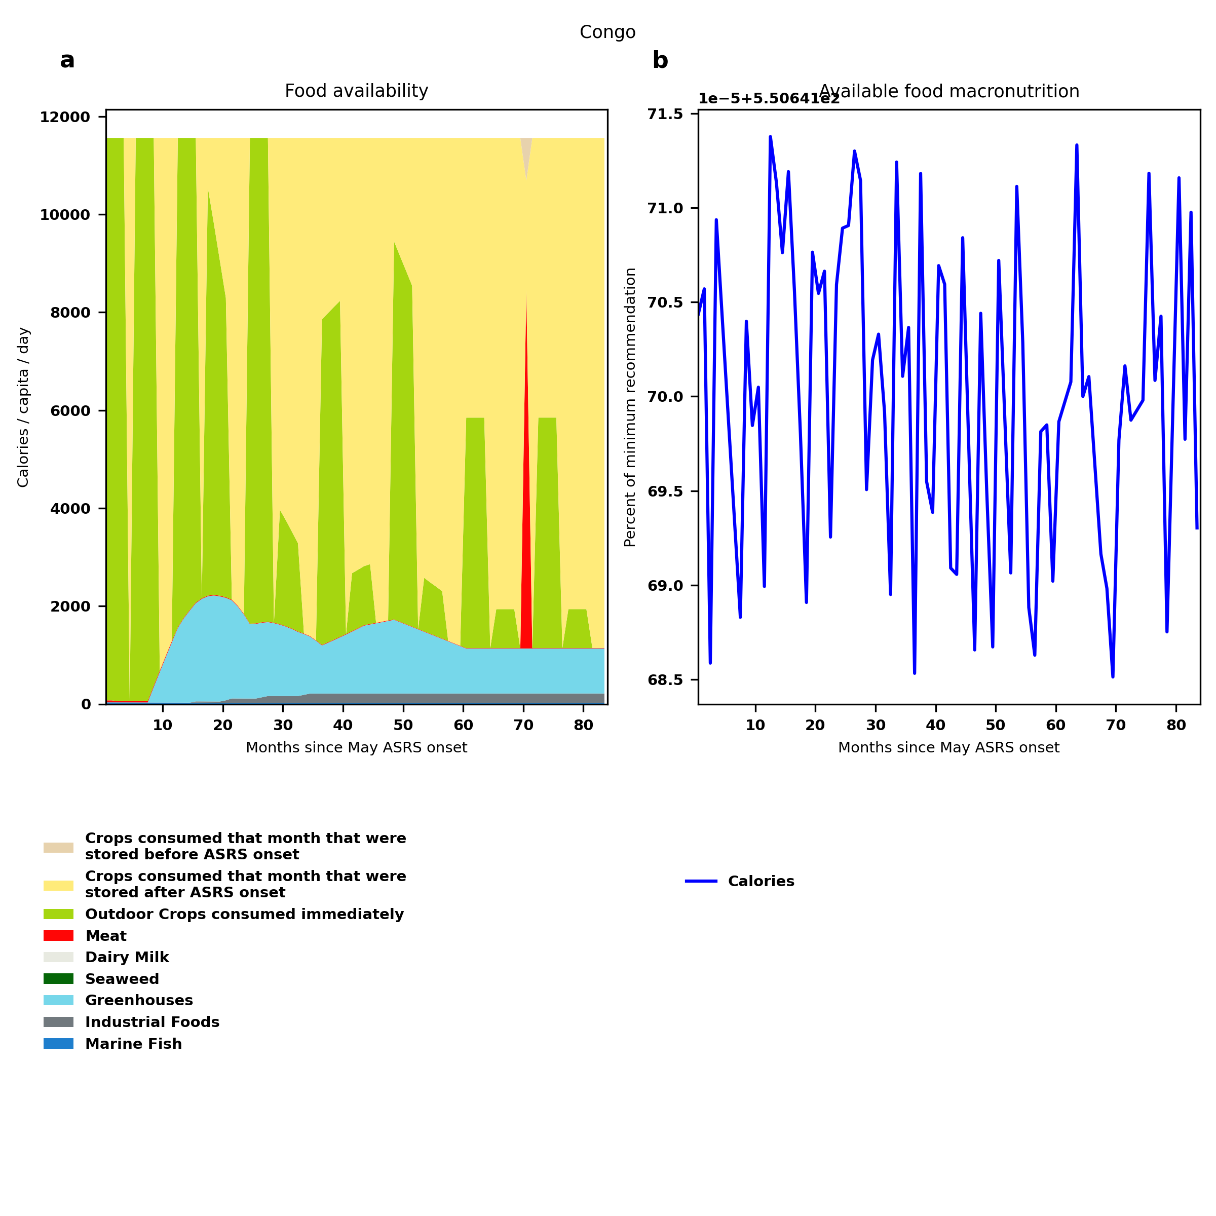
Congo: Percent fed:550.6%
Scenario properties: no food trade 2month feed, 1month biofuel baseline waste minimum sufficient nutrition few stocks used normal crop seasons reduced fish nuclear winter crops don't include protein don't include fat cull animals use resilient foods dairy cow feed prioritized

Slide 34
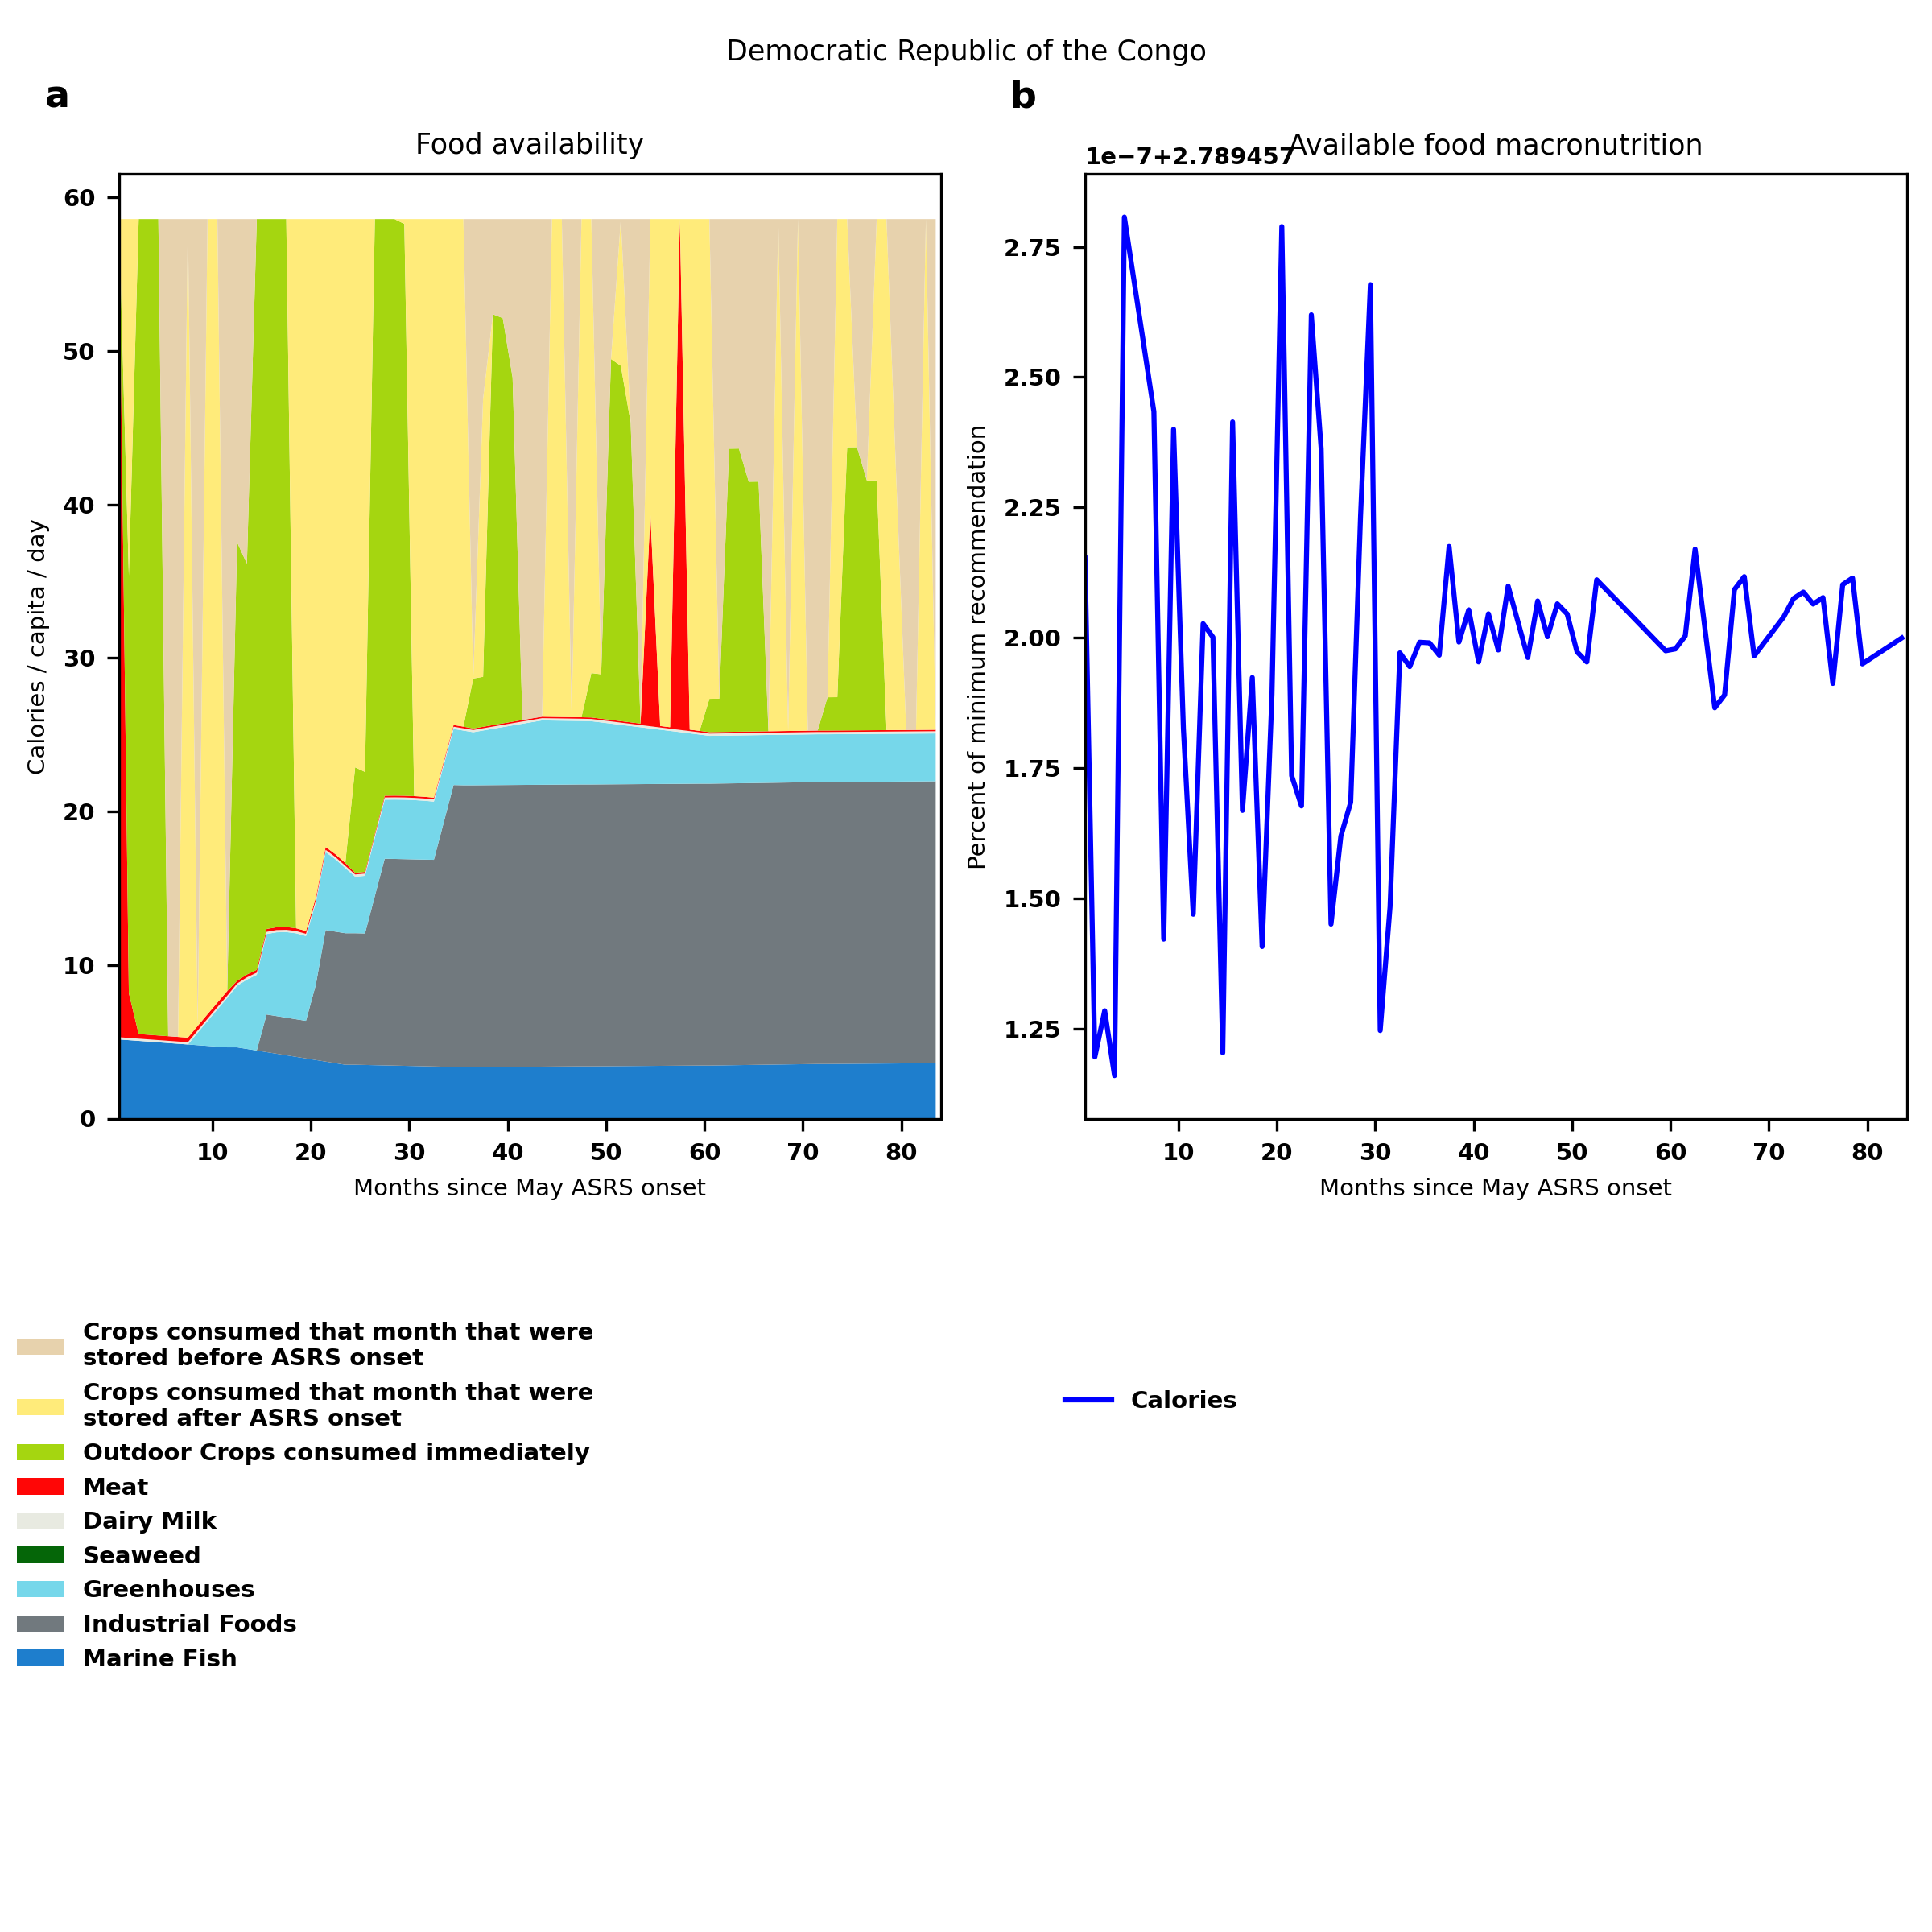
Democratic Republic of the Congo: Percent fed:2.8%
Scenario properties: no food trade 2month feed, 1month biofuel baseline waste minimum sufficient nutrition few stocks used normal crop seasons reduced fish nuclear winter crops don't include protein don't include fat cull animals use resilient foods dairy cow feed prioritized

Slide 35
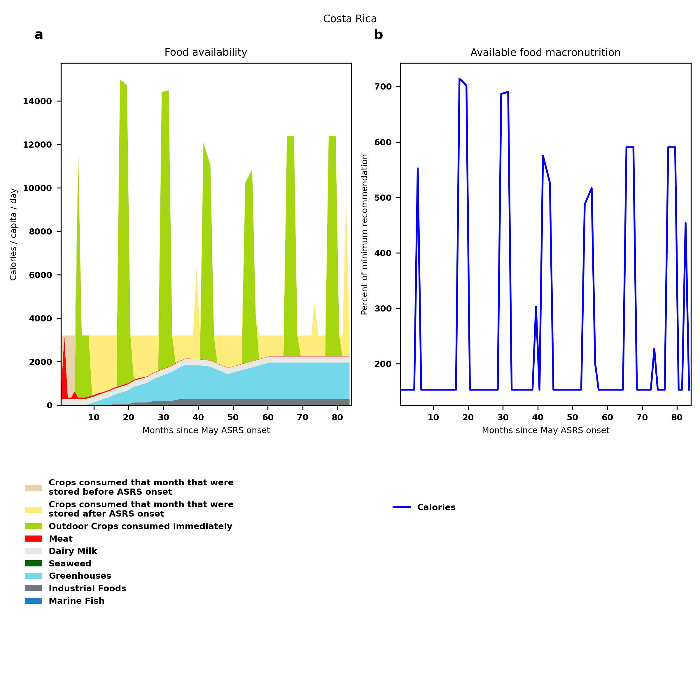
Costa Rica: Percent fed:152.9%
Scenario properties: no food trade 2month feed, 1month biofuel baseline waste minimum sufficient nutrition few stocks used normal crop seasons reduced fish nuclear winter crops don't include protein don't include fat cull animals use resilient foods dairy cow feed prioritized

Slide 36
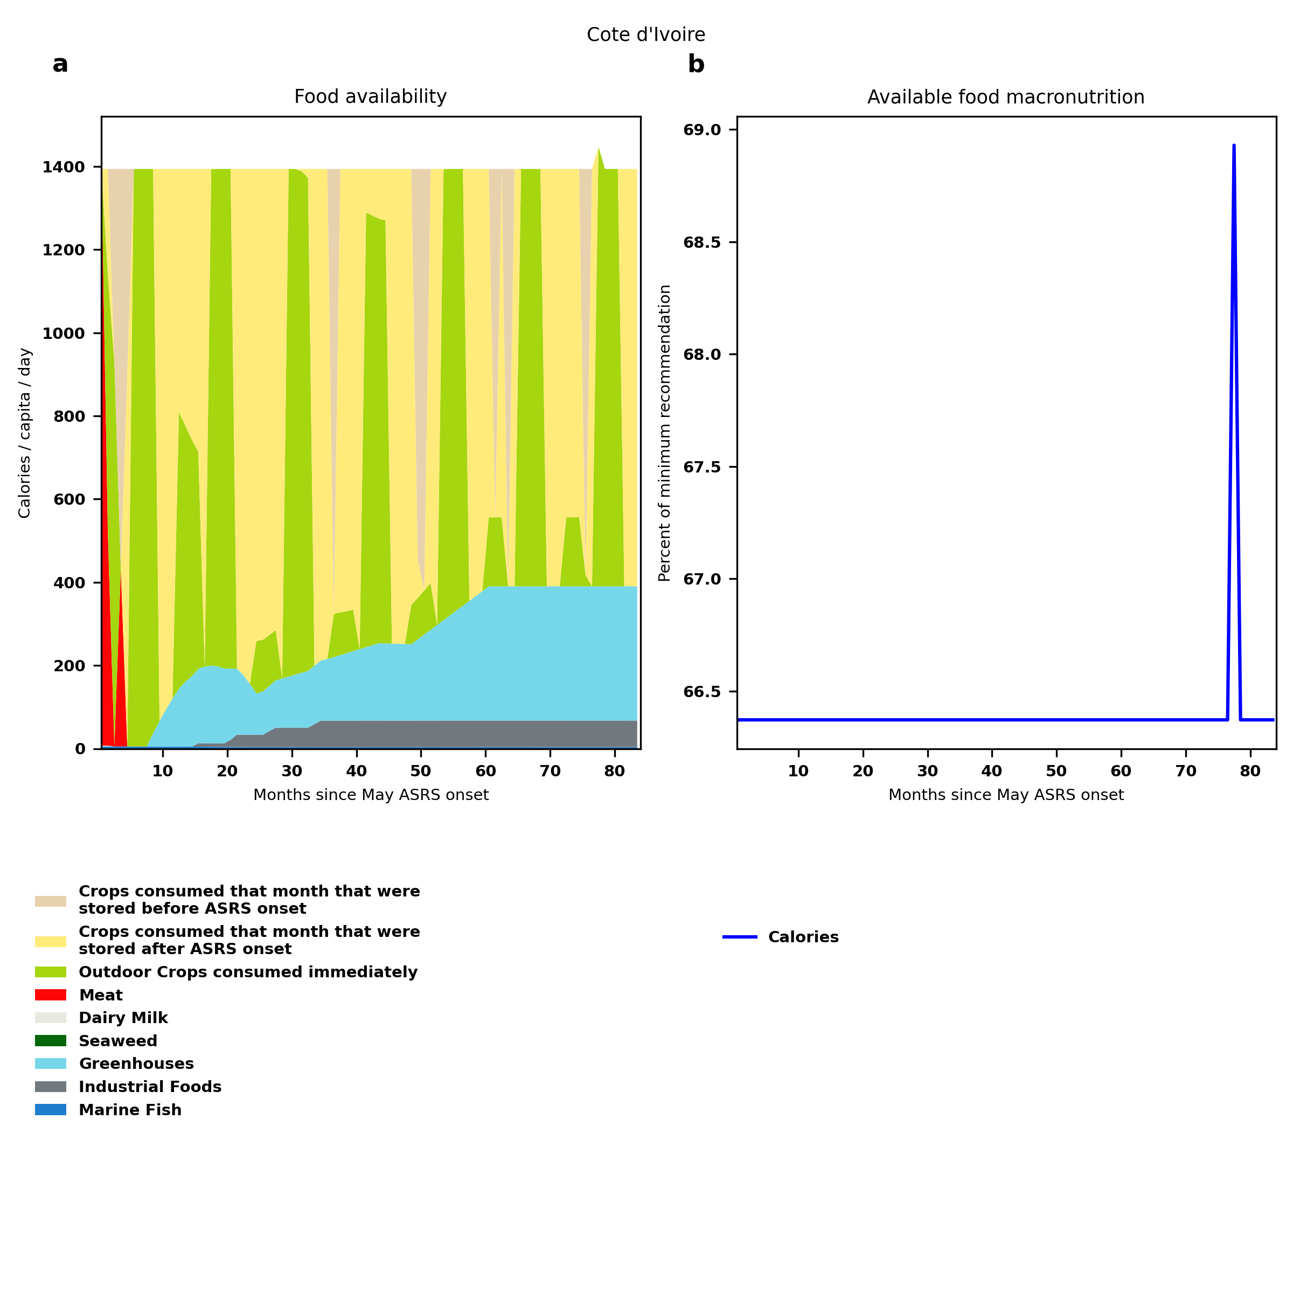
Cote d'Ivoire: Percent fed:66.4%
Scenario properties: no food trade 2month feed, 1month biofuel baseline waste minimum sufficient nutrition few stocks used normal crop seasons reduced fish nuclear winter crops don't include protein don't include fat cull animals use resilient foods dairy cow feed prioritized

Slide 37
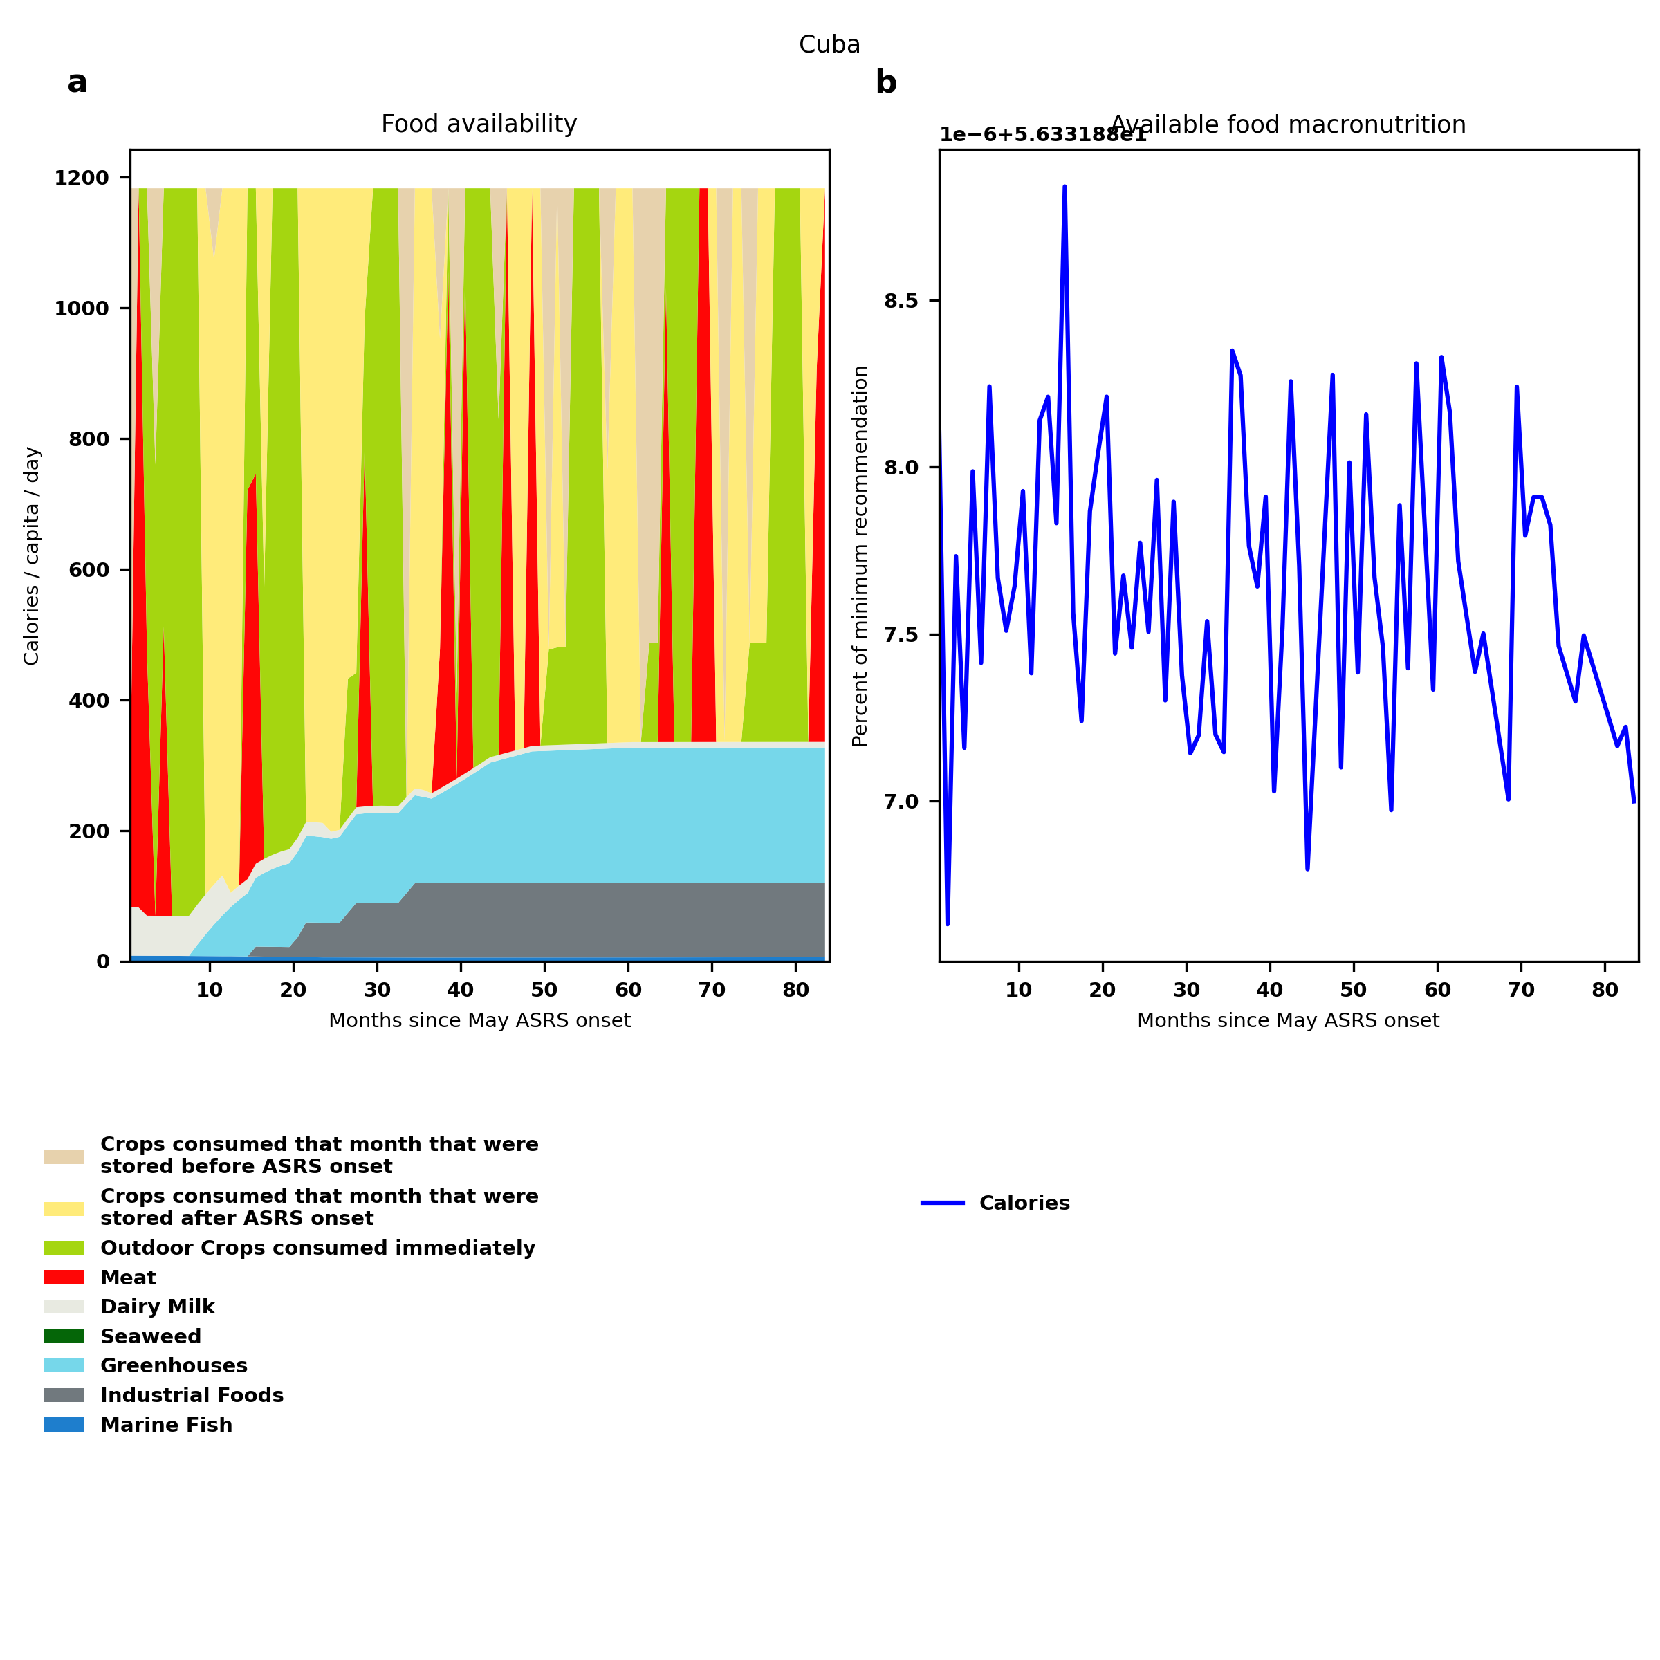
Cuba: Percent fed:56.3%
Scenario properties: no food trade 2month feed, 1month biofuel baseline waste minimum sufficient nutrition few stocks used normal crop seasons reduced fish nuclear winter crops don't include protein don't include fat cull animals use resilient foods dairy cow feed prioritized

Slide 38
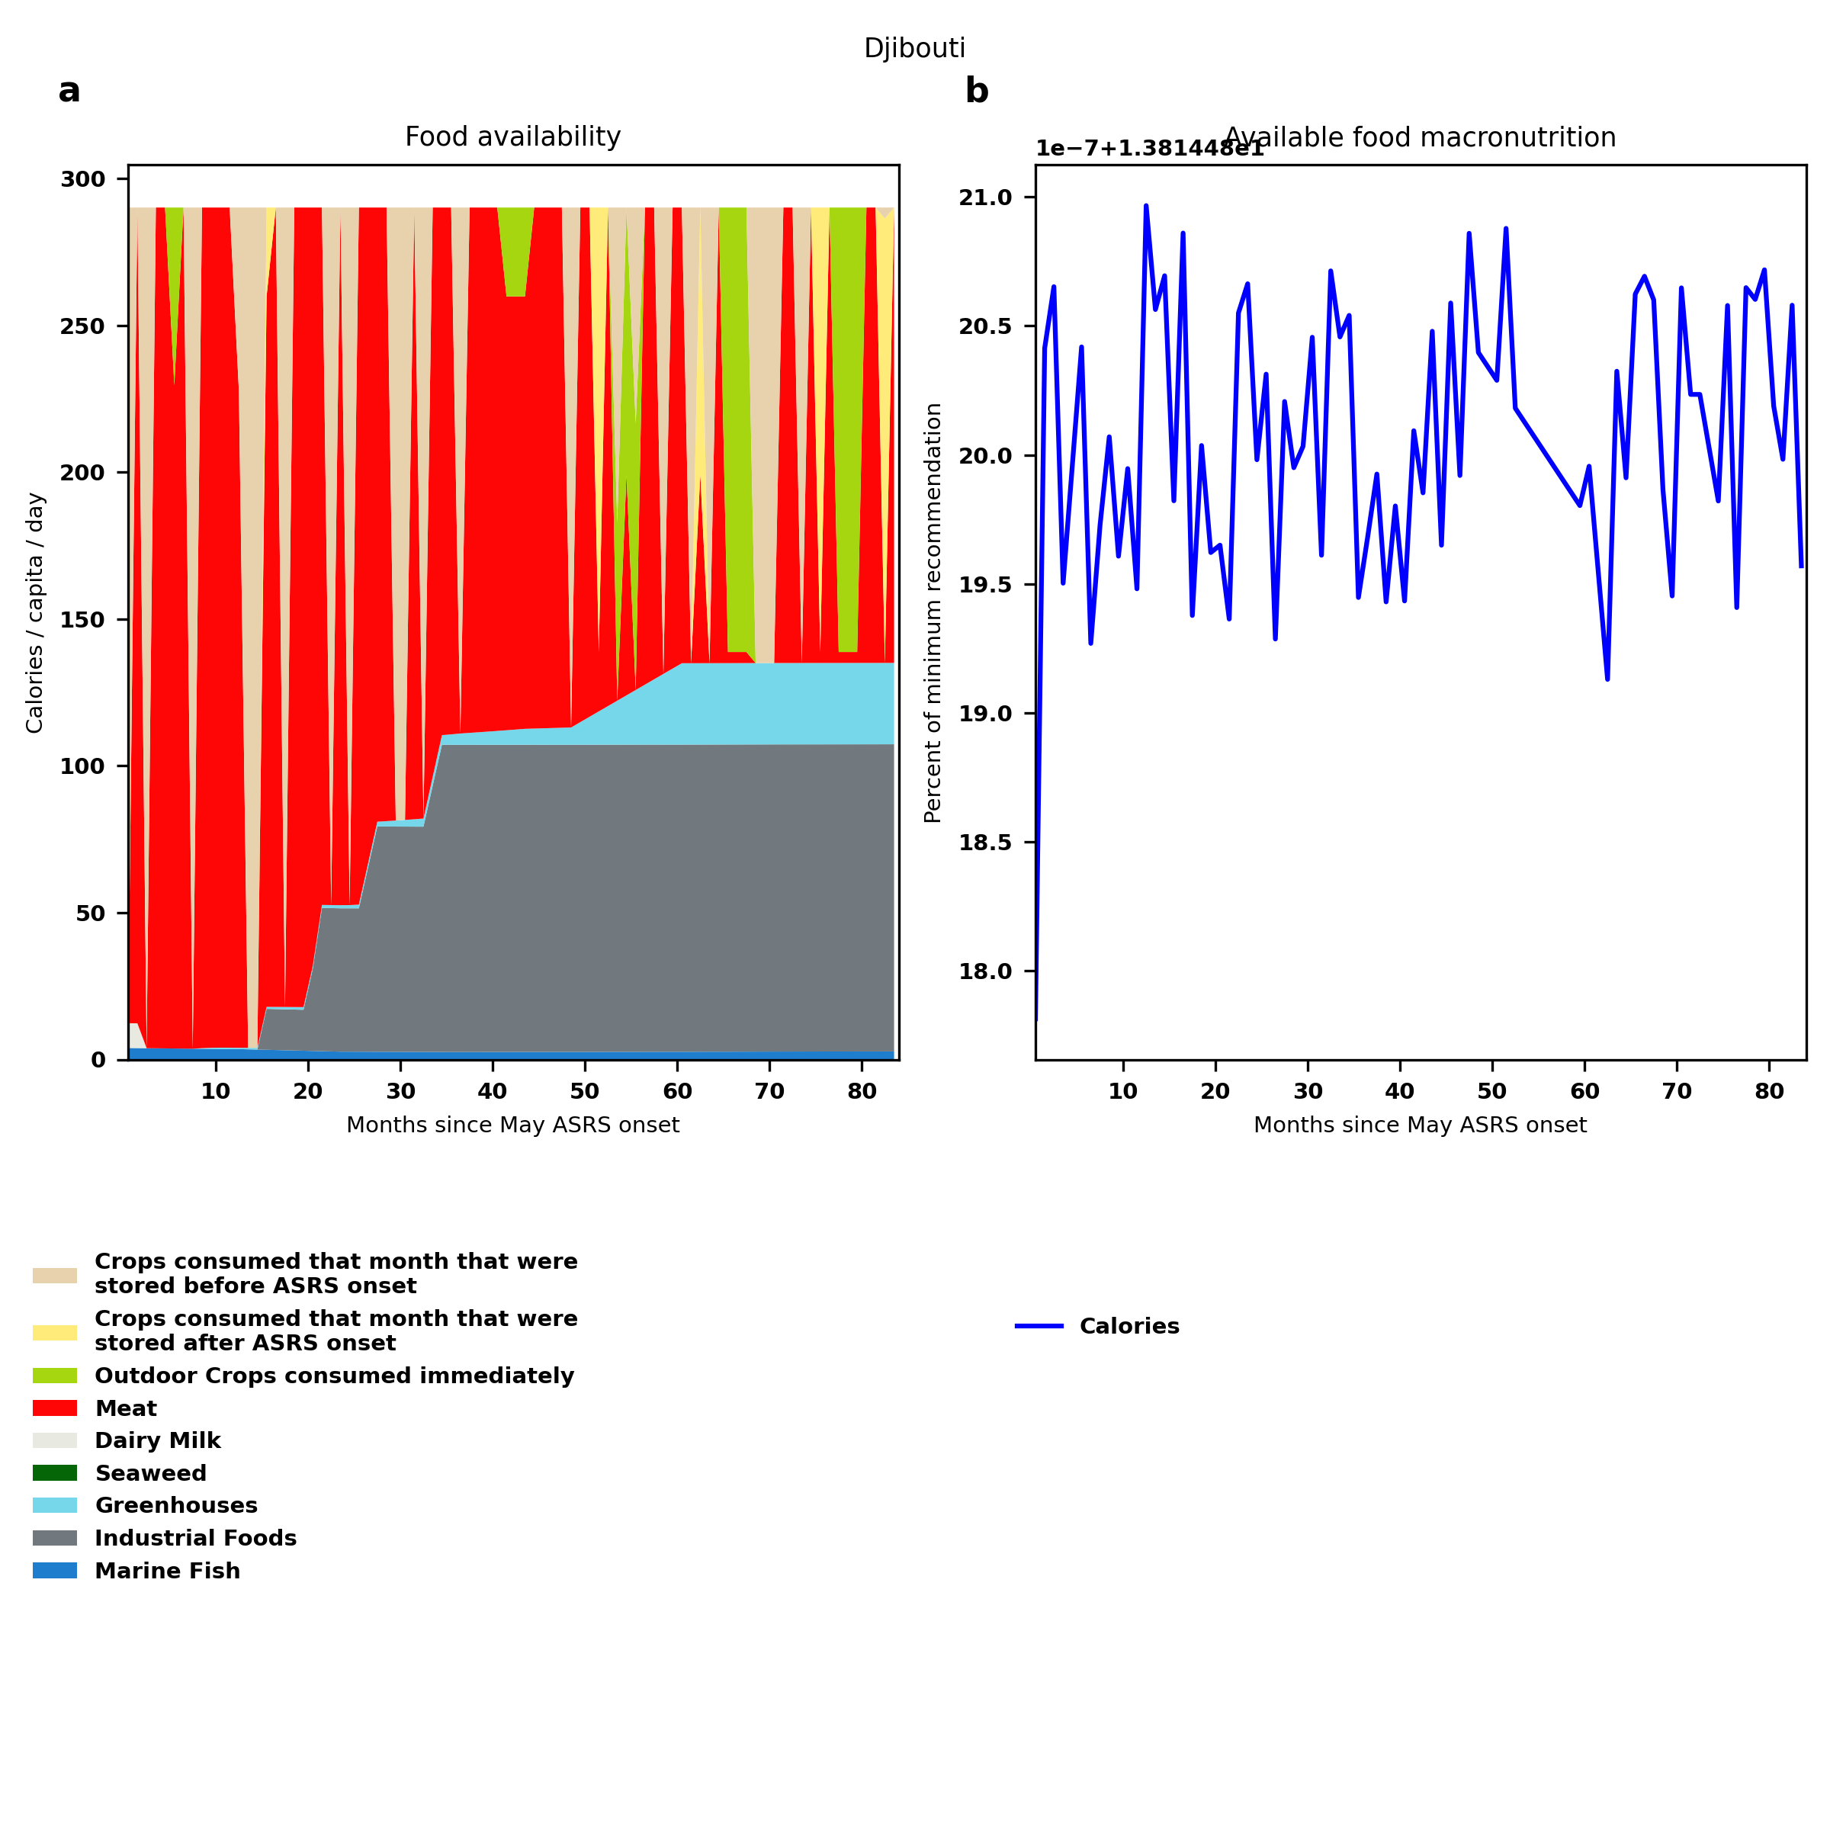
Djibouti: Percent fed:13.8%
Scenario properties: no food trade 2month feed, 1month biofuel baseline waste minimum sufficient nutrition few stocks used normal crop seasons reduced fish nuclear winter crops don't include protein don't include fat cull animals use resilient foods dairy cow feed prioritized

Slide 39
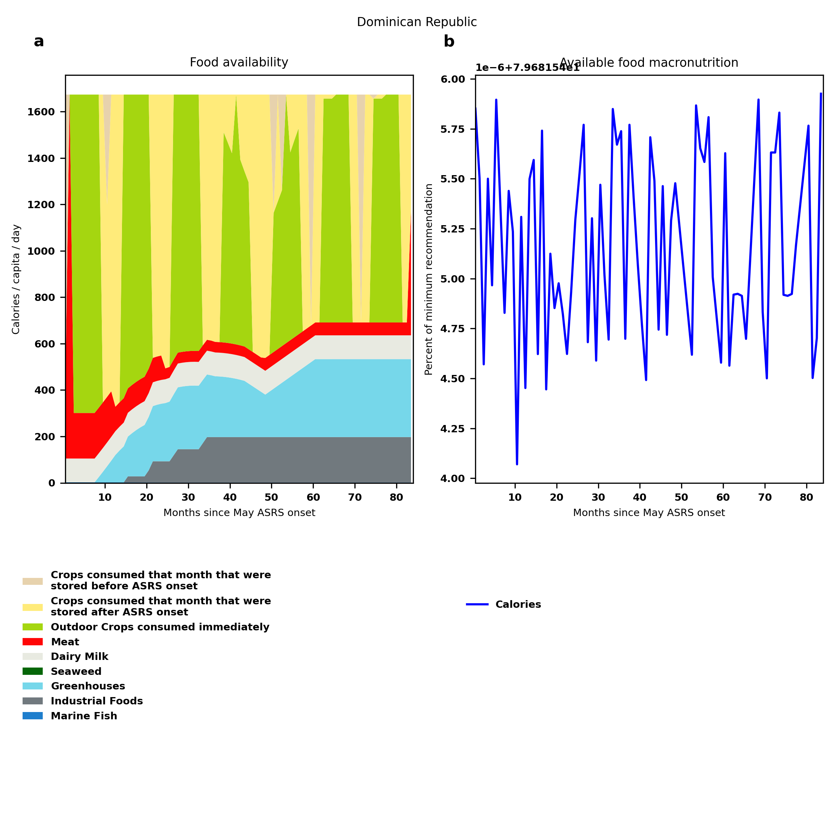
Dominican Republic: Percent fed:79.7%
Scenario properties: no food trade 2month feed, 1month biofuel baseline waste minimum sufficient nutrition few stocks used normal crop seasons reduced fish nuclear winter crops don't include protein don't include fat cull animals use resilient foods dairy cow feed prioritized

Slide 40
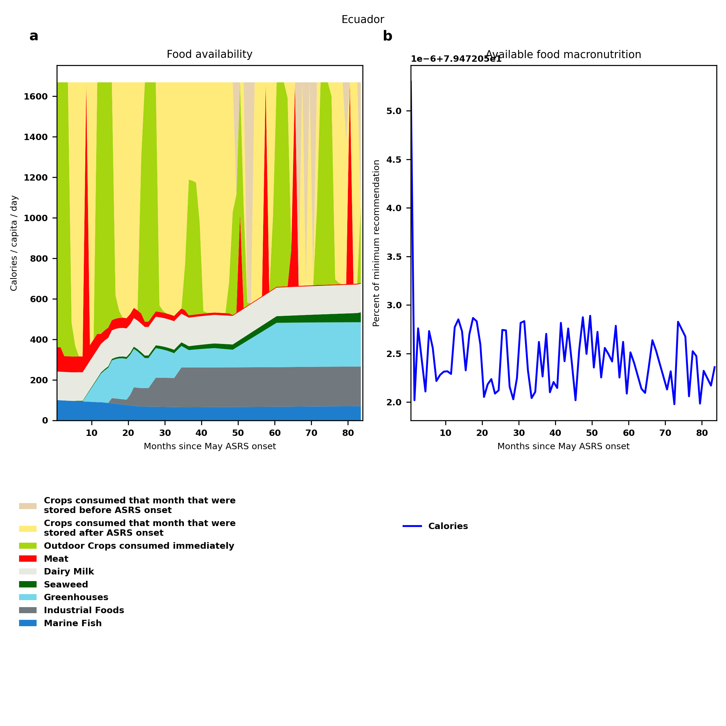
Ecuador: Percent fed:79.5%
Scenario properties: no food trade 2month feed, 1month biofuel baseline waste minimum sufficient nutrition few stocks used normal crop seasons reduced fish nuclear winter crops don't include protein don't include fat cull animals use resilient foods dairy cow feed prioritized

Slide 41
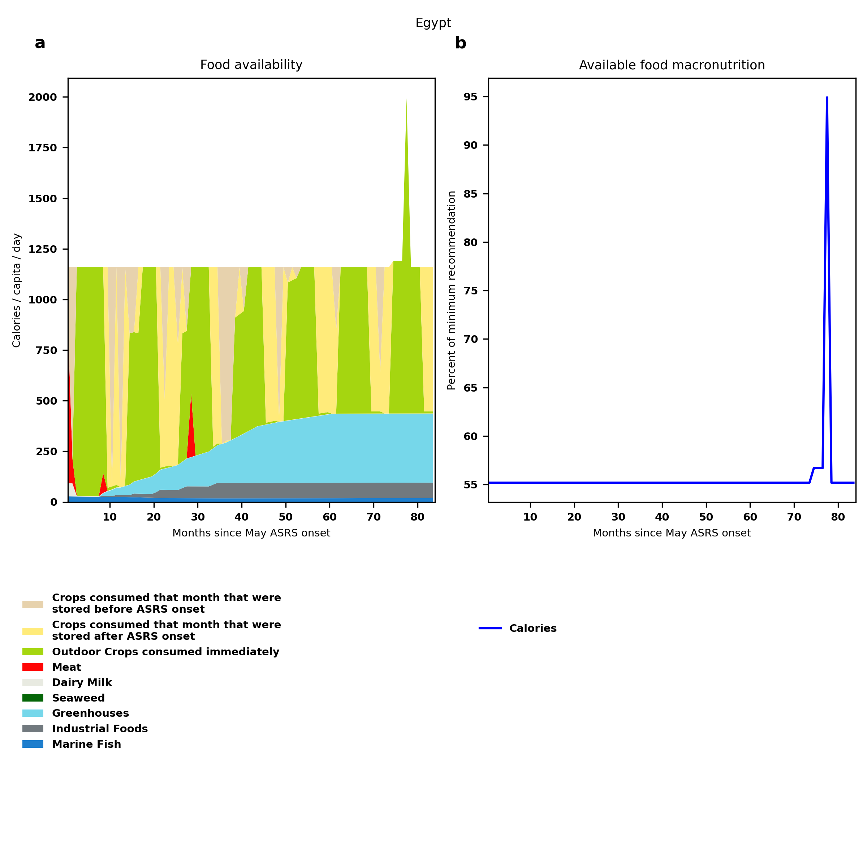
Egypt: Percent fed:55.2%
Scenario properties: no food trade 2month feed, 1month biofuel baseline waste minimum sufficient nutrition few stocks used normal crop seasons reduced fish nuclear winter crops don't include protein don't include fat cull animals use resilient foods dairy cow feed prioritized

Slide 42
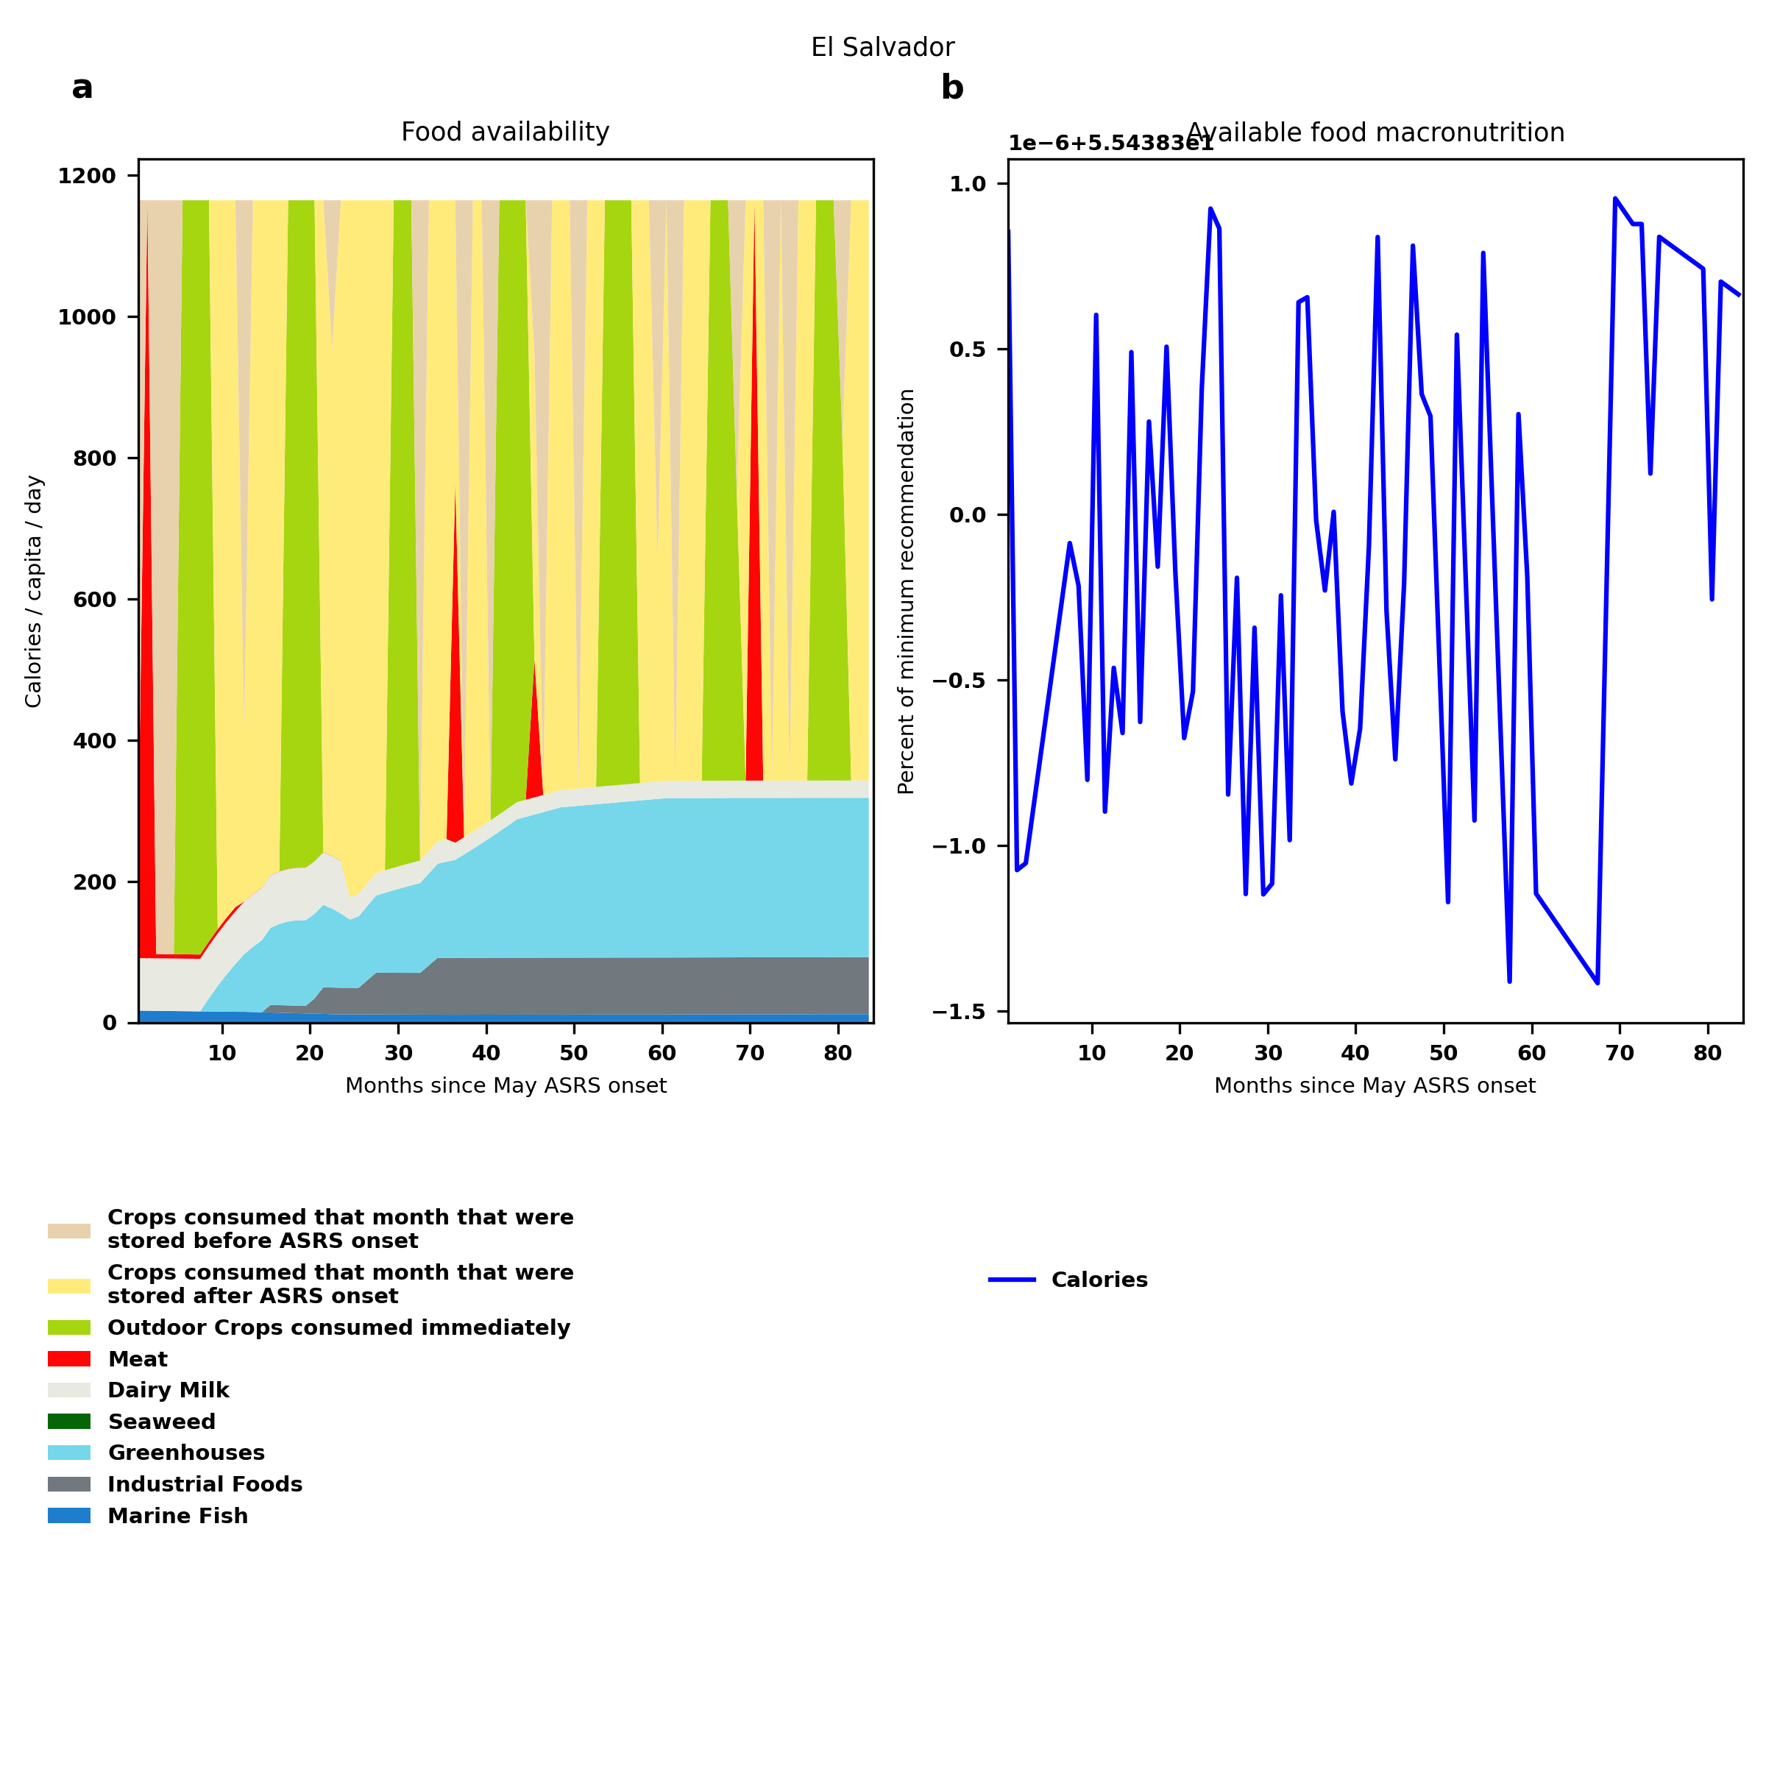
El Salvador: Percent fed:55.4%
Scenario properties: no food trade 2month feed, 1month biofuel baseline waste minimum sufficient nutrition few stocks used normal crop seasons reduced fish nuclear winter crops don't include protein don't include fat cull animals use resilient foods dairy cow feed prioritized

Slide 43
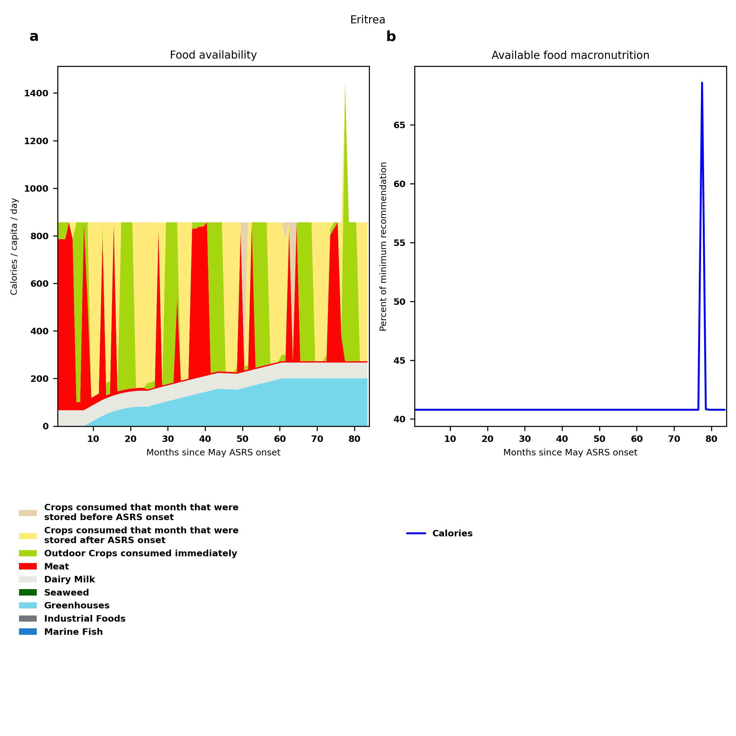
Eritrea: Percent fed:40.8%
Scenario properties: no food trade 2month feed, 1month biofuel baseline waste minimum sufficient nutrition few stocks used normal crop seasons reduced fish nuclear winter crops don't include protein don't include fat cull animals use resilient foods dairy cow feed prioritized

Slide 44
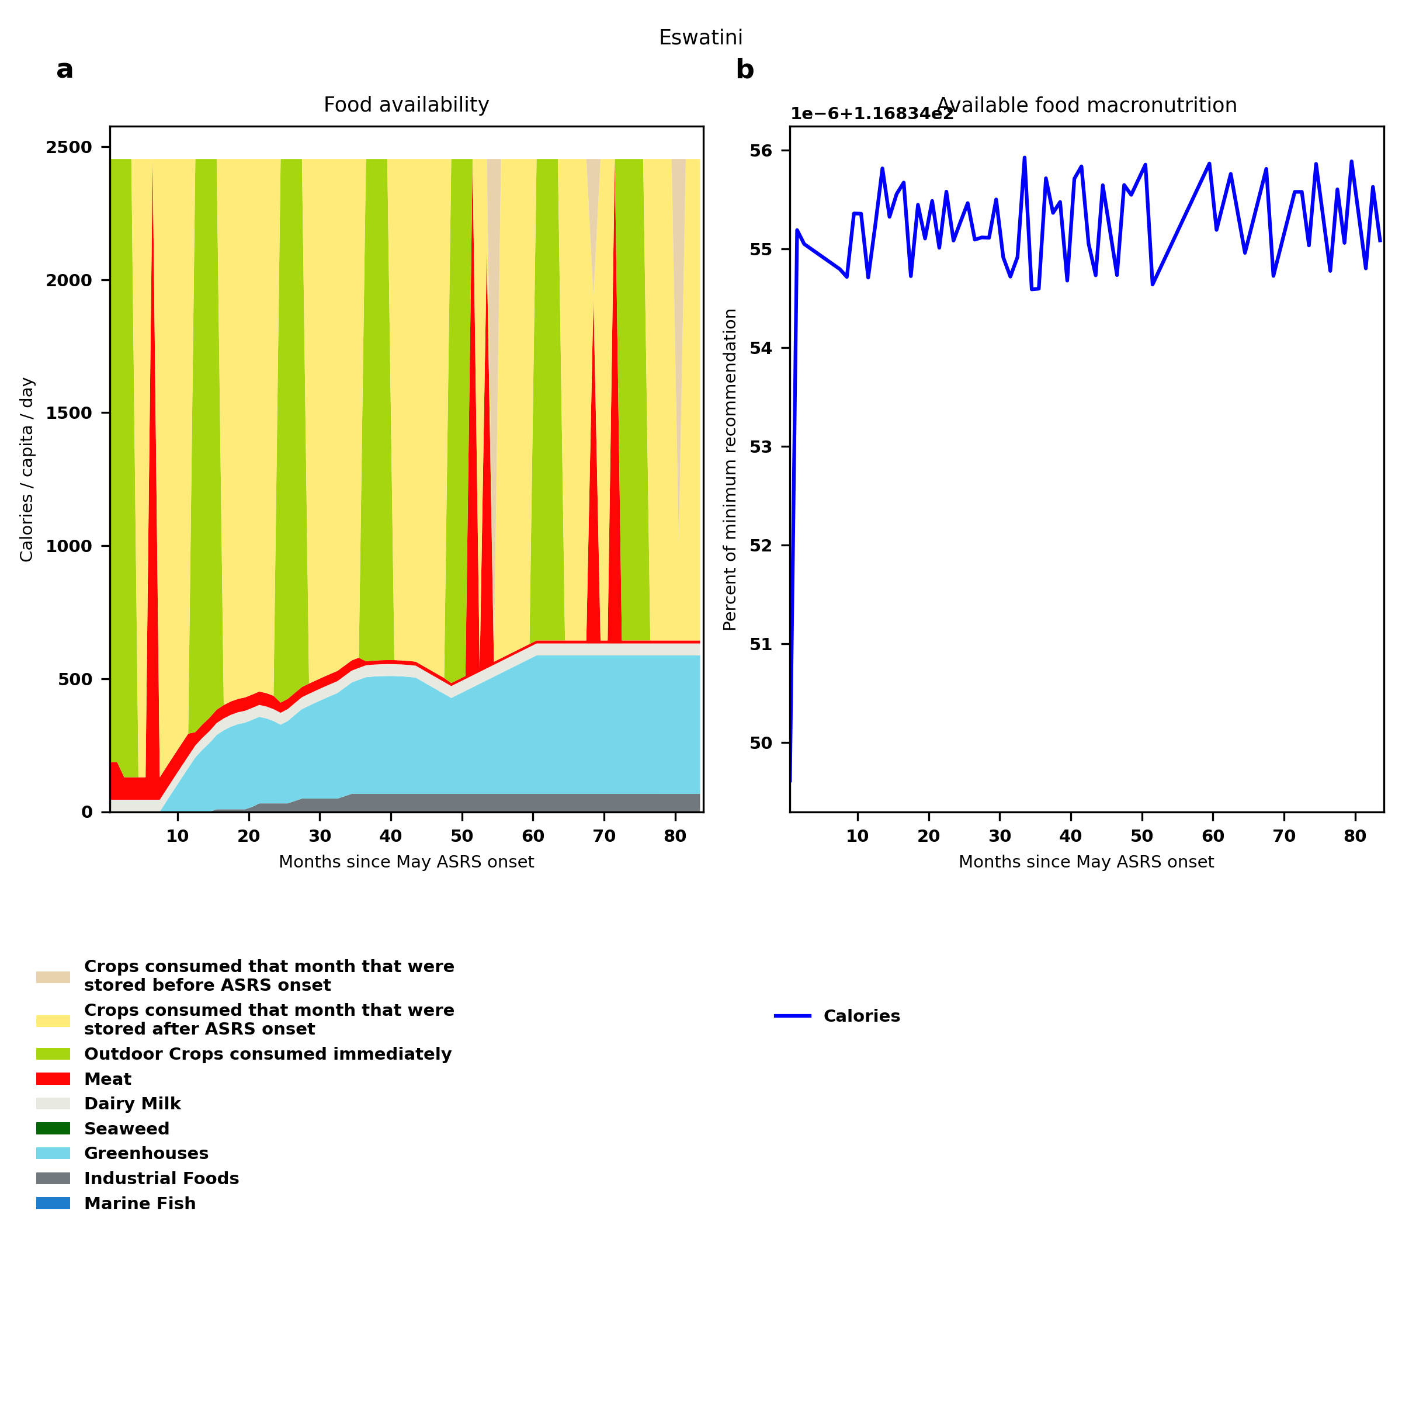
Eswatini: Percent fed:116.8%
Scenario properties: no food trade 2month feed, 1month biofuel baseline waste minimum sufficient nutrition few stocks used normal crop seasons reduced fish nuclear winter crops don't include protein don't include fat cull animals use resilient foods dairy cow feed prioritized

Slide 45
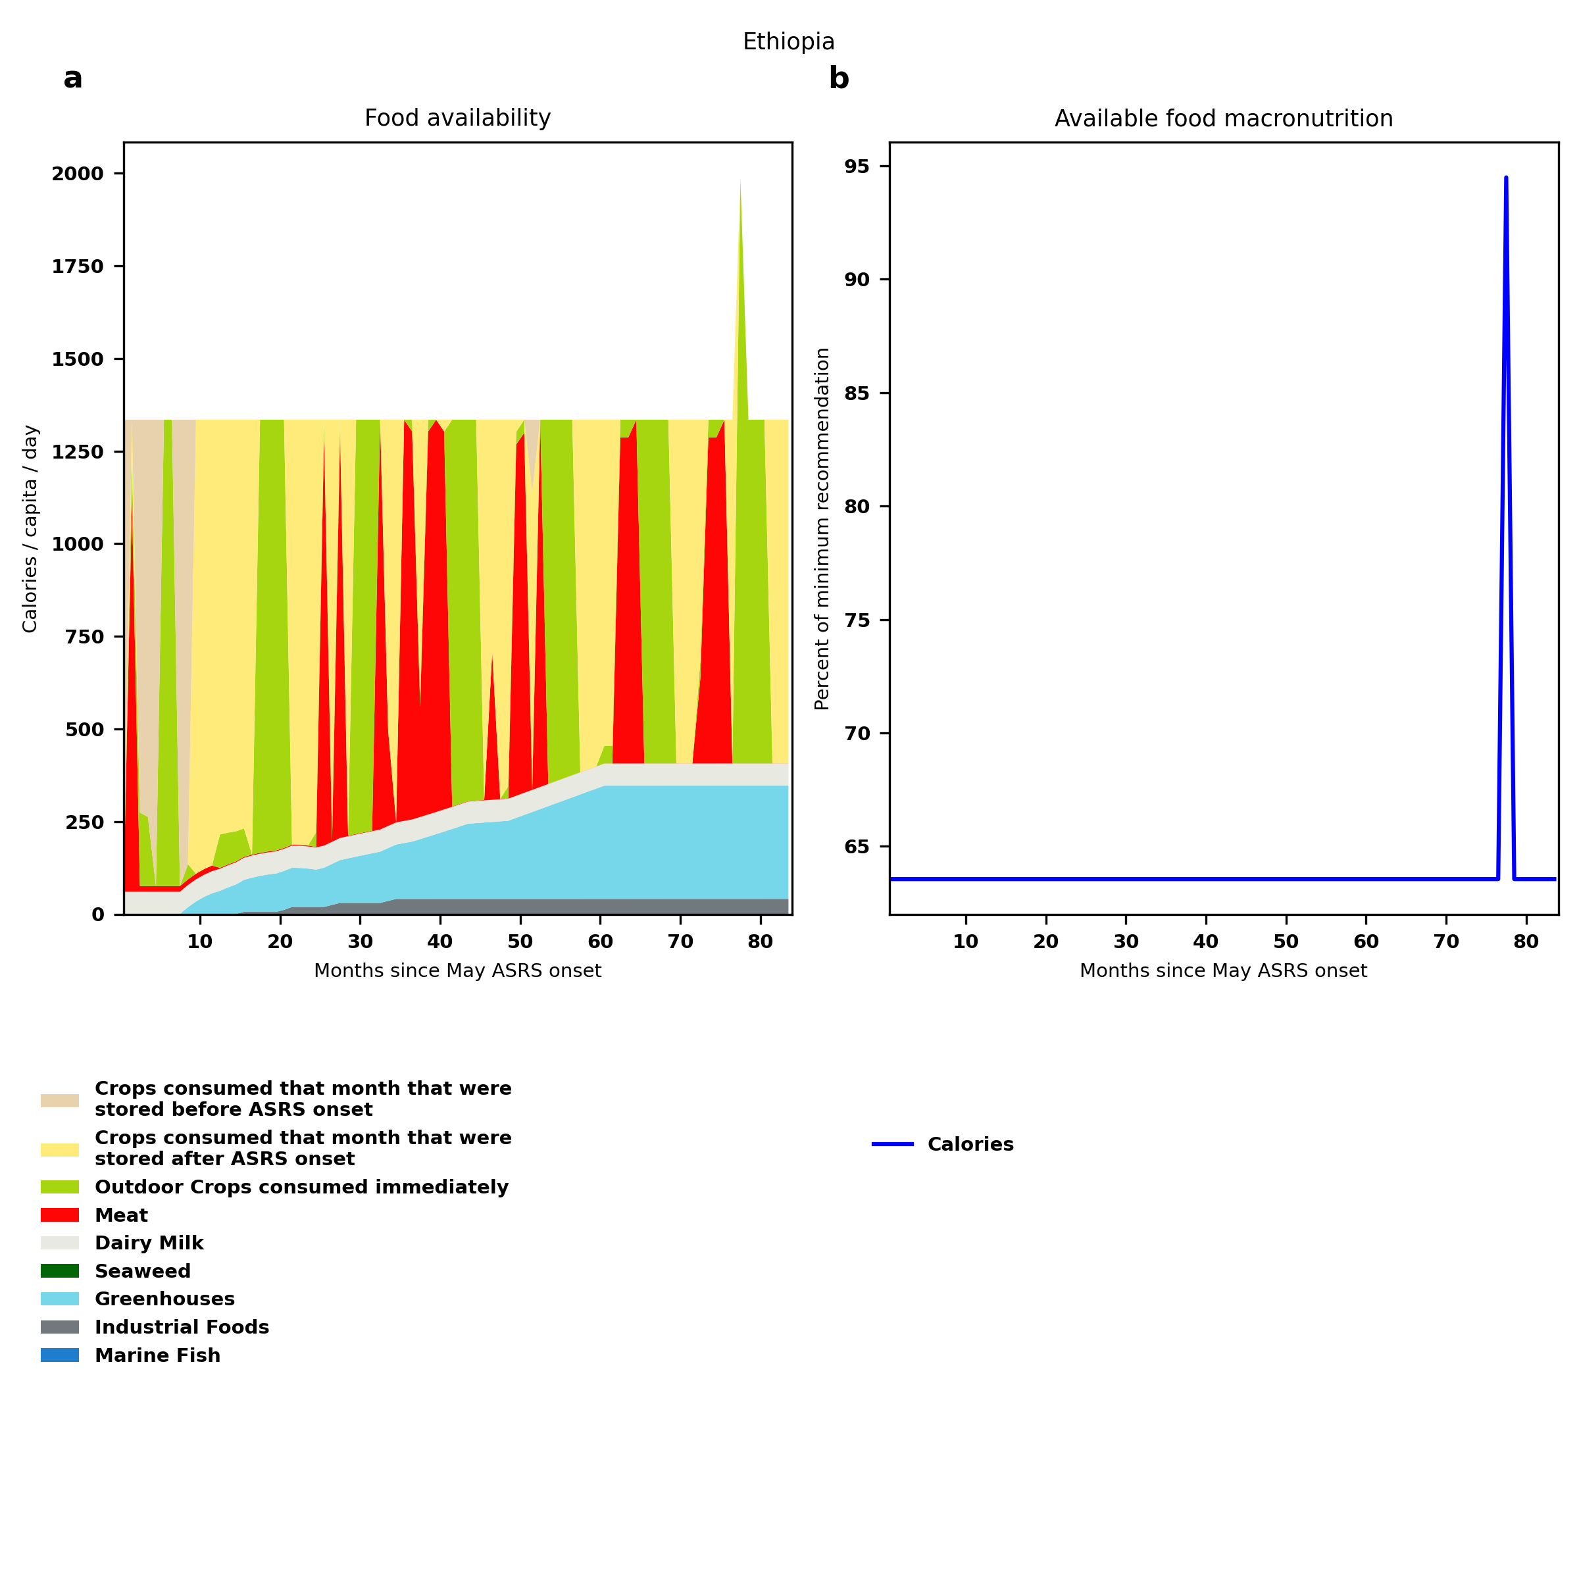
Ethiopia: Percent fed:63.6%
Scenario properties: no food trade 2month feed, 1month biofuel baseline waste minimum sufficient nutrition few stocks used normal crop seasons reduced fish nuclear winter crops don't include protein don't include fat cull animals use resilient foods dairy cow feed prioritized

Slide 46
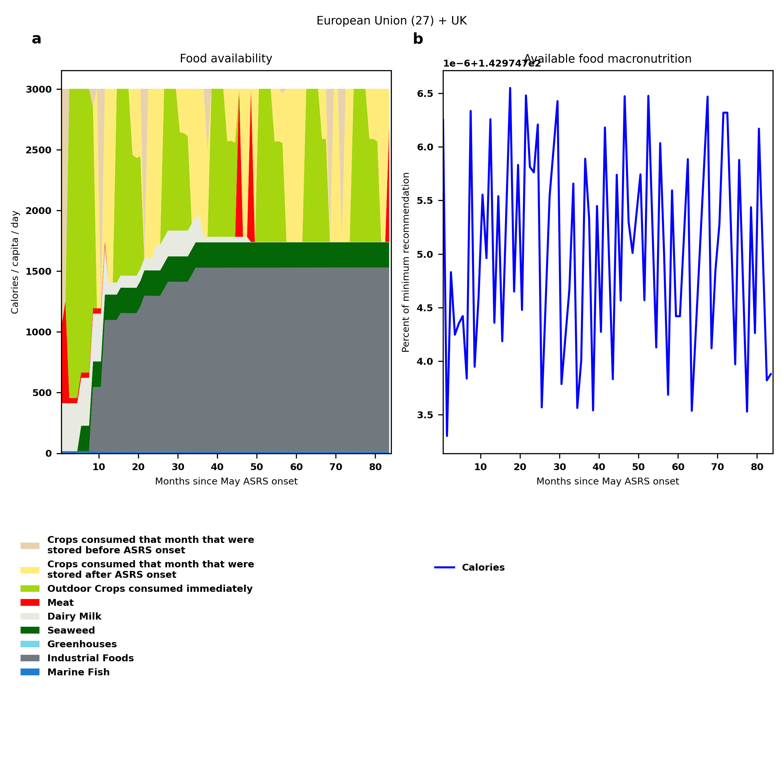
European Union (27) + UK: Percent fed:143.0%
Scenario properties: no food trade 2month feed, 1month biofuel baseline waste minimum sufficient nutrition few stocks used normal crop seasons reduced fish nuclear winter crops don't include protein don't include fat cull animals use resilient foods dairy cow feed prioritized

Slide 47
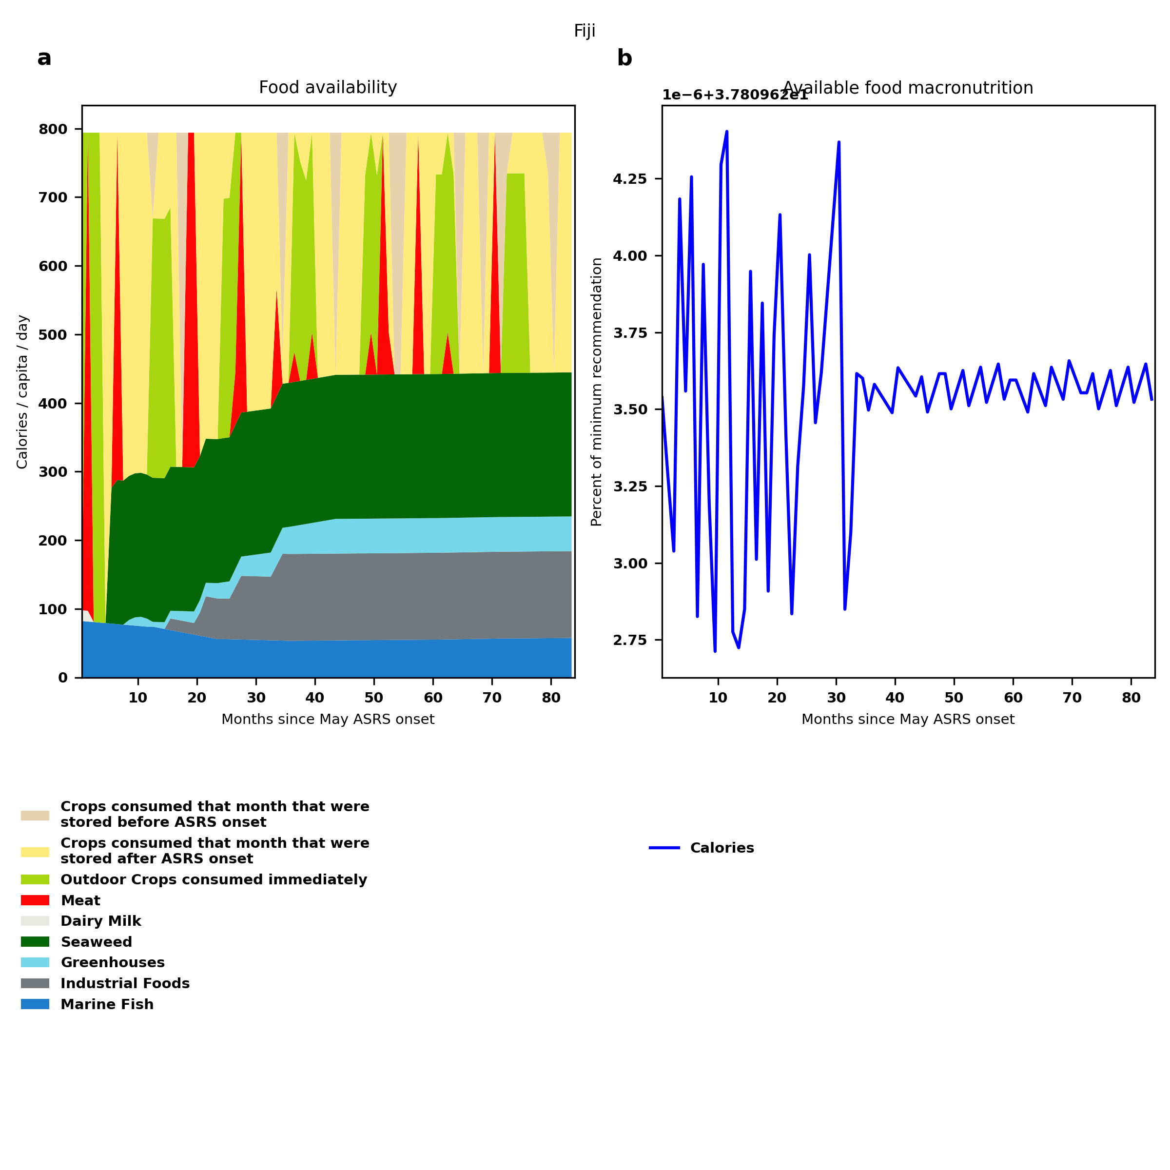
Fiji: Percent fed:37.8%
Scenario properties: no food trade 2month feed, 1month biofuel baseline waste minimum sufficient nutrition few stocks used normal crop seasons reduced fish nuclear winter crops don't include protein don't include fat cull animals use resilient foods dairy cow feed prioritized

Slide 48
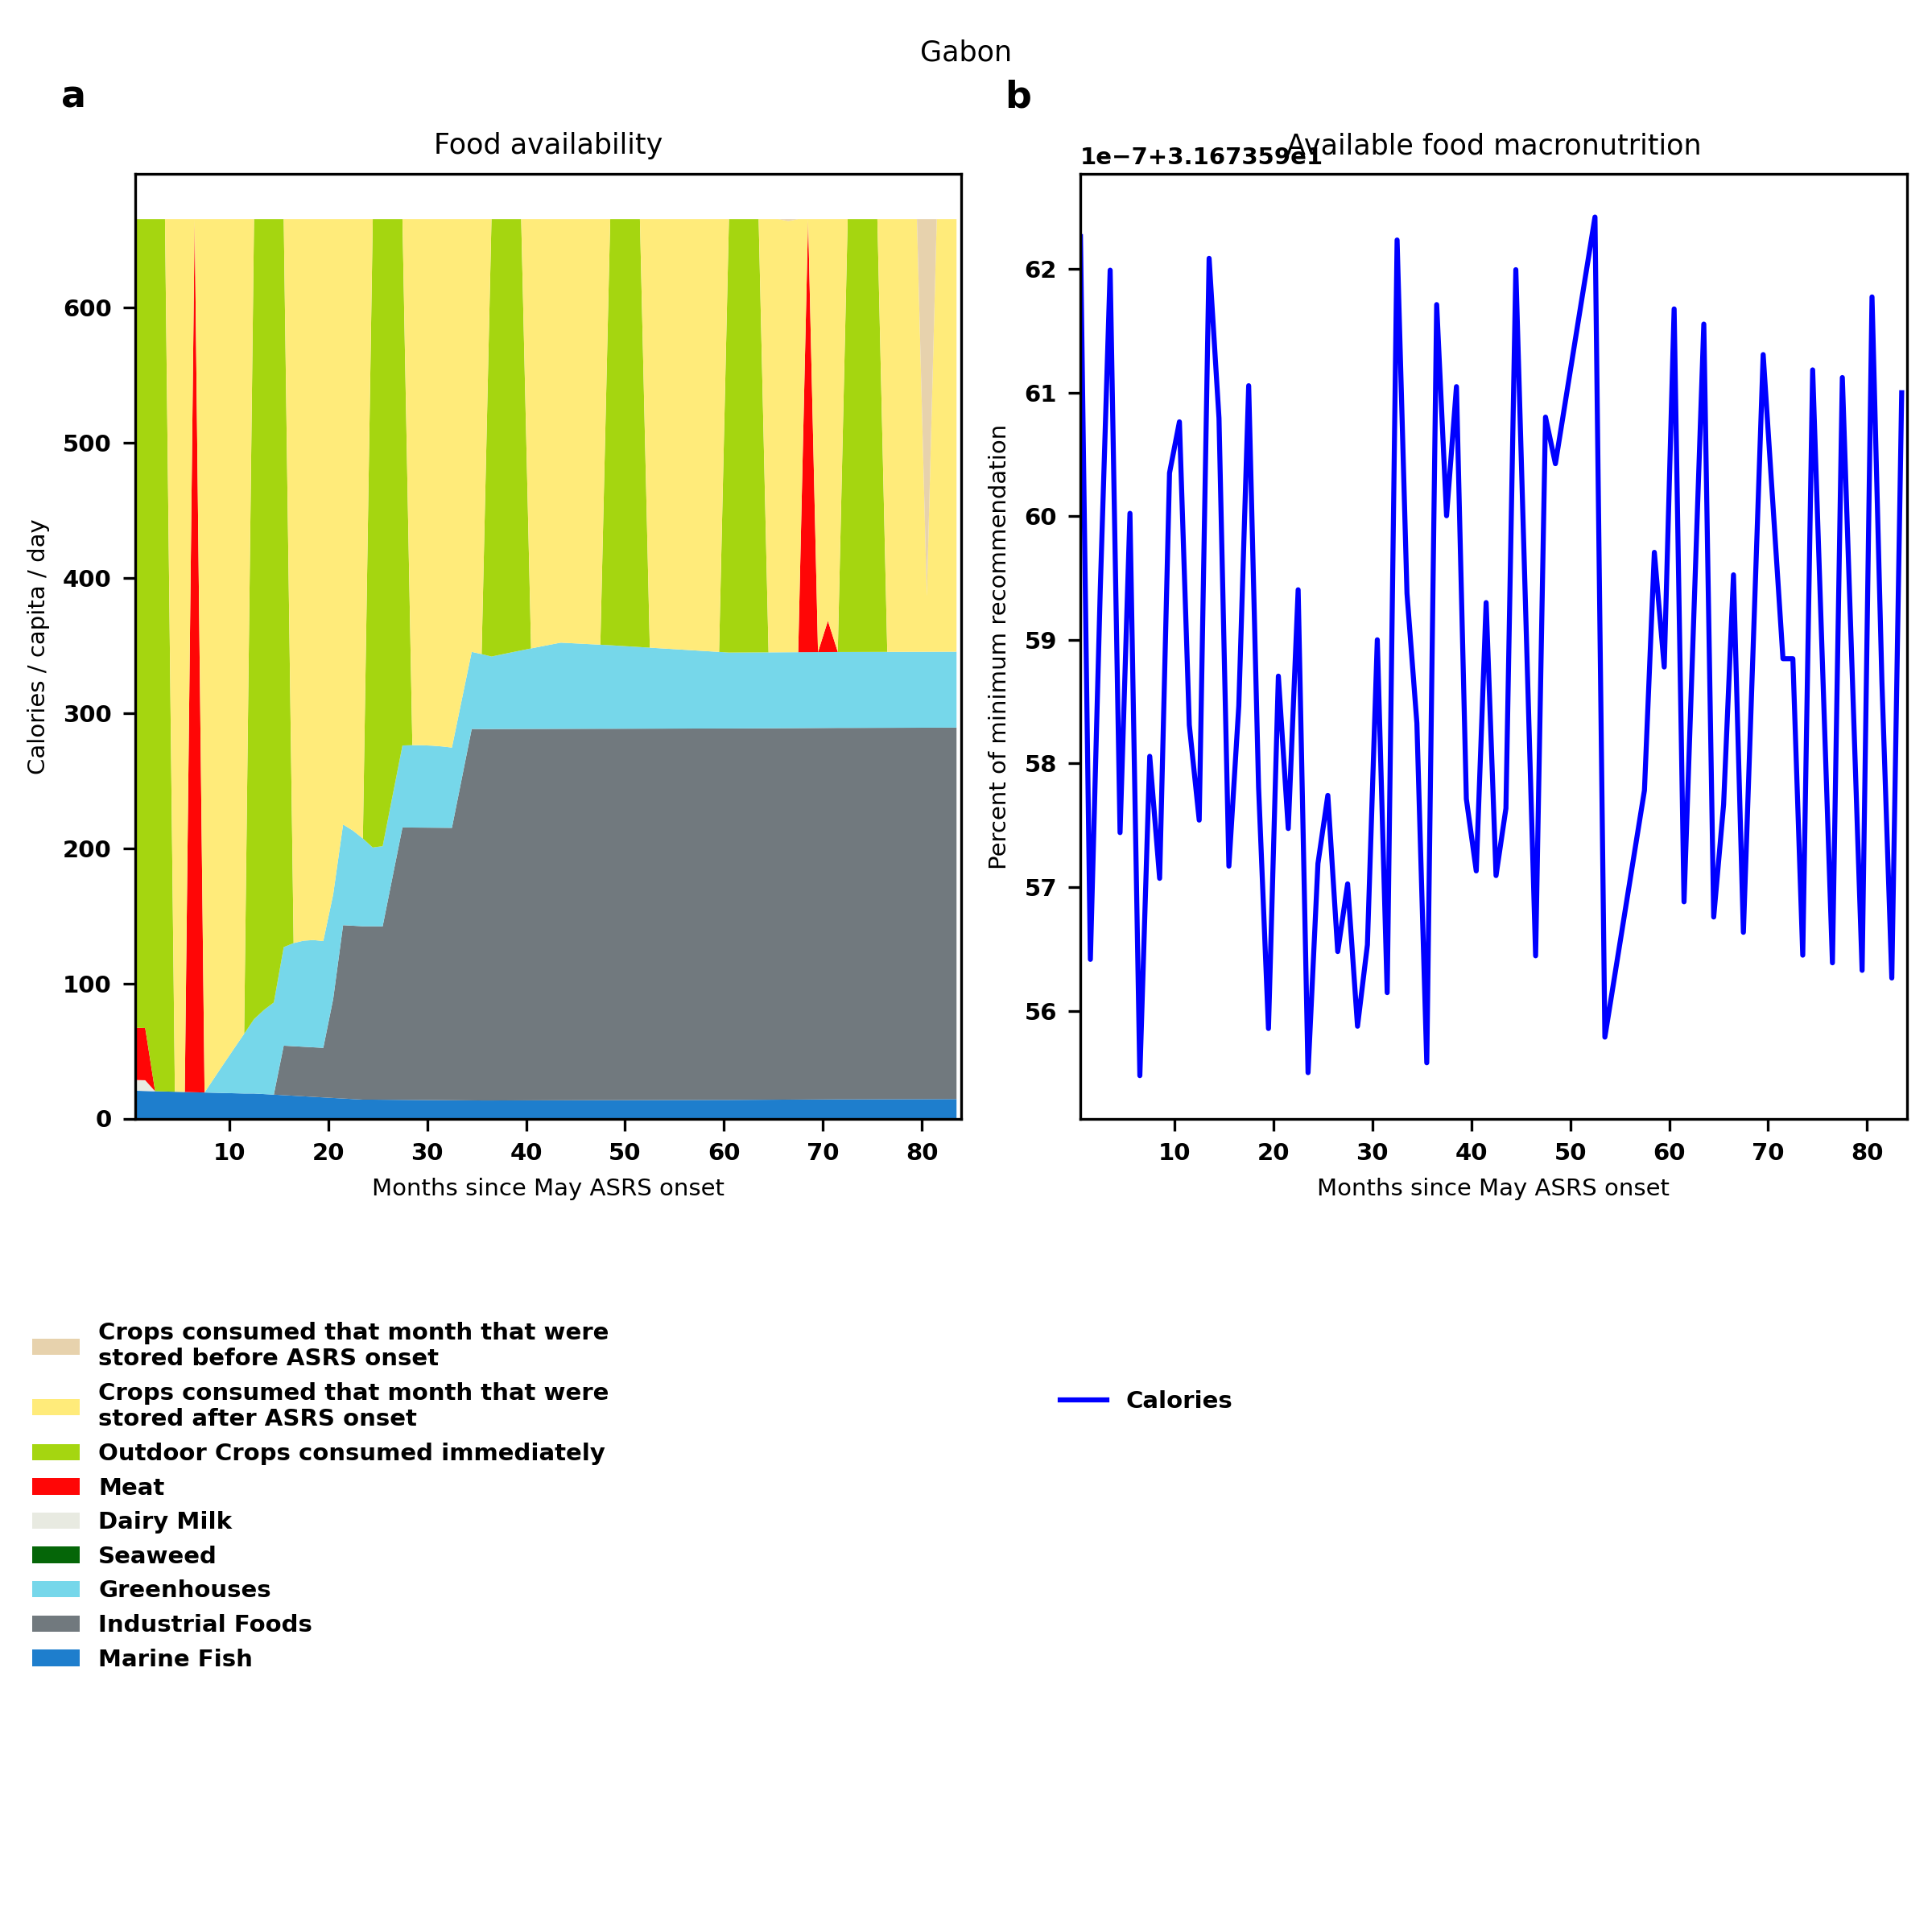
Gabon: Percent fed:31.7%
Scenario properties: no food trade 2month feed, 1month biofuel baseline waste minimum sufficient nutrition few stocks used normal crop seasons reduced fish nuclear winter crops don't include protein don't include fat cull animals use resilient foods dairy cow feed prioritized

Slide 49
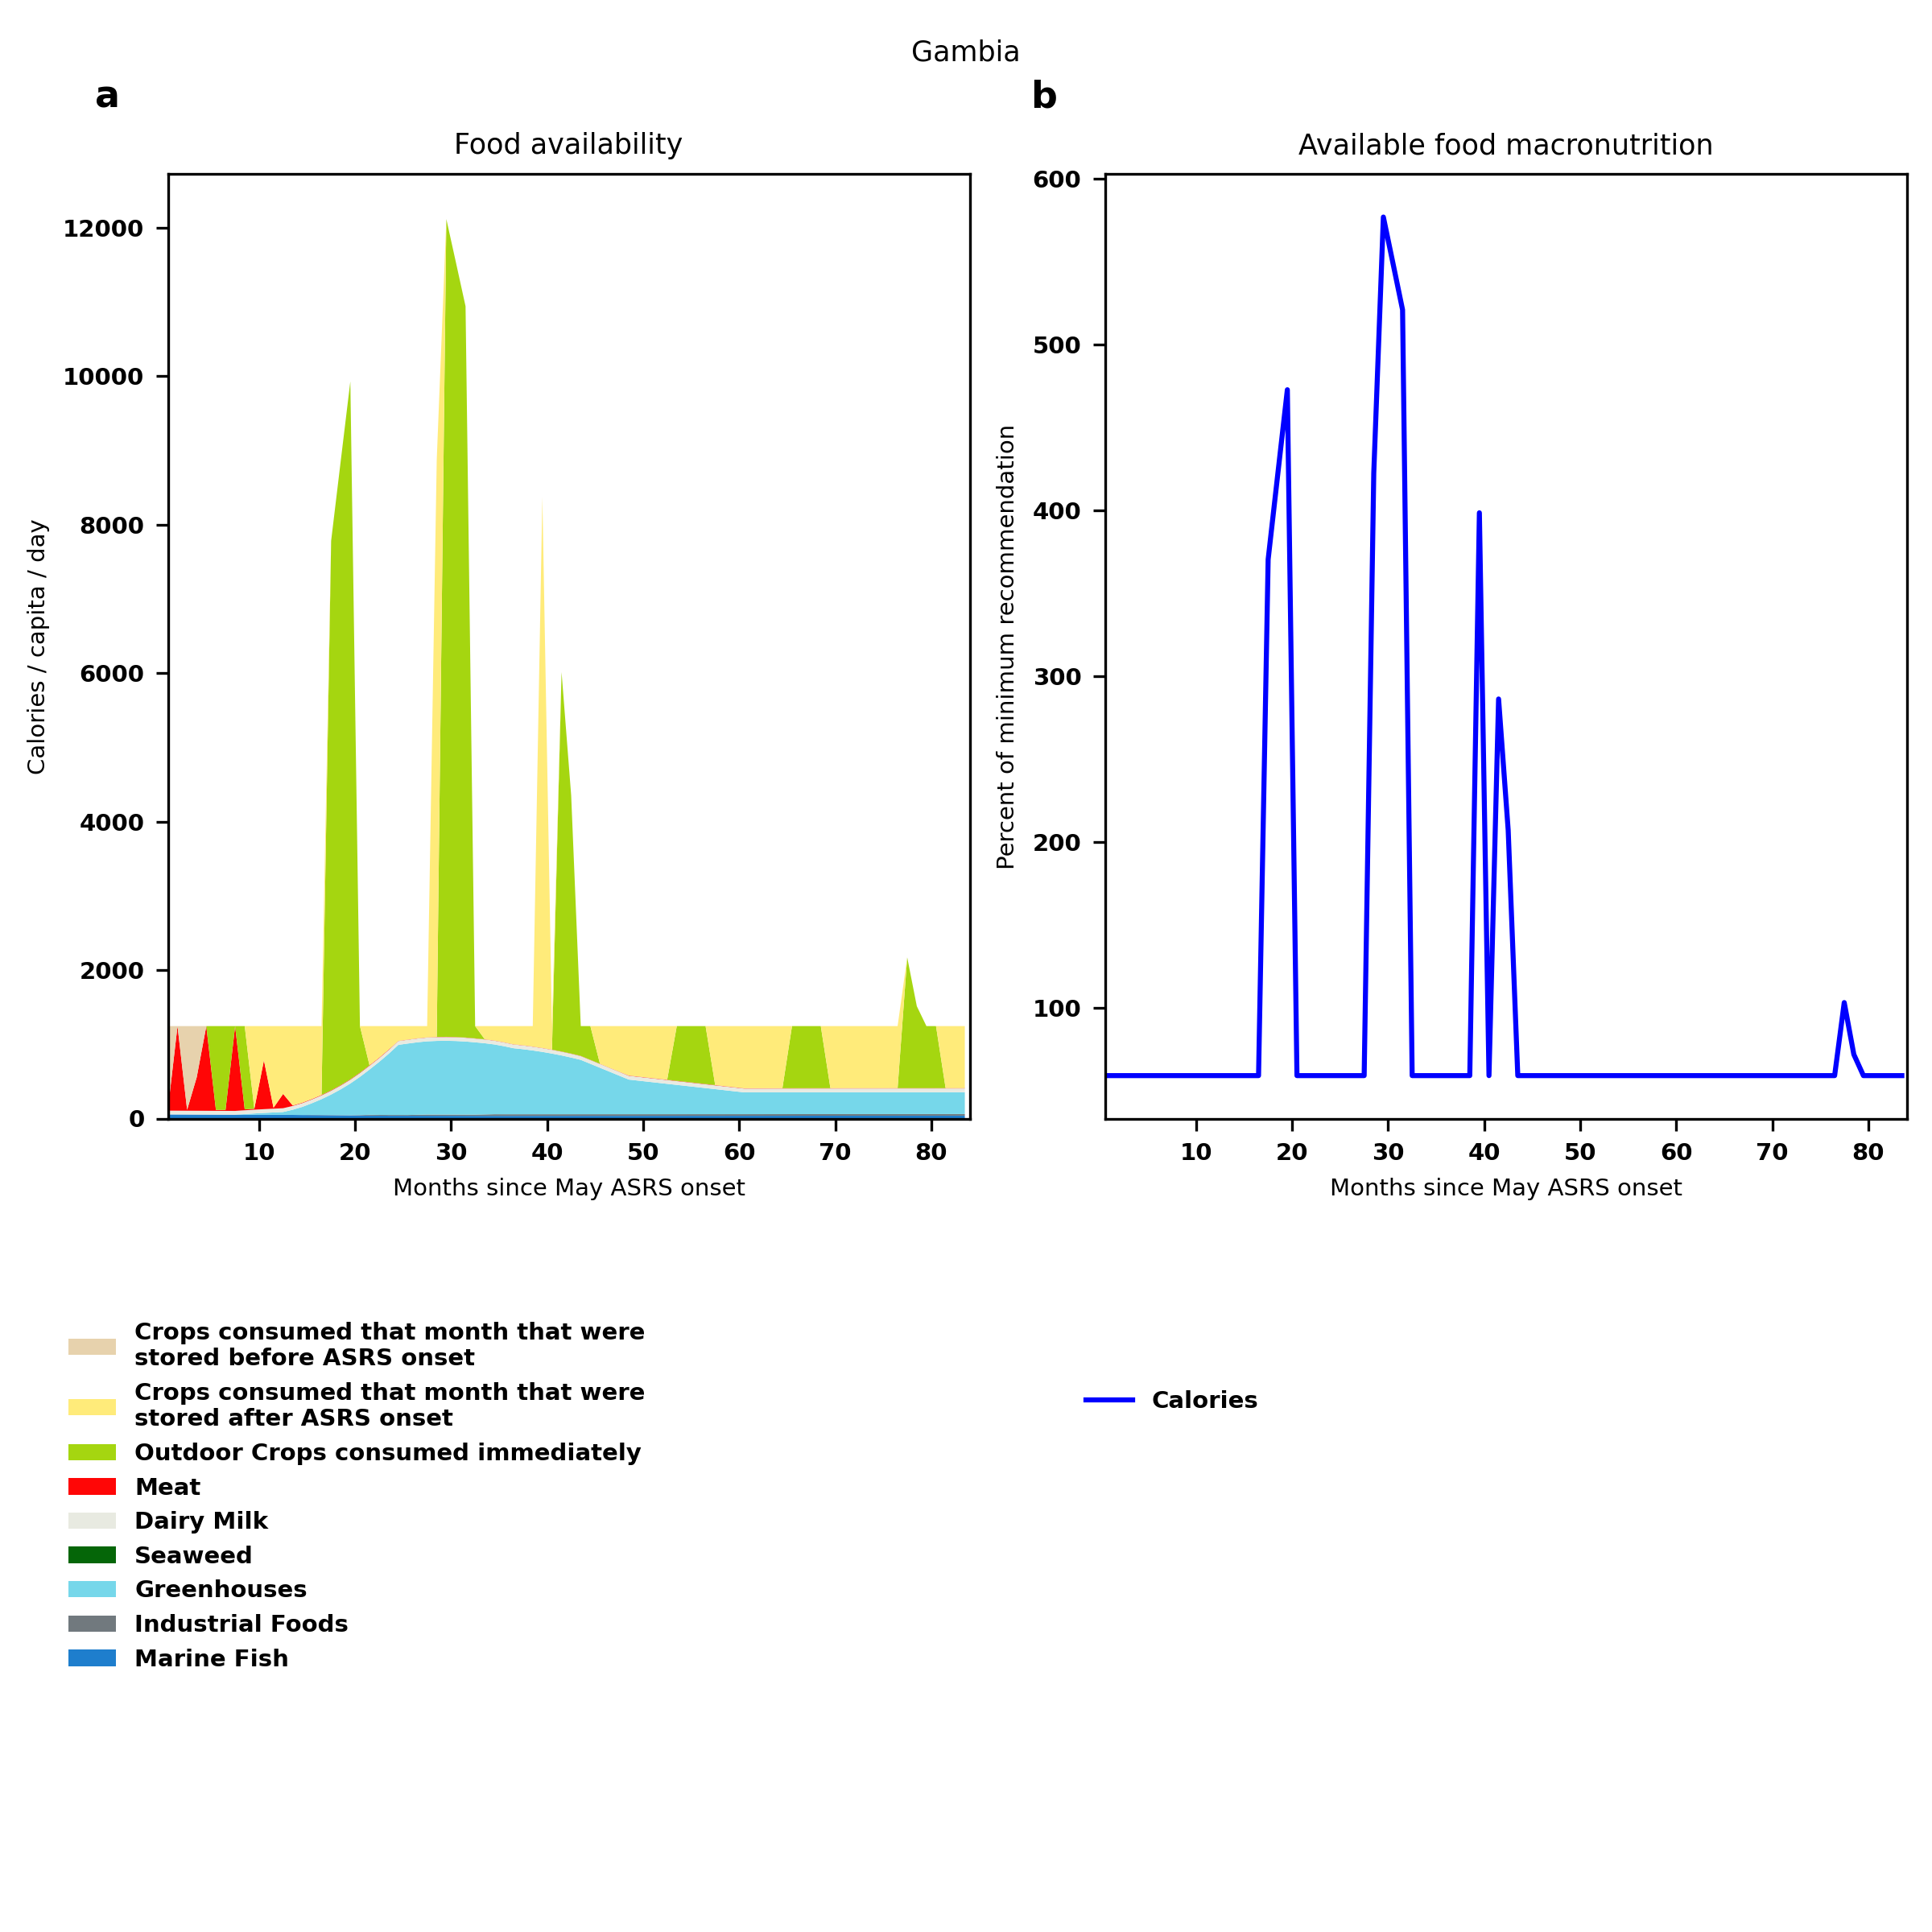
Gambia: Percent fed:59.3%
Scenario properties: no food trade 2month feed, 1month biofuel baseline waste minimum sufficient nutrition few stocks used normal crop seasons reduced fish nuclear winter crops don't include protein don't include fat cull animals use resilient foods dairy cow feed prioritized

Slide 50
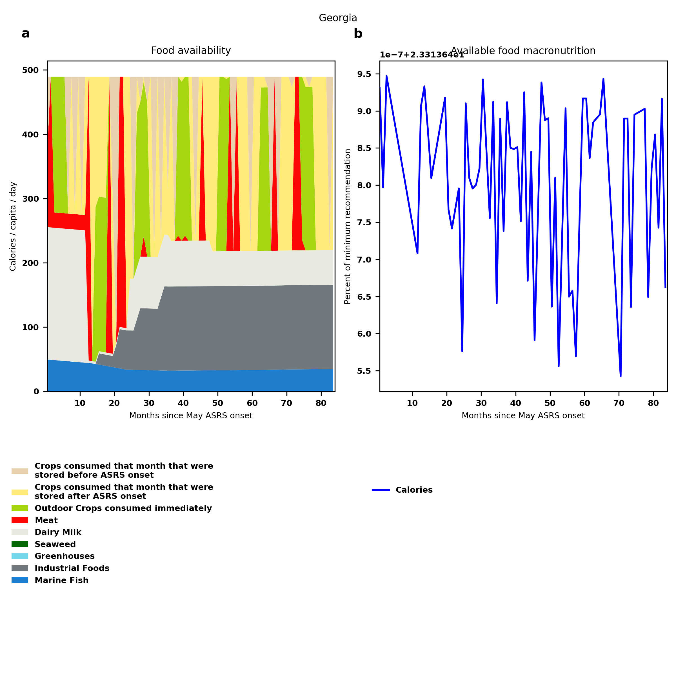
Georgia: Percent fed:23.3%
Scenario properties: no food trade 2month feed, 1month biofuel baseline waste minimum sufficient nutrition few stocks used normal crop seasons reduced fish nuclear winter crops don't include protein don't include fat cull animals use resilient foods dairy cow feed prioritized

Slide 51
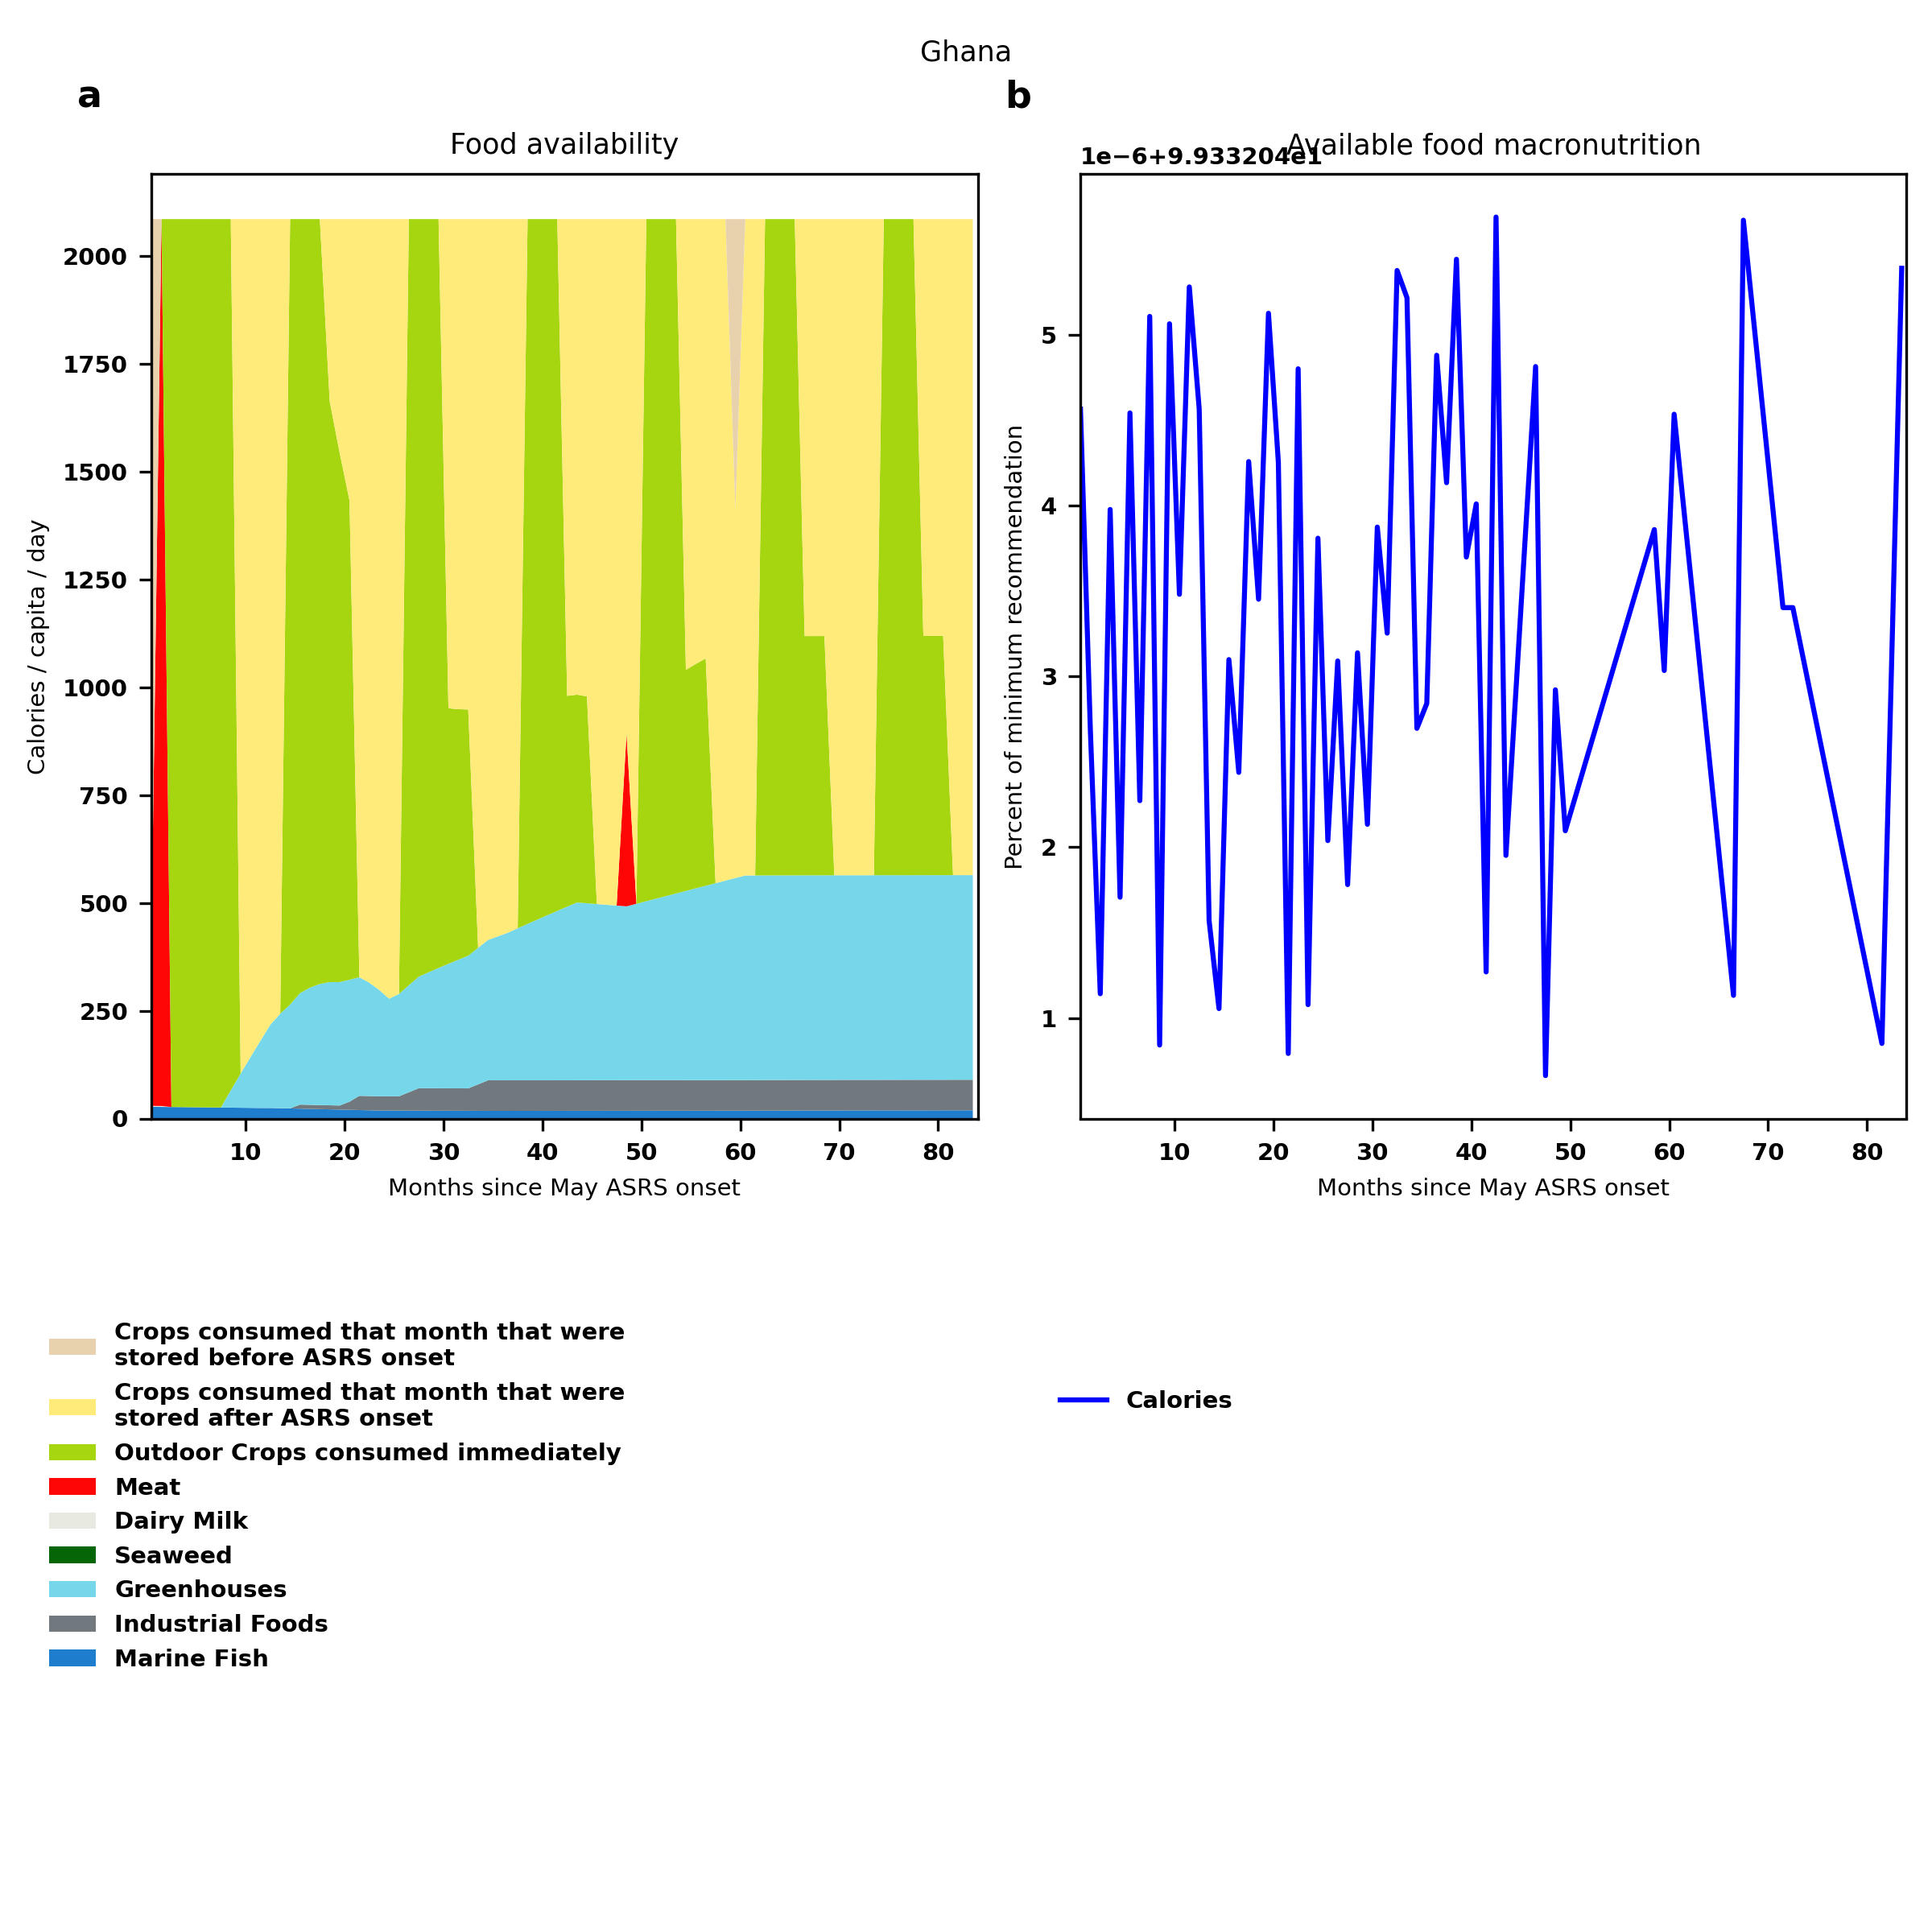
Ghana: Percent fed:99.3%
Scenario properties: no food trade 2month feed, 1month biofuel baseline waste minimum sufficient nutrition few stocks used normal crop seasons reduced fish nuclear winter crops don't include protein don't include fat cull animals use resilient foods dairy cow feed prioritized

Slide 52

Guatemala: Percent fed:93.8%
Scenario properties: no food trade 2month feed, 1month biofuel baseline waste minimum sufficient nutrition few stocks used normal crop seasons reduced fish nuclear winter crops don't include protein don't include fat cull animals use resilient foods dairy cow feed prioritized

Slide 53

Guinea: Percent fed:102.1%
Scenario properties: no food trade 2month feed, 1month biofuel baseline waste minimum sufficient nutrition few stocks used normal crop seasons reduced fish nuclear winter crops don't include protein don't include fat cull animals use resilient foods dairy cow feed prioritized

Slide 54

Guinea-Bissau: Percent fed:76.0%
Scenario properties: no food trade 2month feed, 1month biofuel baseline waste minimum sufficient nutrition few stocks used normal crop seasons reduced fish nuclear winter crops don't include protein don't include fat cull animals use resilient foods dairy cow feed prioritized

Slide 55

Guyana: Percent fed:291.0%
Scenario properties: no food trade 2month feed, 1month biofuel baseline waste minimum sufficient nutrition few stocks used normal crop seasons reduced fish nuclear winter crops don't include protein don't include fat cull animals use resilient foods dairy cow feed prioritized

Slide 56

Haiti: Percent fed:61.1%
Scenario properties: no food trade 2month feed, 1month biofuel baseline waste minimum sufficient nutrition few stocks used normal crop seasons reduced fish nuclear winter crops don't include protein don't include fat cull animals use resilient foods dairy cow feed prioritized

Slide 57

Honduras: Percent fed:62.0%
Scenario properties: no food trade 2month feed, 1month biofuel baseline waste minimum sufficient nutrition few stocks used normal crop seasons reduced fish nuclear winter crops don't include protein don't include fat cull animals use resilient foods dairy cow feed prioritized

Slide 58

India: Percent fed:81.7%
Scenario properties: no food trade 2month feed, 1month biofuel baseline waste minimum sufficient nutrition few stocks used normal crop seasons reduced fish nuclear winter crops don't include protein don't include fat cull animals use resilient foods dairy cow feed prioritized

Slide 59

Indonesia: Percent fed:155.5%
Scenario properties: no food trade 2month feed, 1month biofuel baseline waste minimum sufficient nutrition few stocks used normal crop seasons reduced fish nuclear winter crops don't include protein don't include fat cull animals use resilient foods dairy cow feed prioritized

Slide 60

Iran (Islamic Republic of): Percent fed:53.6%
Scenario properties: no food trade 2month feed, 1month biofuel baseline waste minimum sufficient nutrition few stocks used normal crop seasons reduced fish nuclear winter crops don't include protein don't include fat cull animals use resilient foods dairy cow feed prioritized

Slide 61

Iraq: Percent fed:41.1%
Scenario properties: no food trade 2month feed, 1month biofuel baseline waste minimum sufficient nutrition few stocks used normal crop seasons reduced fish nuclear winter crops don't include protein don't include fat cull animals use resilient foods dairy cow feed prioritized

Slide 62

Israel: Percent fed:39.7%
Scenario properties: no food trade 2month feed, 1month biofuel baseline waste minimum sufficient nutrition few stocks used normal crop seasons reduced fish nuclear winter crops don't include protein don't include fat cull animals use resilient foods dairy cow feed prioritized

Slide 63

Jamaica: Percent fed:39.7%
Scenario properties: no food trade 2month feed, 1month biofuel baseline waste minimum sufficient nutrition few stocks used normal crop seasons reduced fish nuclear winter crops don't include protein don't include fat cull animals use resilient foods dairy cow feed prioritized

Slide 64

Japan: Percent fed:64.9%
Scenario properties: no food trade 2month feed, 1month biofuel baseline waste minimum sufficient nutrition few stocks used normal crop seasons reduced fish nuclear winter crops don't include protein don't include fat cull animals use resilient foods dairy cow feed prioritized

Slide 65

Jordan: Percent fed:12.9%
Scenario properties: no food trade 2month feed, 1month biofuel baseline waste minimum sufficient nutrition few stocks used normal crop seasons reduced fish nuclear winter crops don't include protein don't include fat cull animals use resilient foods dairy cow feed prioritized

Slide 66

Kazakhstan: Percent fed:110.5%
Scenario properties: no food trade 2month feed, 1month biofuel baseline waste minimum sufficient nutrition few stocks used normal crop seasons reduced fish nuclear winter crops don't include protein don't include fat cull animals use resilient foods dairy cow feed prioritized

Slide 67

Kenya: Percent fed:50.4%
Scenario properties: no food trade 2month feed, 1month biofuel baseline waste minimum sufficient nutrition few stocks used normal crop seasons reduced fish nuclear winter crops don't include protein don't include fat cull animals use resilient foods dairy cow feed prioritized

Slide 68

Democratic People's Republic of Korea: Percent fed:40.0%
Scenario properties: no food trade 2month feed, 1month biofuel baseline waste minimum sufficient nutrition few stocks used normal crop seasons reduced fish nuclear winter crops don't include protein don't include fat cull animals use resilient foods dairy cow feed prioritized

Slide 69

Republic of Korea: Percent fed:35.4%
Scenario properties: no food trade 2month feed, 1month biofuel baseline waste minimum sufficient nutrition few stocks used normal crop seasons reduced fish nuclear winter crops don't include protein don't include fat cull animals use resilient foods dairy cow feed prioritized

Slide 70

Kuwait: Percent fed:1.3%
Scenario properties: no food trade 2month feed, 1month biofuel baseline waste minimum sufficient nutrition few stocks used normal crop seasons reduced fish nuclear winter crops don't include protein don't include fat cull animals use resilient foods dairy cow feed prioritized

Slide 71

Kyrgyzstan: Percent fed:40.1%
Scenario properties: no food trade 2month feed, 1month biofuel baseline waste minimum sufficient nutrition few stocks used normal crop seasons reduced fish nuclear winter crops don't include protein don't include fat cull animals use resilient foods dairy cow feed prioritized

Slide 72

Lao People's Democratic Republic: Percent fed:128.6%
Scenario properties: no food trade 2month feed, 1month biofuel baseline waste minimum sufficient nutrition few stocks used normal crop seasons reduced fish nuclear winter crops don't include protein don't include fat cull animals use resilient foods dairy cow feed prioritized

Slide 73

Lebanon: Percent fed:22.3%
Scenario properties: no food trade 2month feed, 1month biofuel baseline waste minimum sufficient nutrition few stocks used normal crop seasons reduced fish nuclear winter crops don't include protein don't include fat cull animals use resilient foods dairy cow feed prioritized

Slide 74

Lesotho: Percent fed:19.4%
Scenario properties: no food trade 2month feed, 1month biofuel baseline waste minimum sufficient nutrition few stocks used normal crop seasons reduced fish nuclear winter crops don't include protein don't include fat cull animals use resilient foods dairy cow feed prioritized

Slide 75

Liberia: Percent fed:25.2%
Scenario properties: no food trade 2month feed, 1month biofuel baseline waste minimum sufficient nutrition few stocks used normal crop seasons reduced fish nuclear winter crops don't include protein don't include fat cull animals use resilient foods dairy cow feed prioritized

Slide 76

Libya: Percent fed:49.9%
Scenario properties: no food trade 2month feed, 1month biofuel baseline waste minimum sufficient nutrition few stocks used normal crop seasons reduced fish nuclear winter crops don't include protein don't include fat cull animals use resilient foods dairy cow feed prioritized

Slide 77

Madagascar: Percent fed:59.0%
Scenario properties: no food trade 2month feed, 1month biofuel baseline waste minimum sufficient nutrition few stocks used normal crop seasons reduced fish nuclear winter crops don't include protein don't include fat cull animals use resilient foods dairy cow feed prioritized

Slide 78

Malawi: Percent fed:103.9%
Scenario properties: no food trade 2month feed, 1month biofuel baseline waste minimum sufficient nutrition few stocks used normal crop seasons reduced fish nuclear winter crops don't include protein don't include fat cull animals use resilient foods dairy cow feed prioritized

Slide 79

Malaysia: Percent fed:156.9%
Scenario properties: no food trade 2month feed, 1month biofuel baseline waste minimum sufficient nutrition few stocks used normal crop seasons reduced fish nuclear winter crops don't include protein don't include fat cull animals use resilient foods dairy cow feed prioritized

Slide 80

Mali: Percent fed:131.9%
Scenario properties: no food trade 2month feed, 1month biofuel baseline waste minimum sufficient nutrition few stocks used normal crop seasons reduced fish nuclear winter crops don't include protein don't include fat cull animals use resilient foods dairy cow feed prioritized

Slide 81

Mauritania: Percent fed:76.8%
Scenario properties: no food trade 2month feed, 1month biofuel baseline waste minimum sufficient nutrition few stocks used normal crop seasons reduced fish nuclear winter crops don't include protein don't include fat cull animals use resilient foods dairy cow feed prioritized

Slide 82

Mauritius: Percent fed:22.3%
Scenario properties: no food trade 2month feed, 1month biofuel baseline waste minimum sufficient nutrition few stocks used normal crop seasons reduced fish nuclear winter crops don't include protein don't include fat cull animals use resilient foods dairy cow feed prioritized

Slide 83

Mexico: Percent fed:45.4%
Scenario properties: no food trade 2month feed, 1month biofuel baseline waste minimum sufficient nutrition few stocks used normal crop seasons reduced fish nuclear winter crops don't include protein don't include fat cull animals use resilient foods dairy cow feed prioritized

Slide 84

Republic of Moldova: Percent fed:72.1%
Scenario properties: no food trade 2month feed, 1month biofuel baseline waste minimum sufficient nutrition few stocks used normal crop seasons reduced fish nuclear winter crops don't include protein don't include fat cull animals use resilient foods dairy cow feed prioritized

Slide 85

Mongolia: Percent fed:67.6%
Scenario properties: no food trade 2month feed, 1month biofuel baseline waste minimum sufficient nutrition few stocks used normal crop seasons reduced fish nuclear winter crops don't include protein don't include fat cull animals use resilient foods dairy cow feed prioritized

Slide 86

Morocco: Percent fed:65.0%
Scenario properties: no food trade 2month feed, 1month biofuel baseline waste minimum sufficient nutrition few stocks used normal crop seasons reduced fish nuclear winter crops don't include protein don't include fat cull animals use resilient foods dairy cow feed prioritized

Slide 87

Mozambique: Percent fed:43.3%
Scenario properties: no food trade 2month feed, 1month biofuel baseline waste minimum sufficient nutrition few stocks used normal crop seasons reduced fish nuclear winter crops don't include protein don't include fat cull animals use resilient foods dairy cow feed prioritized

Slide 88

Namibia: Percent fed:49.0%
Scenario properties: no food trade 2month feed, 1month biofuel baseline waste minimum sufficient nutrition few stocks used normal crop seasons reduced fish nuclear winter crops don't include protein don't include fat cull animals use resilient foods dairy cow feed prioritized

Slide 89

Nepal: Percent fed:55.9%
Scenario properties: no food trade 2month feed, 1month biofuel baseline waste minimum sufficient nutrition few stocks used normal crop seasons reduced fish nuclear winter crops don't include protein don't include fat cull animals use resilient foods dairy cow feed prioritized

Slide 90

New Zealand: Percent fed:383.8%
Scenario properties: no food trade 2month feed, 1month biofuel baseline waste minimum sufficient nutrition few stocks used normal crop seasons reduced fish nuclear winter crops don't include protein don't include fat cull animals use resilient foods dairy cow feed prioritized

Slide 91

Nicaragua: Percent fed:84.7%
Scenario properties: no food trade 2month feed, 1month biofuel baseline waste minimum sufficient nutrition few stocks used normal crop seasons reduced fish nuclear winter crops don't include protein don't include fat cull animals use resilient foods dairy cow feed prioritized

Slide 92

Niger: Percent fed:77.3%
Scenario properties: no food trade 2month feed, 1month biofuel baseline waste minimum sufficient nutrition few stocks used normal crop seasons reduced fish nuclear winter crops don't include protein don't include fat cull animals use resilient foods dairy cow feed prioritized

Slide 93

Nigeria: Percent fed:63.3%
Scenario properties: no food trade 2month feed, 1month biofuel baseline waste minimum sufficient nutrition few stocks used normal crop seasons reduced fish nuclear winter crops don't include protein don't include fat cull animals use resilient foods dairy cow feed prioritized

Slide 94

North Macedonia: Percent fed:38.3%
Scenario properties: no food trade 2month feed, 1month biofuel baseline waste minimum sufficient nutrition few stocks used normal crop seasons reduced fish nuclear winter crops don't include protein don't include fat cull animals use resilient foods dairy cow feed prioritized

Slide 95

Norway: Percent fed:112.5%
Scenario properties: no food trade 2month feed, 1month biofuel baseline waste minimum sufficient nutrition few stocks used normal crop seasons reduced fish nuclear winter crops don't include protein don't include fat cull animals use resilient foods dairy cow feed prioritized

Slide 96

Oman: Percent fed:26.4%
Scenario properties: no food trade 2month feed, 1month biofuel baseline waste minimum sufficient nutrition few stocks used normal crop seasons reduced fish nuclear winter crops don't include protein don't include fat cull animals use resilient foods dairy cow feed prioritized

Slide 97

Pakistan: Percent fed:59.2%
Scenario properties: no food trade 2month feed, 1month biofuel baseline waste minimum sufficient nutrition few stocks used normal crop seasons reduced fish nuclear winter crops don't include protein don't include fat cull animals use resilient foods dairy cow feed prioritized

Slide 98

Panama: Percent fed:108.3%
Scenario properties: no food trade 2month feed, 1month biofuel baseline waste minimum sufficient nutrition few stocks used normal crop seasons reduced fish nuclear winter crops don't include protein don't include fat cull animals use resilient foods dairy cow feed prioritized

Slide 99

Papua New Guinea: Percent fed:38.7%
Scenario properties: no food trade 2month feed, 1month biofuel baseline waste minimum sufficient nutrition few stocks used normal crop seasons reduced fish nuclear winter crops don't include protein don't include fat cull animals use resilient foods dairy cow feed prioritized

Slide 100

Paraguay: Percent fed:465.6%
Scenario properties: no food trade 2month feed, 1month biofuel baseline waste minimum sufficient nutrition few stocks used normal crop seasons reduced fish nuclear winter crops don't include protein don't include fat cull animals use resilient foods dairy cow feed prioritized

Slide 101

Peru: Percent fed:61.4%
Scenario properties: no food trade 2month feed, 1month biofuel baseline waste minimum sufficient nutrition few stocks used normal crop seasons reduced fish nuclear winter crops don't include protein don't include fat cull animals use resilient foods dairy cow feed prioritized

Slide 102

Philippines: Percent fed:88.2%
Scenario properties: no food trade 2month feed, 1month biofuel baseline waste minimum sufficient nutrition few stocks used normal crop seasons reduced fish nuclear winter crops don't include protein don't include fat cull animals use resilient foods dairy cow feed prioritized

Slide 103

Qatar: Percent fed:1.6%
Scenario properties: no food trade 2month feed, 1month biofuel baseline waste minimum sufficient nutrition few stocks used normal crop seasons reduced fish nuclear winter crops don't include protein don't include fat cull animals use resilient foods dairy cow feed prioritized

Slide 104

Russian Federation: Percent fed:128.1%
Scenario properties: no food trade 2month feed, 1month biofuel baseline waste minimum sufficient nutrition few stocks used normal crop seasons reduced fish nuclear winter crops don't include protein don't include fat cull animals use resilient foods dairy cow feed prioritized

Slide 105

Rwanda: Percent fed:36.0%
Scenario properties: no food trade 2month feed, 1month biofuel baseline waste minimum sufficient nutrition few stocks used normal crop seasons reduced fish nuclear winter crops don't include protein don't include fat cull animals use resilient foods dairy cow feed prioritized

Slide 106

Saudi Arabia: Percent fed:47.3%
Scenario properties: no food trade 2month feed, 1month biofuel baseline waste minimum sufficient nutrition few stocks used normal crop seasons reduced fish nuclear winter crops don't include protein don't include fat cull animals use resilient foods dairy cow feed prioritized

Slide 107

Senegal: Percent fed:127.7%
Scenario properties: no food trade 2month feed, 1month biofuel baseline waste minimum sufficient nutrition few stocks used normal crop seasons reduced fish nuclear winter crops don't include protein don't include fat cull animals use resilient foods dairy cow feed prioritized

Slide 108

Serbia: Percent fed:128.7%
Scenario properties: no food trade 2month feed, 1month biofuel baseline waste minimum sufficient nutrition few stocks used normal crop seasons reduced fish nuclear winter crops don't include protein don't include fat cull animals use resilient foods dairy cow feed prioritized

Slide 109

Sierra Leone: Percent fed:54.7%
Scenario properties: no food trade 2month feed, 1month biofuel baseline waste minimum sufficient nutrition few stocks used normal crop seasons reduced fish nuclear winter crops don't include protein don't include fat cull animals use resilient foods dairy cow feed prioritized

Slide 110

Singapore: Percent fed:9.1%
Scenario properties: no food trade 2month feed, 1month biofuel baseline waste minimum sufficient nutrition few stocks used normal crop seasons reduced fish nuclear winter crops don't include protein don't include fat cull animals use resilient foods dairy cow feed prioritized

Slide 111

Somalia: Percent fed:35.4%
Scenario properties: no food trade 2month feed, 1month biofuel baseline waste minimum sufficient nutrition few stocks used normal crop seasons reduced fish nuclear winter crops don't include protein don't include fat cull animals use resilient foods dairy cow feed prioritized

Slide 112

South Africa: Percent fed:90.3%
Scenario properties: no food trade 2month feed, 1month biofuel baseline waste minimum sufficient nutrition few stocks used normal crop seasons reduced fish nuclear winter crops don't include protein don't include fat cull animals use resilient foods dairy cow feed prioritized

Slide 113

South Sudan: Percent fed:53.8%
Scenario properties: no food trade 2month feed, 1month biofuel baseline waste minimum sufficient nutrition few stocks used normal crop seasons reduced fish nuclear winter crops don't include protein don't include fat cull animals use resilient foods dairy cow feed prioritized

Slide 114

Sri Lanka: Percent fed:95.0%
Scenario properties: no food trade 2month feed, 1month biofuel baseline waste minimum sufficient nutrition few stocks used normal crop seasons reduced fish nuclear winter crops don't include protein don't include fat cull animals use resilient foods dairy cow feed prioritized

Slide 115

Sudan: Percent fed:72.1%
Scenario properties: no food trade 2month feed, 1month biofuel baseline waste minimum sufficient nutrition few stocks used normal crop seasons reduced fish nuclear winter crops don't include protein don't include fat cull animals use resilient foods dairy cow feed prioritized

Slide 116

Suriname: Percent fed:70.7%
Scenario properties: no food trade 2month feed, 1month biofuel baseline waste minimum sufficient nutrition few stocks used normal crop seasons reduced fish nuclear winter crops don't include protein don't include fat cull animals use resilient foods dairy cow feed prioritized

Slide 117

Switzerland: Percent fed:62.0%
Scenario properties: no food trade 2month feed, 1month biofuel baseline waste minimum sufficient nutrition few stocks used normal crop seasons reduced fish nuclear winter crops don't include protein don't include fat cull animals use resilient foods dairy cow feed prioritized

Slide 118

Syrian Arab Republic: Percent fed:73.0%
Scenario properties: no food trade 2month feed, 1month biofuel baseline waste minimum sufficient nutrition few stocks used normal crop seasons reduced fish nuclear winter crops don't include protein don't include fat cull animals use resilient foods dairy cow feed prioritized

Slide 119

Taiwan: Percent fed:36.3%
Scenario properties: no food trade 2month feed, 1month biofuel baseline waste minimum sufficient nutrition few stocks used normal crop seasons reduced fish nuclear winter crops don't include protein don't include fat cull animals use resilient foods dairy cow feed prioritized

Slide 120

Tajikistan: Percent fed:25.9%
Scenario properties: no food trade 2month feed, 1month biofuel baseline waste minimum sufficient nutrition few stocks used normal crop seasons reduced fish nuclear winter crops don't include protein don't include fat cull animals use resilient foods dairy cow feed prioritized

Slide 121

United Republic of Tanzania: Percent fed:80.3%
Scenario properties: no food trade 2month feed, 1month biofuel baseline waste minimum sufficient nutrition few stocks used normal crop seasons reduced fish nuclear winter crops don't include protein don't include fat cull animals use resilient foods dairy cow feed prioritized

Slide 122

Thailand: Percent fed:115.8%
Scenario properties: no food trade 2month feed, 1month biofuel baseline waste minimum sufficient nutrition few stocks used normal crop seasons reduced fish nuclear winter crops don't include protein don't include fat cull animals use resilient foods dairy cow feed prioritized

Slide 123

Togo: Percent fed:75.9%
Scenario properties: no food trade 2month feed, 1month biofuel baseline waste minimum sufficient nutrition few stocks used normal crop seasons reduced fish nuclear winter crops don't include protein don't include fat cull animals use resilient foods dairy cow feed prioritized

Slide 124

Trinidad and Tobago: Percent fed:3.6%
Scenario properties: no food trade 2month feed, 1month biofuel baseline waste minimum sufficient nutrition few stocks used normal crop seasons reduced fish nuclear winter crops don't include protein don't include fat cull animals use resilient foods dairy cow feed prioritized

Slide 125

Tunisia: Percent fed:90.0%
Scenario properties: no food trade 2month feed, 1month biofuel baseline waste minimum sufficient nutrition few stocks used normal crop seasons reduced fish nuclear winter crops don't include protein don't include fat cull animals use resilient foods dairy cow feed prioritized

Slide 126

Turkiye: Percent fed:73.8%
Scenario properties: no food trade 2month feed, 1month biofuel baseline waste minimum sufficient nutrition few stocks used normal crop seasons reduced fish nuclear winter crops don't include protein don't include fat cull animals use resilient foods dairy cow feed prioritized

Slide 127

Turkmenistan: Percent fed:40.2%
Scenario properties: no food trade 2month feed, 1month biofuel baseline waste minimum sufficient nutrition few stocks used normal crop seasons reduced fish nuclear winter crops don't include protein don't include fat cull animals use resilient foods dairy cow feed prioritized

Slide 128

Uganda: Percent fed:36.9%
Scenario properties: no food trade 2month feed, 1month biofuel baseline waste minimum sufficient nutrition few stocks used normal crop seasons reduced fish nuclear winter crops don't include protein don't include fat cull animals use resilient foods dairy cow feed prioritized

Slide 129

Ukraine: Percent fed:126.2%
Scenario properties: no food trade 2month feed, 1month biofuel baseline waste minimum sufficient nutrition few stocks used normal crop seasons reduced fish nuclear winter crops don't include protein don't include fat cull animals use resilient foods dairy cow feed prioritized

Slide 130

United Arab Emirates: Percent fed:23.3%
Scenario properties: no food trade 2month feed, 1month biofuel baseline waste minimum sufficient nutrition few stocks used normal crop seasons reduced fish nuclear winter crops don't include protein don't include fat cull animals use resilient foods dairy cow feed prioritized

Slide 131

United States of America: Percent fed:327.0%
Scenario properties: no food trade 2month feed, 1month biofuel baseline waste minimum sufficient nutrition few stocks used normal crop seasons reduced fish nuclear winter crops don't include protein don't include fat cull animals use resilient foods dairy cow feed prioritized

Slide 132

Uruguay: Percent fed:1015.1%
Scenario properties: no food trade 2month feed, 1month biofuel baseline waste minimum sufficient nutrition few stocks used normal crop seasons reduced fish nuclear winter crops don't include protein don't include fat cull animals use resilient foods dairy cow feed prioritized

Slide 133

Uzbekistan: Percent fed:45.9%
Scenario properties: no food trade 2month feed, 1month biofuel baseline waste minimum sufficient nutrition few stocks used normal crop seasons reduced fish nuclear winter crops don't include protein don't include fat cull animals use resilient foods dairy cow feed prioritized

Slide 134

Venezuela (Bolivarian Republic of): Percent fed:42.2%
Scenario properties: no food trade 2month feed, 1month biofuel baseline waste minimum sufficient nutrition few stocks used normal crop seasons reduced fish nuclear winter crops don't include protein don't include fat cull animals use resilient foods dairy cow feed prioritized

Slide 135

Viet Nam: Percent fed:81.5%
Scenario properties: no food trade 2month feed, 1month biofuel baseline waste minimum sufficient nutrition few stocks used normal crop seasons reduced fish nuclear winter crops don't include protein don't include fat cull animals use resilient foods dairy cow feed prioritized

Slide 136

Yemen: Percent fed:11.6%
Scenario properties: no food trade 2month feed, 1month biofuel baseline waste minimum sufficient nutrition few stocks used normal crop seasons reduced fish nuclear winter crops don't include protein don't include fat cull animals use resilient foods dairy cow feed prioritized

Slide 137

Zambia: Percent fed:63.4%
Scenario properties: no food trade 2month feed, 1month biofuel baseline waste minimum sufficient nutrition few stocks used normal crop seasons reduced fish nuclear winter crops don't include protein don't include fat cull animals use resilient foods dairy cow feed prioritized

Slide 138

Zimbabwe: Percent fed:38.0%
Scenario properties: no food trade 2month feed, 1month biofuel baseline waste minimum sufficient nutrition few stocks used normal crop seasons reduced fish nuclear winter crops don't include protein don't include fat cull animals use resilient foods dairy cow feed prioritized

